Slide 1
Georgia GMIS

Slide 2
Agenda
Introduction​ GMIS/History
Best Practices across the state
​Areas of growth
Cyber Security

Slide 3
Continued
Infrastructure protection
Collaborative Software/Customer facing portals
Disaster Recovery Business Continuity
​Summary​

Slide 4
Introduction
Georgia GMIS (Government Management Science) is a State chapter of GMIS International. Our chapter was founded in 1974. We have over 50 municipalities and counties combined through out the state of Georgia. Our certifications has expanded to include the following:
Educational Component UGA Carl Vinson Institute of Government, Duke University, University North Carolina
Local Certification LGCIO-Local Government Chief Information Officer
National Certification CGCIO- National Certified Government Chief Information Officer
18 months program composed of Technology project, Finance, and Human Resources classes

Slide 5
Vision
The Georgia Chapter of Government Management Information Sciences (GA-GMIS) will be the foremost association for connecting public service information technology professionals in Georgia.

Slide 6
Mission
The purpose of Georgia GMIS is to provide a forum for the exchange of ideas, information, and techniques to foster enhancements in hardware, software and communications development as they relate to government activities. We will maintain an atmosphere of trust, support and mutual respect among all GMIS members while working to foster an environment of openness and candor in the internal decision-making process.

Slide 7
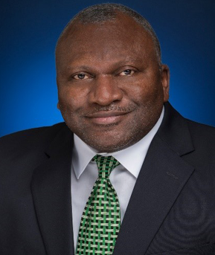
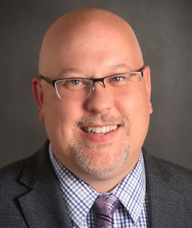
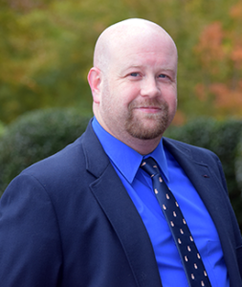
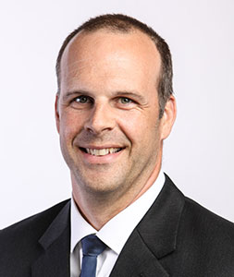
Meet Our Board Leadership
MICHAEL HICKS
President
JONATHAN REICH
1st Vice President
JAMIE POWNALL
2ND Vice President
JONATHAN TAYLOR
3RD Vice President

Slide 8
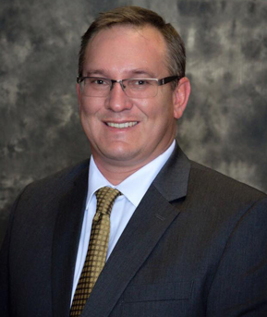
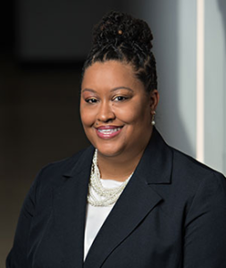
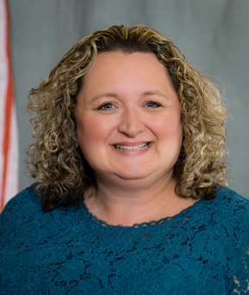
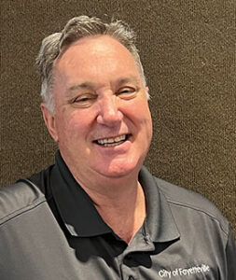
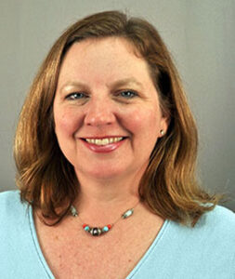
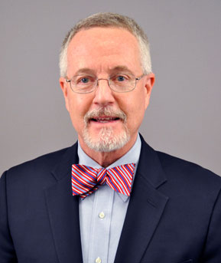
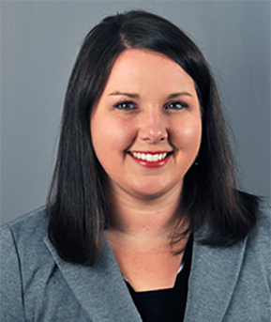
Meet Our Extended Board Team
BEN BRENGMAN
Executive Director
JAIME MONTALVO
Secretary
KAREN KNIGHT
Director of Corporate Sponsorship
KELVIN JOINER
Treasurer
MARCI CAMPBELL
UGA Education Partner
MIKE HOURIHAN
UGA Education Partner
TIFFANY SMITH
UGA Partner

Slide 9
Areas Of Growth
Outreach Committee
Education Committee
Sponsorship Committee
Treasurer Committee
By-Laws Committee
Jonathan Taylor
Chair
Jamie Pownall
Chair
Karen Knight
Chair
Kelvin Joiner
Chair
Jonathan Reich
Chair

Slide 10
Georgia GMIS Goals and Objectives
Goal 1: Expand Georgia GMIS Education and Certification Program
Objectives:
Create list of certifications and identify SMEs to deliver curriculum; preference is to fast-track certification between conferences. (2 conf. per year)
Secure Geek Trak coalition w/ Augusta Tech or other training institutions to offer various locations to attend training. (Designed for your technical person)
Implement GMIS membership education referral program.
Provide access to professional services through GA GMIS listserv and other collaboration portals. ( Collaboration portal high usage)

Slide 11
Georgia GMIS Goals and Objectives
Goal 2: Growth and Customer Service
Objectives:
Establish mentorship program for new agencies to ensure long term engagement and increase membership.
Foster relationships with GMA (Georgia Municipal Association), GTA (Georgia Technology Authority), TAG (Technology Association of Georgia) and other State agencies for stronger technology collaboration.
Provide monthly virtual training on relevant topics to enhance constituents level of understanding on specifics trending issues.
GMIS Leadership will attend other state conferences to provide awareness to Georgia GMIS.

Slide 12
GMIS Membership Benefits
Participate in a Membership Referral Program to reduce the cost of your agency membership.
Network with your peers from hundreds of agencies throughout the United States and internationally.
Participate in The Atlas and Info-Tech through the GMIS Partnerships with these organizations
Participate closer to home in activities hosted by GMIS chapters. Many chapters offer free workshops and annual in-state conferences.

Slide 13
CGCIO
The Certified Government Chief Information Officer™ (CGCIO™)
emerging technologies
security
ethics
contract management
interpersonal communication
project and resource management
sustainability
other related topics
Notes:
Introduction to the CGCIO program at CVIG

Slide 14
IT Risk Management (Cybersecurity)
Manage Risks, Not Eliminate them
IT Risk Management – 4 A’s
Availability
Access
Accuracy
Agility
Notes:
The 4 A’s of IT Risk Management Commissioners should understand.
Availability – Which Business Processes have top priority, second, third, etc. – This is leaderships role to define.
Access – Focuses on the value of the information and the consequences for misuse
Accuracy – impact of incomplete and inaccurate information on strategies and decisions.
Agility – On time, and under budget? What impact does the IT project have on larger strategies?

Slide 15
Cybersecurity
People are likely the weakest link !
Process – Policies and Procedures
Systems and Data
Would you know if you were hacked?
Notes:
Go over the three big Red Flag Data Types – then ask the question if they know how many files and which files contain this information. Is this information being protected?

Slide 16
Cybersecurity
PII – Personally Identifiable Information
PHI – Personal Health Information
HIPAA (Heath Insurance Portability and Accountability Act)
PIFI – Personal Identifiable Financial Info.
Question – How many files in your County currently contain this type of information?
Is this information protected?
Notes:
Go over the three big Red Flag Data Types – then ask the question if they know how many files and which files contain this information. Is this information being protected?

Slide 17
Cyber Security Best practices
Have a password management software that sends updates to change passwords every 90 days
Mandatory 2FA
Install Endpoint protection software immediately
Provide Security Awareness Training every quarter
Monitor website usage
Hold specific training with H.R. and Finance

Slide 18
Cyber Best Practice Continued
Conduct quarterly “Lunch/learn relative to Cyber Security and Phishing Campaigns
Become part of Human Resources Orientation to advise new users about Cyber protocol
Couple security training with H.R. mandated training to garner a lower insurance rate in the marketplace
Ensure City and County Manager has by-In for mandatory security training

Slide 19
Summary
The current culture of Cyber Attacks has caused a paradigm shift in the way we conduct business and communicate with each other. we believe that collaboration is the key to a robust fortification. Sharing ideas, resources, and open communication adds to operation efficiency. As we work to expand our agencies, garner Subject Matter Experts, make edits and amendments to our organization will foster a welcoming/rewarding environment.

Slide 20
Disaster Recovery
“If you fail to plan, you are planning to fail!”

Slide 21
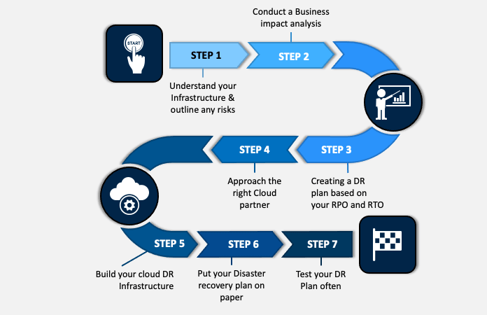
Pathway to DR

Slide 22
Business Continuity

Slide 23
Business Continuity

Slide 24
Causes of Disruption
Natural disasters
War or terrorism
Civil disruption
Accident or human error
Cybercrime

Slide 25
Extent of Disruption
Single data center or building
Whole organization
City or County wide
Regional or national
Global

Slide 26
Seven Key Elements in Your Business Continuity Playbook
Dependable Business Continuity Team
Contact Information
Effective Communication Plan
Risk Assessment Plan
Business Impact Analysis (BIA)
Detail Response Plan
Test your Business Continuity Plan

Slide 27
Six Key Elements in Your Disaster Recovery Playbook
Full inventory of your assets
Minimum acceptable impacts
Document DR processes
DR responsibilities
Communication plan
Training and rehearsal

Slide 28
Key Recovery Objectives
RTO is the goal your organization sets for the maximum length of time it should take to restore normal operations following an outage or data loss.
RPO is your goal for the maximum amount of data the organization can tolerate losing. This parameter is measured in time: from the moment a failure occurs to your last valid data backup. For example, if you experience a failure now and your last full data backup was 24 hours ago, the RPO is 24 hours.

Slide 29
Conclusion
It is important to define what a disaster is and to have a disaster recovery plan that reflects this definition and the impact that it may have on business outcomes. Create Recovery Time Objective (RTO) and Recovery Point Objective (RPO) based on impact analysis and risk assessments and then choose the appropriate architecture to mitigate against disasters. Ensure you have a plan and validate the plan with testing.
The Average is 20 days to recover from a disaster, depending on how well your plan, could shorten or lengthen your RPO !
You don’t want to tell your citizens their data is gone or your services will be down for extended amount of time. Treat disaster recovery as you would in the public safety sector for life safety. Cost will continue to grow in the future to meet the cyber insurance requirements and to allow for a faster and reliable disaster recovery.

Slide 30
THANK YOU Questions ???

