Slide 1
THE CHALLENGES OF Original Intent Keith L. Dougherty, uga

Slide 2
Original Intent
Have you ever been asked what a particular ordinance, statute, or clause in a constitution means?
For example, Art 1, sec. 1, para. 18 of the Georgia Constitution reads:
No person shall be put in jeopardy of life or liberty more than once for the same offense except when a new trial has been granted after conviction or in case of mistrial.

Slide 3
Original Intent
Have you ever been asked what a particular ordinance, statute, or clause in a constitution means?
For example, Art 1, sec. 1, para. 18 of the Georgia Constitution reads:
No person shall be put in jeopardy of life or liberty more than once for the same offense except when a new trial has been granted after conviction or in case of mistrial.
What does that mean?

Slide 4
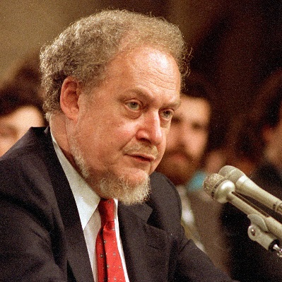
Original Intent
Some scholars, such as Robert Bork, claim that the best way to understand what a clause means is to consider what the authors of the clause intended it to mean.
This sounds like a good idea, but can it be done?
We’ll answer by looking at the intent of the framers of the U.S. Constitution with respect to ex post facto laws, the removal of executive appointees, and the existence of explanatory amendments.
Robert Bork

Slide 5
Original Intent 1: Ex Post Facto Laws
The U.S. Constitution prohibits both the states and the federal government from passing ex post facto laws. That is, it prohibits laws that have retroactive effects.
Ex: you drive the speed limit of 50 mph today, the government passes a law tomorrow that reduces the speed limit to 40 mph, then tries to penalize you for violating the law.
Such a law would be an ex post facto law.

Slide 6
Original Intent 1: Ex Post Facto Laws
Article 1, sec. 9: “No Bill of Attainder or ex post facto Law shall be passed.”
Article 1, sec. 10: “No state shall enter into any Treaty, Alliance, or Confederation; grant Letters of Marque and Reprisal; coin Money; emit Bills of Credit; make any Thing but gold and silver Coin a Tender in Payment of Debts; pass any Bill of Attainder, ex post facto Law, or Law impairing the Obligation of Contracts, or grant any Title of Nobility.
Did the framers intend to prohibit both criminal and civil ex post facto laws?
Criminal law – law concerned with crimes (e.g. laws against theft, murder, espionage).
Civil law -- law concerned with private relations between members of society (e.g., suits over breach of contract, property ownership, divorce).

Slide 7
Poll
Did the framers intend to prohibit both criminal and civil ex post facto laws?
Yes.
No.
Not sure.
https://forms.gle/Xc3h7Cuh9d195EoE6
Criminal law – law concerned with crimes (e.g. laws against theft, murder, espionage).
Civil law -- law concerned with private relations between members of society (e.g., suits over breach of contract, property ownership, divorce).

Slide 8
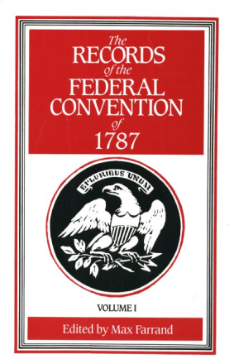
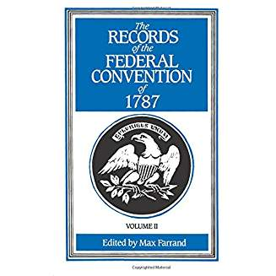
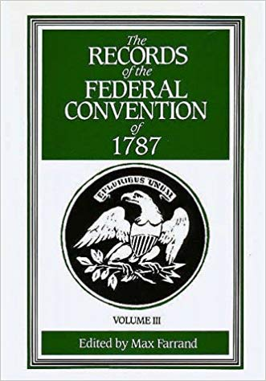
Original Intent 1: Ex Post Facto Laws
Because the U.S. Constitutional Convention chose not to record the positions of individuals delegates, the most comprehensive records come from the notes of James Madison.
These were first published in 1840 (fifty-three years after the Constitutional Convention).

Slide 9
Original Intent 1: Ex Post Facto Laws
Perhaps we can determine the framers’ intent on this question by looking at their statements made during the creation of this clause:
James Wilson (PA) believed that the prohibition against ex post facto laws extended to civil law (Aug 22, Farrand, 2: 376).
John Dickinson (DE) said that according to Blackstone’s commentaries “‘ex post facto’ related to criminal cases only; that they would not consequently retrain the States from retrospective laws in civil cases, and that some further provision for this would be requisite” (Aug 29, Farrand, 2: 448-9).
George Mason (VA) moved to strike out the prohibition against ex post facto laws because he wanted the states to be free to enact ex post facto laws in civil cases and he believed “it is not sufficiently clear that the prohibition meant by this phrase was limited to cases of criminal nature” (Sept 14, Farrand, 2: 617).

Slide 10
Original Intent 1: Ex Post Facto Laws
Elbridge Gerry (MA) attempted to clarify the matter by proposing the explicit prohibition of ex post facto laws in civil as well as criminal cases, which all states rejected (Sept 14, Farrand, 2: 617).
William Paterson allegedly changed his mind on the issue (Levy 1988, 294).
The framers made no other statements at the Convention on the question of whether ex post facto laws applied to civil cases.

Slide 11
Poll
Did the framers intend to prohibit both criminal and civil ex post facto laws?
Yes.
No.
Not sure.
https://forms.gle/Xc3h7Cuh9d195EoE6
Criminal law – law concerned with crimes (e.g. laws against theft, murder, espionage).
Civil law -- law concerned with private relations between members of society (e.g., suits over breach of contract, property ownership, divorce).

Slide 12
Original Intent 1: Ex Post Facto Laws
Elbridge Gerry (MA) attempted to clarify the matter by proposing the explicit prohibition of ex post facto laws in civil as well as criminal cases, which all states rejected (Sept 14, Farrand, 2: 617).
William Paterson allegedly changed his mind on the issue (Levy 1988, 294).
The framers made no other statements at the Convention on the question of whether ex post facto laws applied to civil cases.
Questions
Did the framers intend to prohibit ex post facto laws in civil cases?
How do we go about determining the framers intent when 50 of the 55 delegates remain silent on the issue and the remaining 5 disagreed?

Slide 13
Original Intent 2: The removal of executive appointees
Article II, Section 2.
[The President] shall have Power, by and with the Advice and Consent of the Senate, to make Treaties, provided two thirds of the Senators present concur; and he shall nominate, and by and with the Advice and Consent of the Senate, shall appoint Ambassadors, other public Ministers and Consuls, Judges of the supreme Court, and all other Officers of the United States, whose Appointments are not herein otherwise provided for, and which shall be established by Law: but the Congress may by Law vest the Appointment of such inferior Officers, as they think proper, in the President alone, in the Courts of Law, or in the Heads of Departments.

Slide 14
Original Intent 2: The removal of executive appointees
Article II, Section 2.
[The President] shall have Power, by and with the Advice and Consent of the Senate, to make Treaties, provided two thirds of the Senators present concur; and he shall nominate, and by and with the Advice and Consent of the Senate, shall appoint Ambassadors, other public Ministers and Consuls, Judges of the supreme Court, and all other Officers of the United States, whose Appointments are not herein otherwise provided for, and which shall be established by Law: but the Congress may by Law vest the Appointment of such inferior Officers, as they think proper, in the President alone, in the Courts of Law, or in the Heads of Departments.
Article II, Section 4.
The President, Vice President and all civil Officers of the United States, shall be removed from Office on Impeachment for, and Conviction of, Treason, Bribery, or other high Crimes and Misdemeanors.
Does the President have the power to remove inferior officers?

Slide 15
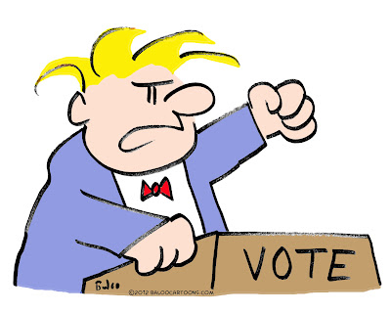
Original Intent 2: The removal of executive appointees
First U.S. Congress (1789-1790)
Madison (who is now a member of the House) sponsors a bill that appoints a secretary of foreign affairs, war, and treasury who "shall be appointed by the president, by and with the advice of the Senate, and to be removable by the President.“
William Smith (SC, House) objects because he thinks "removable by the President" is unconstitutional. Smith says the President can't remove them. They must be impeached (from Article II, Sections 2 & 4).
The idea doesn’t get enough support, so Smith then argues that the President can only remove executive appointees with the advice and consent of the Senate.
James Madison
William Smith

Slide 16
Original Intent 2: The removal of executive appointees
First Congress (1789-1790)
Smith argues that the President can only remove executive appointees with the advice and consent of the Senate.
To Substantiate his point, Smith makes reference to the Federalist papers, in particular Federalist 77 which reads:
“IT HAS been mentioned as one of the advantages to be expected from the co-operation of the Senate, in the business of appointments, that it would contribute to the stability of the administration. The consent of that body would be necessary to displace as well as to appoint.”
Is there any problem referencing the Federalist papers as a source about the intent of the framers?
William Smith

Slide 17
Original Intent 2: The removal of executive appointees
First Congress (1789-1790)
This doesn’t convince enough people, so Smith goes down the hall and asks "Publius" (a.k.a. Madison) what was meant by the passage in Federalist 77.
Madison responds by saying that he changed his mind and that the President alone should have the power to remove members of the executive!
At which point Smith concedes, because he wants to adhere to original intent of the framers.
William Smith
James Madison
What do you think about that? Is it really up to Madison to determine the intent of the framers?

Slide 18
Original Intent 2: The removal of executive appointees
First Congress (1789-1790)
This doesn’t convince enough people, so Smith goes down the hall and asks "Publius" (a.k.a. Madison) what was meant by the passage in Federalist 77.
Madison responds by saying that he changed his mind and that the President alone should have the power to remove members of the executive!
At which point Smith concedes, because he wants to adhere to original intent of the framers.
William Smith
James Madison
Why is Smith listening to the interpretation of one man when he originally thought his idea contradicted the language of the Constitution?

Slide 19
Original Intent 2: The removal of executive appointees
First Congress (1789-1790)
This doesn’t convince enough people, so Smith goes down the hall and asks "Publius" (a.k.a. Madison) what was meant by the passage in Federalist 77.
Madison responds by saying that he changed his mind and that the President alone should have the power to remove members of the executive!
At which point Smith concedes, because he wants to adhere to original intent of the framers.
William Smith
James Madison
Instead of original intent, why don’t we rely on the plain meaning of the text, as understood by people from the period in which it was written?

Slide 20
Original Intent 3: Explanatory Amendments
Necessary and Proper Clause of US Constitution:
The Congress shall have Power To lay and collect Taxes, Duties, Imposts and Excises,..
To borrow Money …
To regulate Commerce …
To establish a uniform Rule of Naturalization …
… To make all Laws which shall be necessary and proper for carrying into Execution the foregoing Powers, and all other Powers vested by this Constitution in the Government of the United States, or in any Department or Officer thereof (Art. 1, Sec. 8).
John Lansing
John Lansing, said it’s not clear what this clause means, so he proposed an explanatory amendment at his state’s ratifying convention to clarify it.

Slide 21
Original Intent 3: Explanatory Amendments
New York Ratifying Convention, July 2, 1788
Lansing proposes the following explanatory amendment:
Respecting the power to make all laws necessary for the carrying the Constitution into execution,--
"Provided, That no power shall be exercised by Congress, but such as is expressly given by this Constitution; and all others, not expressly given, shall be reserved to the respective states, to be by them exercised."
John Lansing
John Jay, a Federalist, encouraged explanatory amendments like this at the New York Ratifying Convention, dominated by Anti-Federalists.
There existence suggests that at least some folks did not read the Constitution with the “same plain meaning.”
What do you think about that?

Slide 22
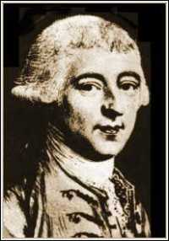
Original Intent 4: Extent of Legislative Power
Philadelphia Convention, July 16, 1787
The sixth resolution of the Report of the Committee of the Whole on the power of the national legislature was presented on the floor:
"And moreover to legislate in all cases to which the separate States are incompetent; or in which the harmony of the U. S. may be interrupted by the exercise of individual legislation."
Pierce Butler (SC) calls for some explanation of the extent of this power; particularly of the word incompetent. The vagueness of the terms rendered it impossible for any precise judgment to be formed.
Nathaniel Gorham (MA). The vagueness of the terms constitutes the propriety of them. We are now establishing general principles, to be extended hereafter into details which will be precise & explicit.
John Rutledge (SC) proposes that the clause be committed to a committee so that the vagueness could be made more explicit.
The states are equally divided on the commitment 5-5, so the question was lost.

Slide 23
Original Intent 4: Extent of Legislative Power
Philadelphia Convention, July 16, 1787
The sixth resolution of the Report of the Committee of the Whole on the power of the national legislature was presented on the floor:
"And moreover to legislate in all cases to which the separate States are incompetent; or in which the harmony of the U. S. may be interrupted by the exercise of individual legislation."
It didn’t end there because the committee of style ultimately re-wrote the whole thing (which is another challenge for those that want to use the details of the text to understand what 55 delegates intended).
But what if the committee of style did not re-write the clause? …
What would have been the extent of the power of the national legislature?

Slide 24
Original Intent: Summary
Challenges for Original Intent:
Often the authors of a law are vague (sometimes intentionally).
Different authors can have different interpretations of the same law.
Many authors of a law are silent, making it difficult for us to know what the majority of the authors thought.
Some of the framers, including James Madison, explicitly said that the original intent of the authors has no bearing on its meaning.
Challenges for Textualism:
The written law can be read differently by people from the originating period, which is why Lansing thought explanatory amendments were needed.
Conclude:
Perhaps there is not AN original understanding of the Constitution. Perhaps there were original understandingS of the Constitution.

Slide 25
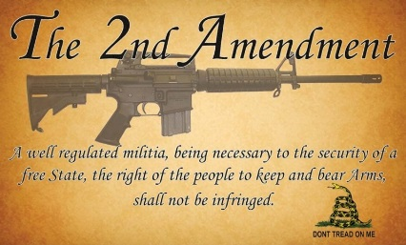
Original Intent
2nd Amendment. A well-regulated Militia, being necessary to the security of a free State, the right of the people to keep and bear Arms, shall not be infringed.
What did the framers mean by this clause?
Citizens must be able to keep the weapons needed to meet their legal obligation to participate in the militia.
Citizens should have the means to protect themselves (and their states) from the federal government.
Citizens have a common-law right to own and use weapons in self-defense.
Not sure.
https://forms.gle/Xc3h7Cuh9d195EoE6

Slide 26
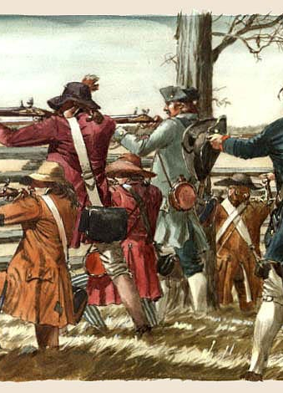
Original Intent
In 1789, when the Bill of Rights were proposed, the United States did not have a standing army.
Instead, armies were created by calling up the state militias, which were early versions of the national guard.

Slide 27
Original Intent
When the second amendment was reported out of the House committee to which it was assigned, it read:
A well-regulated militia, composed of the body of the people, being the best security of a free state; the right of the people to keep and bear arms shall not be infringed, but no person, religiously scrupulous, shall be compelled to bear arms.

Slide 28
Original Intent
When the second amendment was reported out of the House committee to which it was assigned, it read:
A well-regulated militia, composed of the body of the people, being the best security of a free state; the right of the people to keep and bear arms shall not be infringed, but no person, religiously scrupulous, shall be compelled to bear arms.
Elbridge Gerry (MA) proposed to rephrase “a well-regulated militia, trained to arms, being the best …” He thought this would make it clearer that the Government had a duty to provide the security of a free state.
Aedanus Burke (SC) proposed to add to the language: “A standing army of regular troops in time of peace, is dangerous to public liberty, and such shall not be raised or kept up in time of peace but from necessity, and for the security of the people, nor then without the consent of two-thirds of the members present of both houses, and in all cases the military shall be subordinate to the civil authority.”

Slide 29
Original Intent
When the second amendment was reported out of the House committee to which it was assigned, it read:
A well-regulated militia, composed of the body of the people, being the best security of a free state; the right of the people to keep and bear arms shall not be infringed, but no person, religiously scrupulous, shall be compelled to bear arms.
So, it appears at least two framers thought the second amendment was about maintaining a militia.
There were other opinions stated, worth looking up.
None of them were about an individual’s self-defense.
Most members of Congress were silent.

Slide 30
Original Intent
When the second amendment was reported out of the House committee to which it was assigned, it read:
A well-regulated militia, composed of the body of the people, being the best security of a free state; the right of the people to keep and bear arms shall not be infringed, but no person, religiously scrupulous, shall be compelled to bear arms.
The Senate removed the religiously scrupulous clause and amended the language a bit, but it conducted its debates in secrecy, so we cannot use their debates to figure out the Senate’s intent.

Slide 31
Early Interpretations
2nd Amendment. A well regulated Militia, being necessary to the security of a free State, the right of the people to keep and bear Arms, shall not be infringed.
What did the framers mean by this clause?
Citizens must be able to keep the weapons needed to meet their legal obligation to participate in the militia (largely first interpretation).
Citizens should have the means to protect themselves (and their states) from the federal government (Jeffersonian interpretation, 1800).
Citizens have a right to own and use weapons in self-defense (Heller v District of Columbia, 2008).
The Supreme Court didn’t interpret the clause until 1876 (United States v. Cruikshank).

Slide 32
Conclusion
Sometimes there is not enough historical evidence to find the original intent or the original understanding of the U.S. Constitution.
Often different people have different understandings of a law, even at the time it was written.
The Second Amendment may appear crystal clear to us. But even something like that has had different interpretations.
Perhaps the same is true for county and city ordinances, statutes, and local constitutions.

