Slide 1
POWER OF PARTNERSHIPS
THE
Increasing the Effectiveness of Collaboration Between Cities and Nonprofits
Presented by:

Slide 2
NONPROFIT PARTNERSHIP PROGRAM
CHAMBLEE

Slide 3
NONPROFIT PARTNERSHIP PROGRAM
ABOUT THE
Designed to strengthen, promote and connect local nonprofits by enhancing organization visibility while assisting in their development and capacity-building efforts.

Slide 4
NONPROFIT PARTNERSHIP PROGRAM
MEMBERSHIP REQUIREMENTS
To qualify to participate in the NPP nonprofits are required to:
Be a registered 501c3 with the IRS
Provide an IRS determination letter
Maintain an active board of directors
Provide a letter from a CPA verifying the annual proportion of administrative versus program costs or two years of financial statements
Provide a list of programs/initiatives that serve the Chamblee community
Submit a completed program application

Slide 5
NONPROFIT PARTNERSHIP PROGRAM
MISSION
To strengthen, support, and promote the vitality of our nonprofits that support the Chamblee community by being a resource for:
RELATIONSHIP
BUILDING
PROFESSIONAL
DEVELOPMENT
TOOLS & FUNDING OPPORTUNITIES

Slide 6
NONPROFIT PARTNERSHIP PROGRAM
PROGRAMING
The NPP facilitates collaboration, builds community, promotes partnerships, and provides support to expand nonprofits’ capacity to serve the community through:
ROUNDTABLE
DISCUSSION SERIES
ORGANIZATIONAL
DEVELOPMENT
FUNDING
OPPORTUNITIES

Slide 7
LET’S TALK ABOUT…
ROUNDTABLE DISCUSSION SERIES
An informal meeting that focuses on two-way conversations
Discussions are facilitated by city staff
All nonprofits are invited to attend, regardless of membership status
Topics range from volunteerism, strategic planning, strategic partnerships, metrics of success, and more
During the application process, NPP members identify topics they would like to explore
An annual survey is distributed to identify additional topics

Slide 8
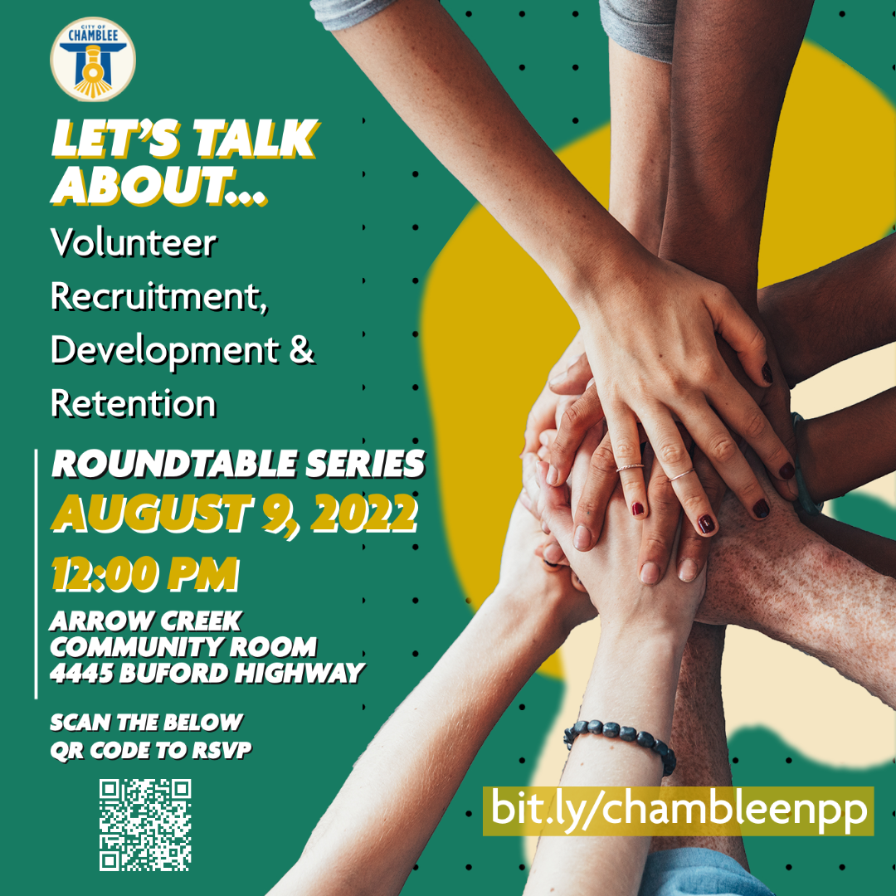
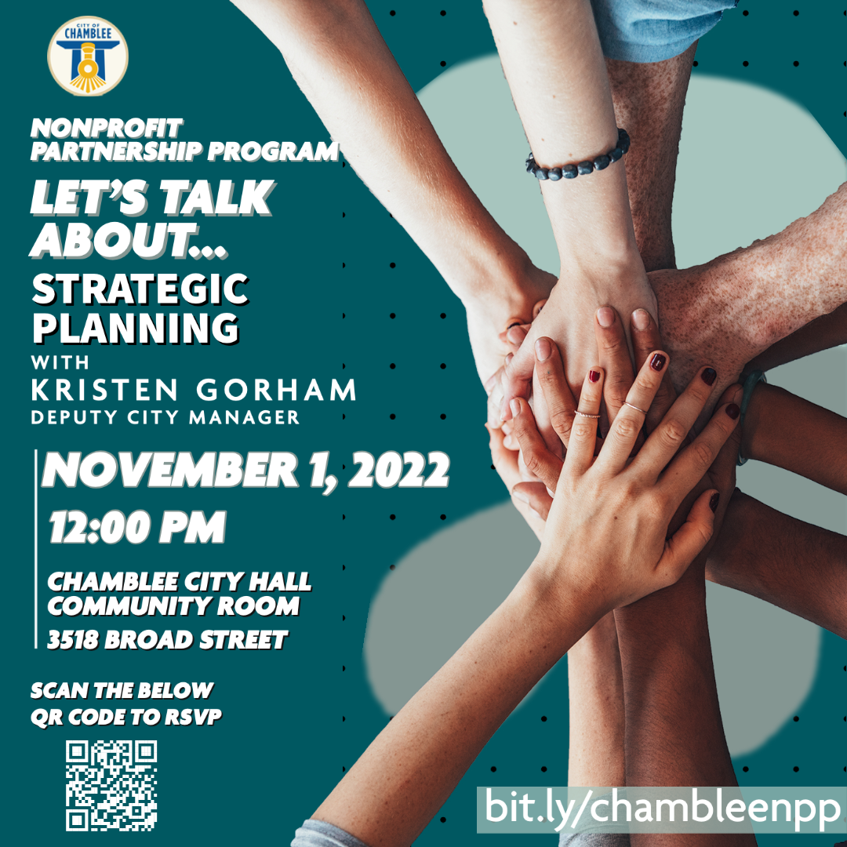
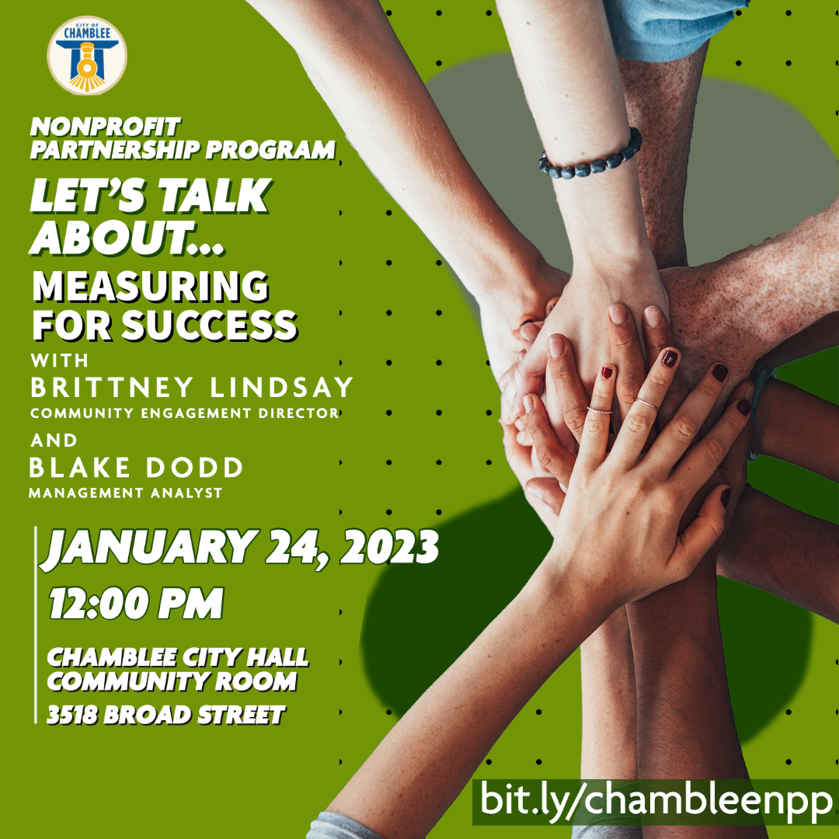
LET’S TALK
ABOUT…
ROUNDTABLE
DISCUSSION SERIES

Slide 9
LUNCH & LEARN
ORGANIZATIONAL DEVELOPMENT SERIES
Nonprofits are invited to come together to learn from a subject area expert to drive personal, team, and organizational development
Exclusive to NPP members
Guest speakers have industry backgrounds in fields such as grant writing, board development, marketing, and more
Topics are selected by the nonprofits during the NPP application process and an annual survey

Slide 10
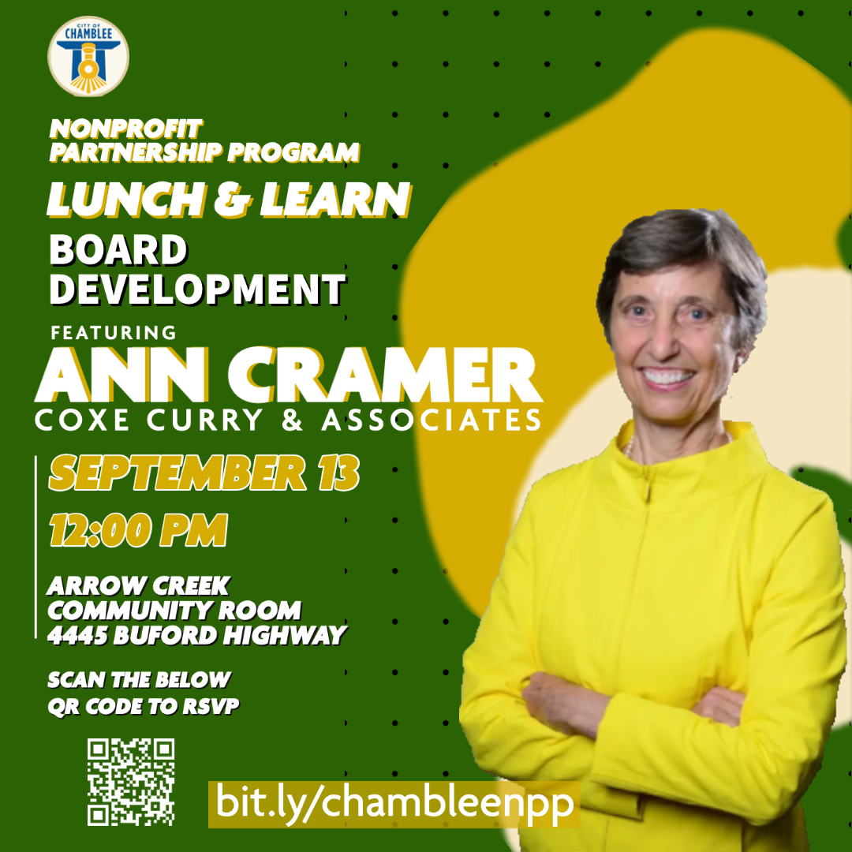
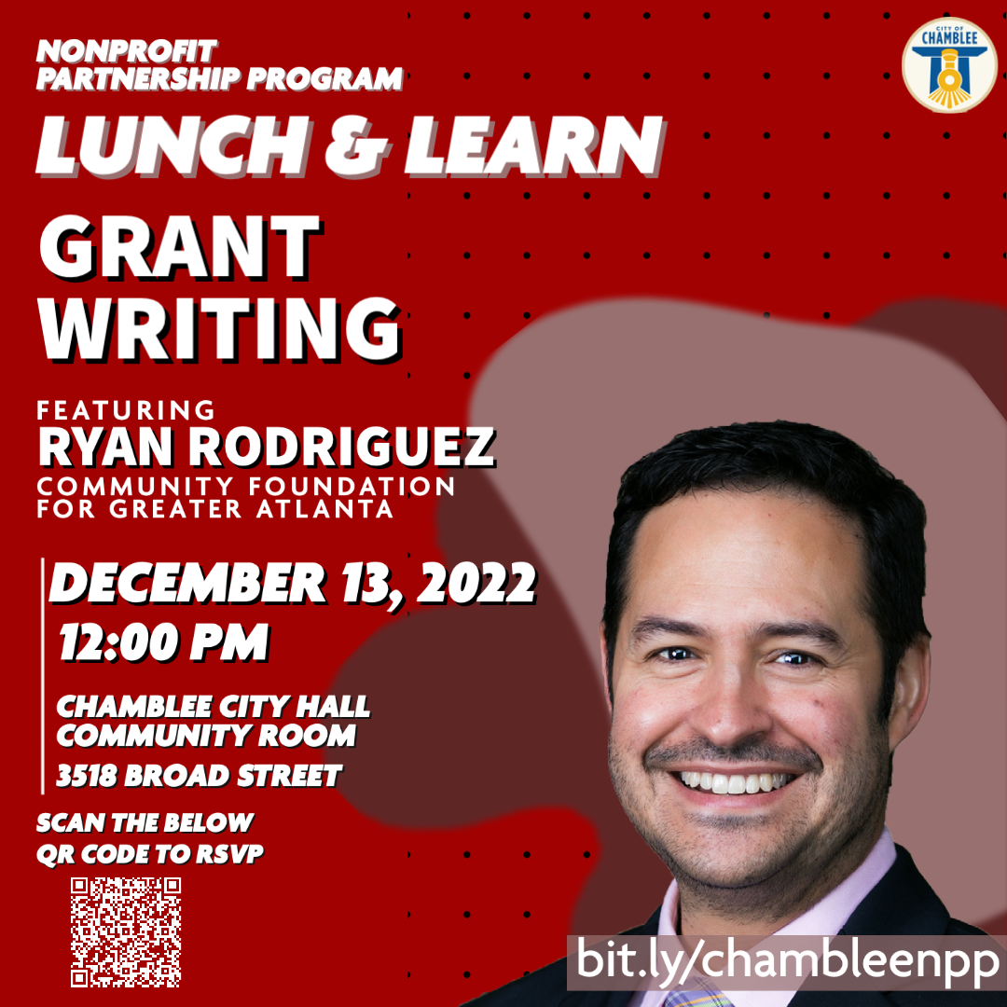
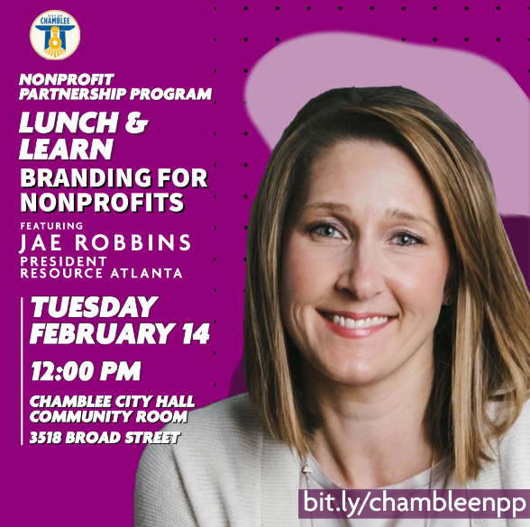
LUNCH & LEARN
ORGANIZATIONAL
DEVELOPMENT SERIES

Slide 11
NPP QUARTERLY GRANT
FUNDING PROGRAM
Active NPP members are eligible to apply for funding for events or programs occurring in the city limits of Chamblee
Funds awarded are required to be spent at a Chamblee business
$100,000 was allocated to the NPP in 2022
Roughly $9,500 was reserved for program expenses
City staff selection committee evaluated applications and recommended projects for approval
NPP members are eligible to apply two times a year

Slide 12
NPP QUARTERLY GRANT
FUNDING PROGRAM
To be eligible for funding nonprofits must:
Be an active member of the NPP
Maintain an IRS 501c3 status for a minimum of two years
Event or program must occur in the city limits of Chamblee
Event or program must support the Chamblee community
Funds requested must be spent at a Chamblee business
Awarded organizations must submit a final report

Slide 13
NPP GRANT AWARDEES
2022

Slide 14
NPP SPONSORSHIP SUMMARY
2022
10
$203,202
$90,505
44.53%
TOTAL
PROJECTS AWARDED
TOTAL
PROJECT COST
TOTAL
GRANT FUNDS AWARDED
TOTAL
PROJECT COST TO BUSINESSES

Slide 15
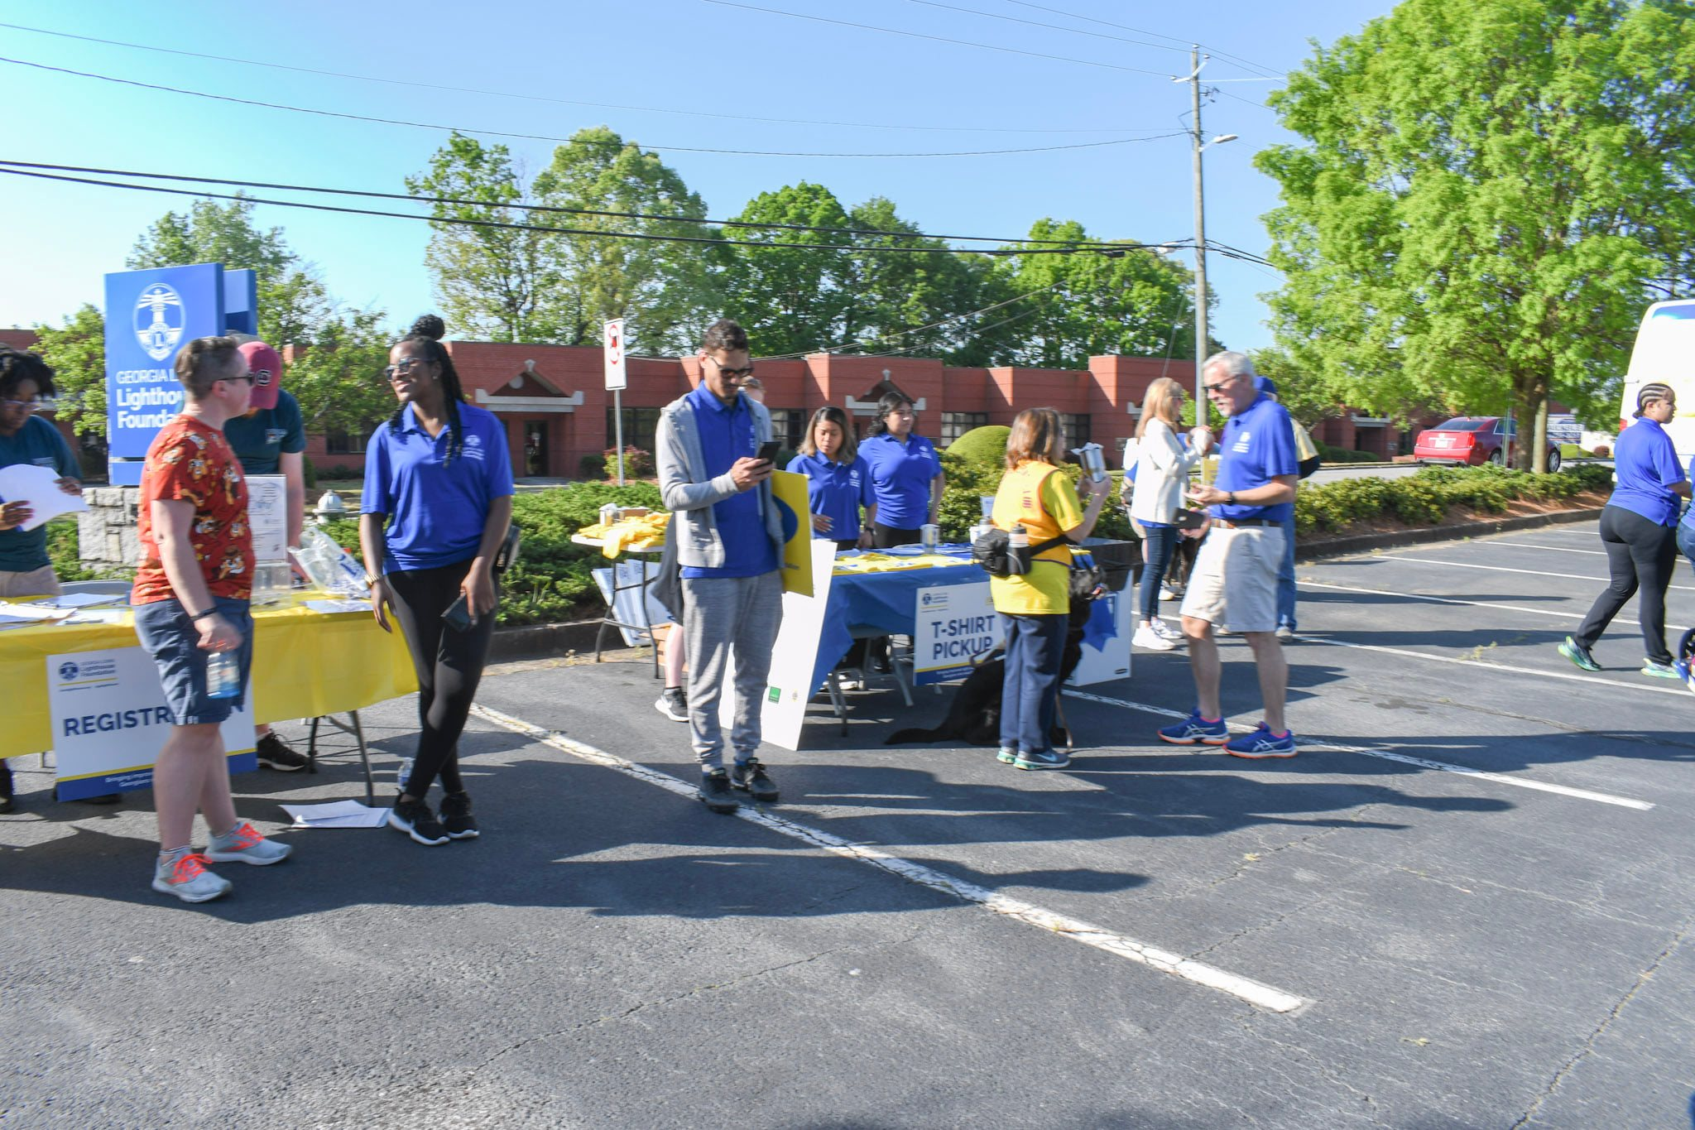
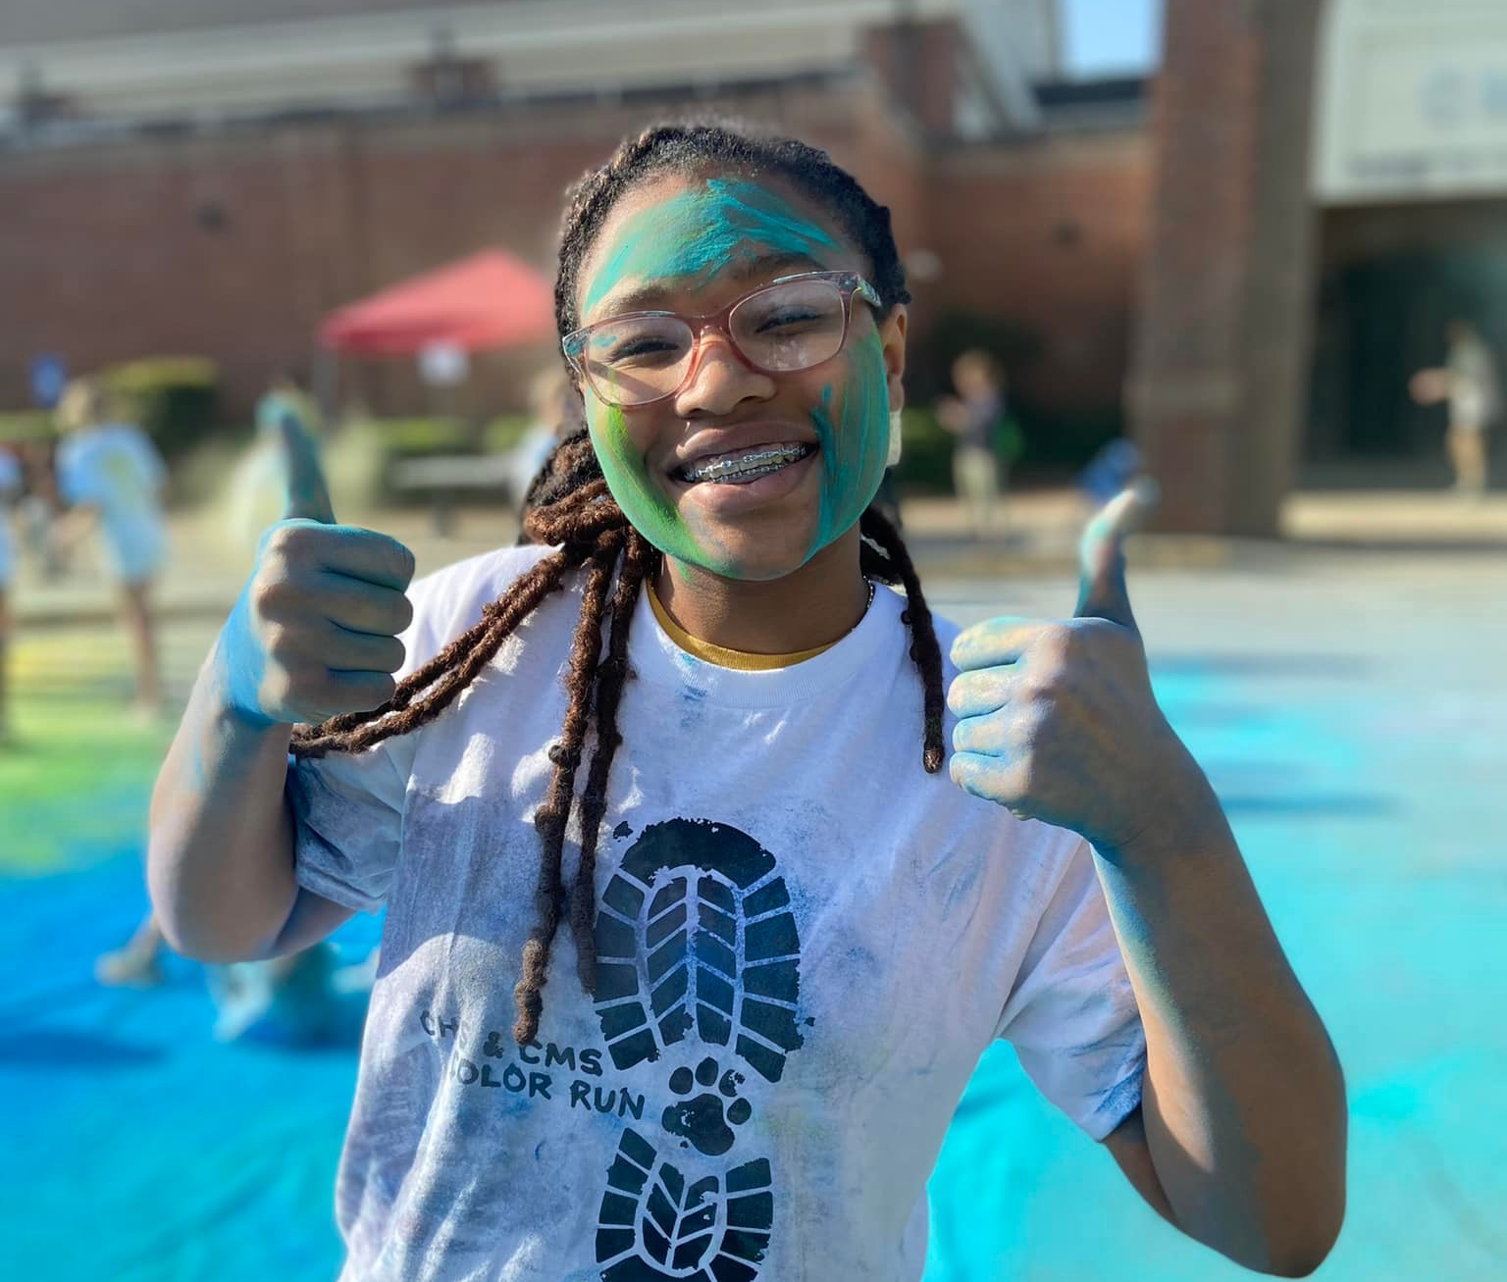
GEORGIA LIONS LIGHTHOUSE STRIDES 4 SIGHT AND SOUND
Project type: Fundraising
Funds raised: $46,365
Total sponsorship: $10,000
CHAMBLEE MS EDUCATION FOUNDATION CHAMBLEE BULLDOG COLOR RUN
Project type: Fundraising
Funds raised: $10,128
Total sponsorship: $8,194

Slide 16
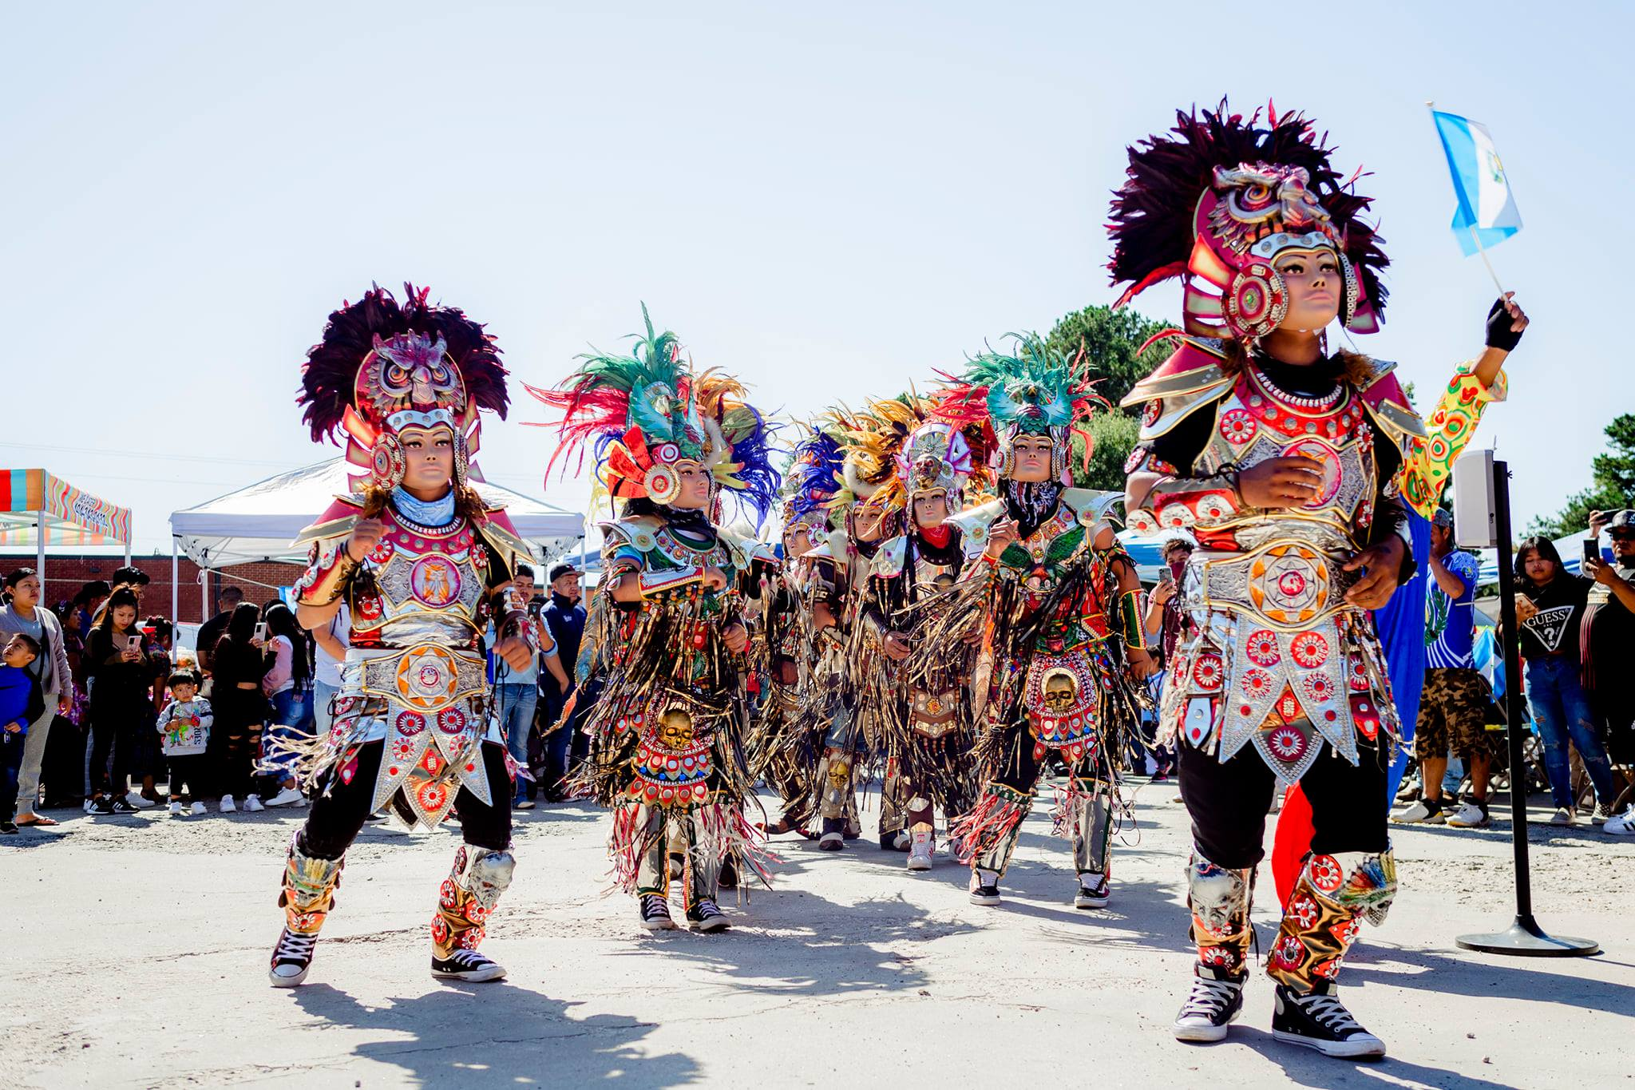
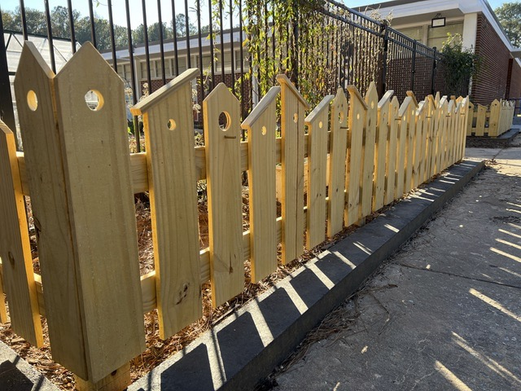
FUNDACIÓN ADELANTE GUATEMALA BARRILETES SOBRE CHAMBLEE
Project type: Community
Funds raised: N/A
Total sponsorship: $10,000
KEEP CHAMBLEE BEAUTIFUL HUNTLEY HILLS ELEMENTARY
SCHOOL GARDEN RENOVATION
Project type: Program
Funds raised: N/A
Total sponsorship: $9,680

Slide 17
NONPROFIT PARTNERSHIP PROGRAM
BENEFITS
The NPP provides support to expand the capacity to serve the community by providing various benefits.

Slide 18
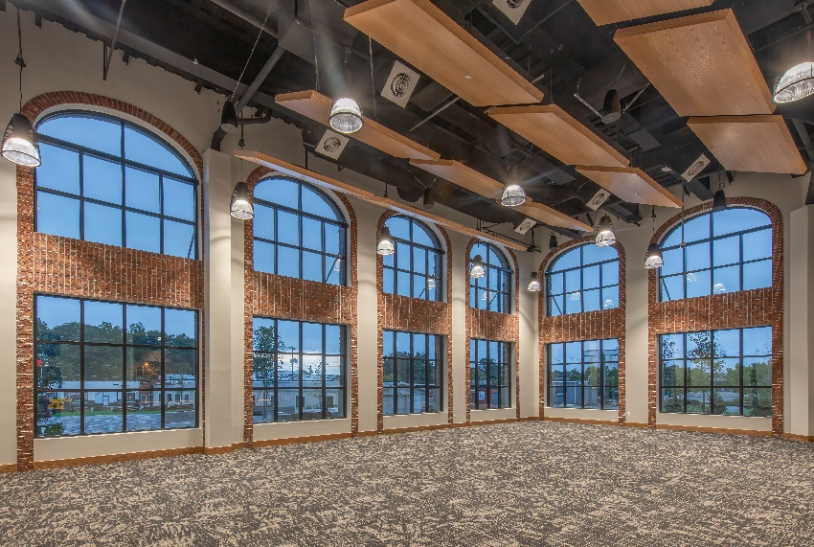
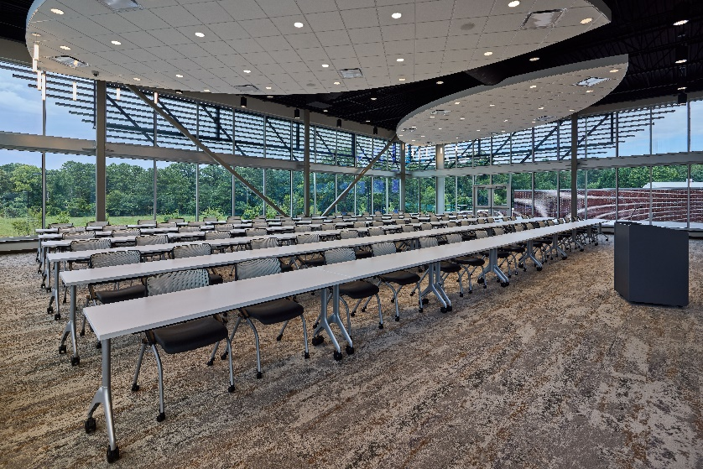
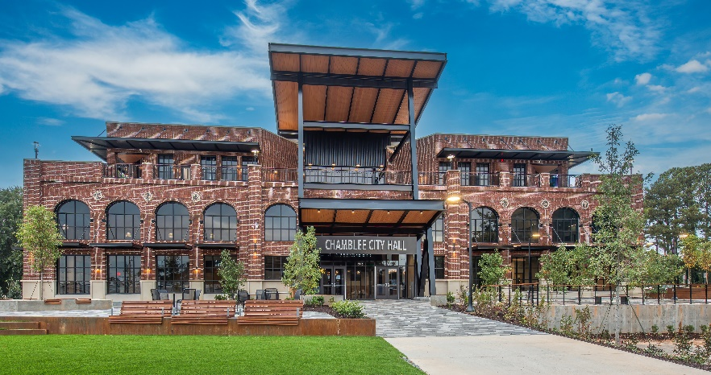
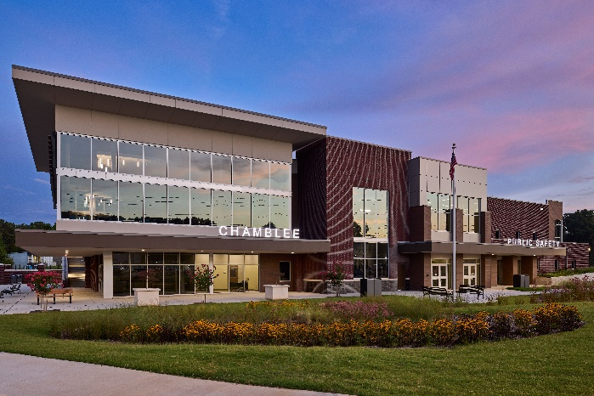
ARROW CREEK & CITY HALL
COMMUNITY ROOM RENTAL
Active members can rent the Arrow Creek Community Room and the City Hall Community Room for meetings, events, and other approved gatherings.
Community Room rental is only available to our NPP members.

Slide 19
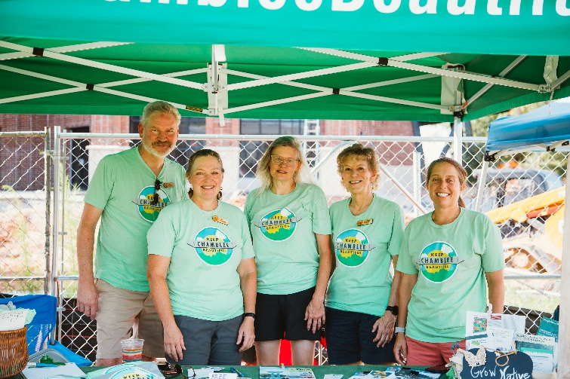
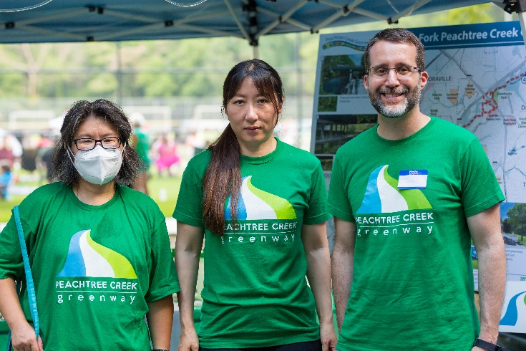
VENDOR BOOTHS
MARKETING OPPORTUNITIES
Active members are eligible to reserve free vendor booths at city events.
Atlanta United Watch Party, Chamblee Summer Concert Series, Taste of Chamblee, and Holiday Hoopla

Slide 20
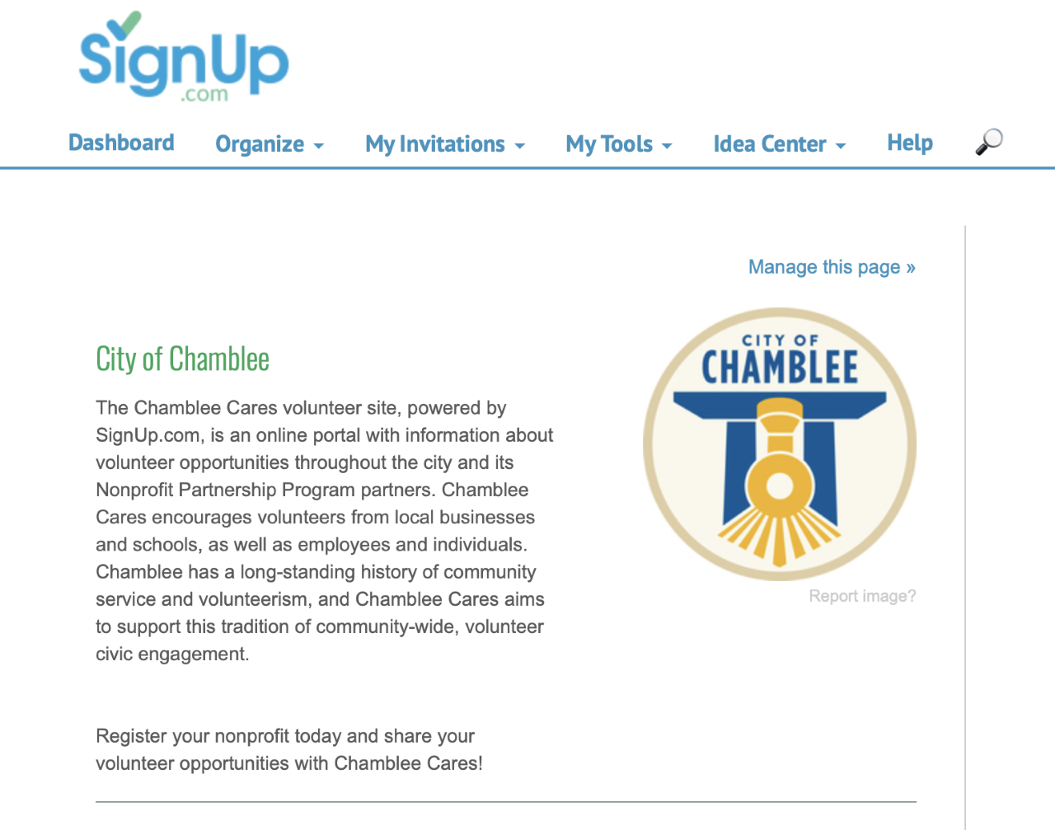
SIGNUP.COM
VOLUNTEER RECRUITMENT
NPP members are granted free access to a Signup.com, a volunteer recruitment portal.
The portal provides a central space for organizations to list volunteer needs and community members a place to connect with volunteer opportunities.
Cost for a premium account = $600

Slide 21
NONPROFIT PARTNERSHIP PROGRAM
PROGRAM SUCCESSES
New collaborations between nonprofits
Increased nonprofit involvement in city studies, events, and initiatives
Enhancements to nonprofits’ organizational development
Enhancements to the NPP’s development
Assist with the decrease of program cost for organizations awarded with grant funds

Slide 22
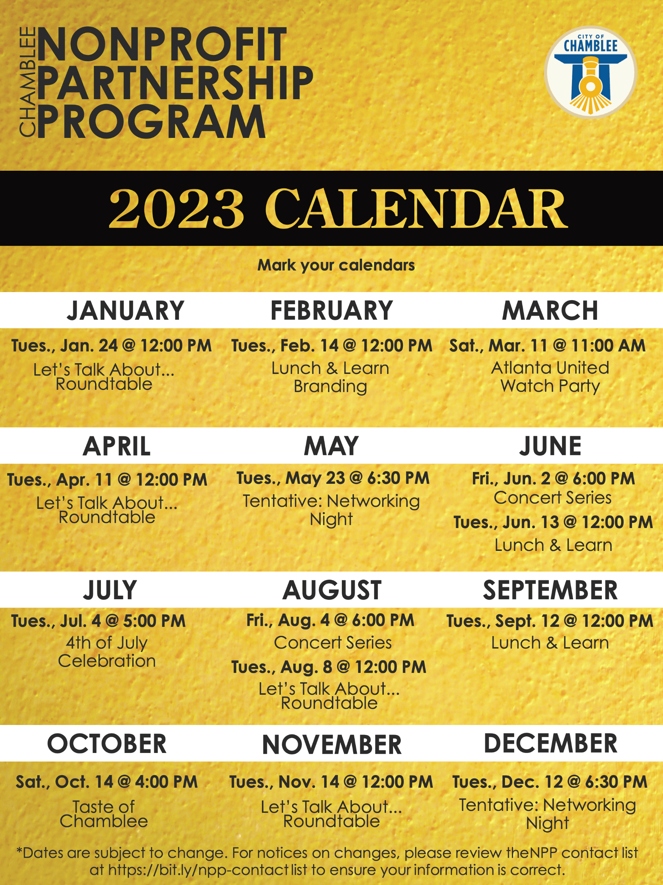
NONPROFIT PARTNERSHIP PROGRAM
PROGRAM REFINEMENTS
Inclusion of two networking nights for NPP members
Review of Signup.com
Grant program was changed from a sponsorship program

Slide 23
NONPROFIT PARTNERSHIP PROGRAM
PROGRAM REFINEMENTS
NPP priorities have been included as a requirement for applicants:
Priorities include Assistance for at-risk or underserved communities; cultural heritage education and awareness; environmental conservation and remediation; and housing assistance.
Creation of a grant collaboration program
Allocate a larger amount of funds to support programs that include collaboration with one or more NPP members, meet one or more of the following NPP priorities, AND result in a major impact for the community.

Slide 24
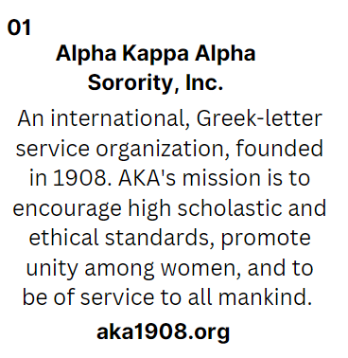
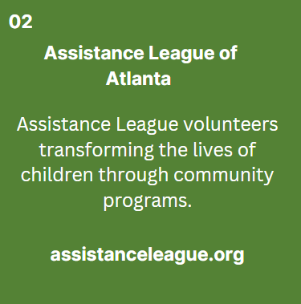
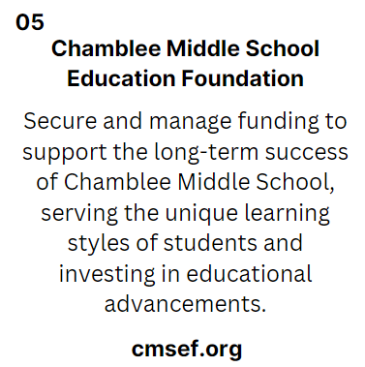
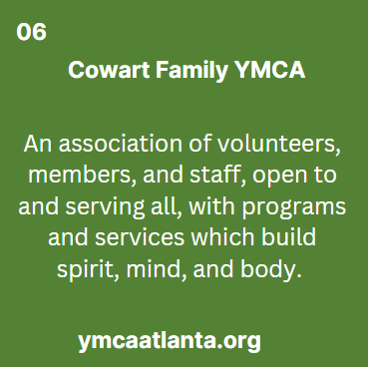
NPP MEMBERS
2023

Slide 25
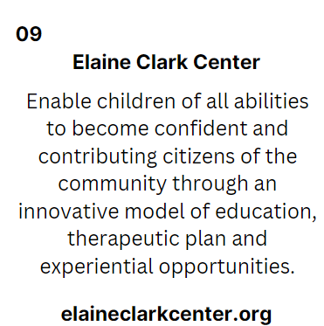
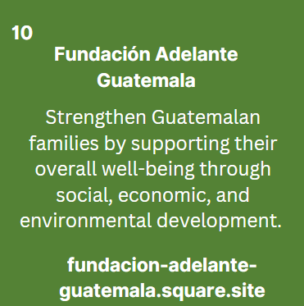
NPP MEMBERS
2023

Slide 26
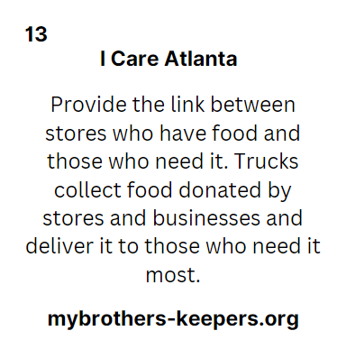
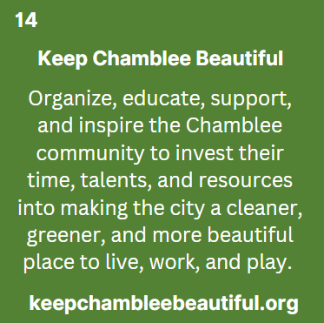
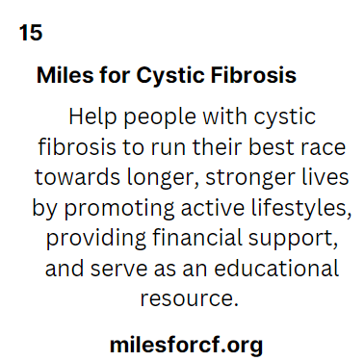
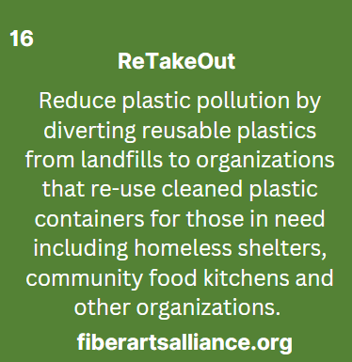
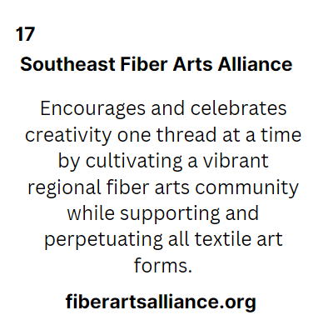
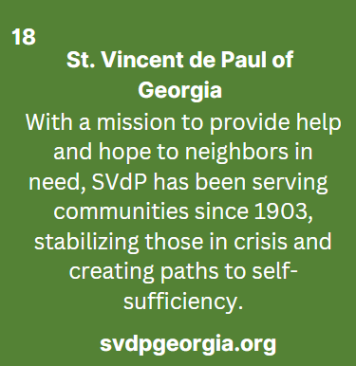
NPP MEMBERS
2023

Slide 27
QUESTIONS?
Jon Walker
City Manager
jwalker@chambleega.gov
Brittney Lindsay
Community Engagement Director
blindsay@chambleega.gov
Blake Dodd
Management Analyst
bdodd@chambleega.gov

