Slide 1
Navigating and Touring Your Financial Statements
Presented by:
John G. Hulsey, CPFO, CGFM
jhulsey@uga.edu

Slide 2
Learning Objectives
At the end of this session, you should be able to:
Discuss the elements of audited external financial statements
Recall how to identify a qualified auditor
Navigate and interpret financial statement information

Slide 3
Elements of
Audited Financial Statements

Slide 4
Who Must Have an Audit?
Each unit of local government shall have an annual audit if ….
> 1,500 population according to latest U.S. Census
OR
> $550,000 expenditures
Others require audit every two years that covers both fiscal years
Agreed upon procedures also allowed
O.C.G.A. §36-81-7(a)(1)

Slide 5
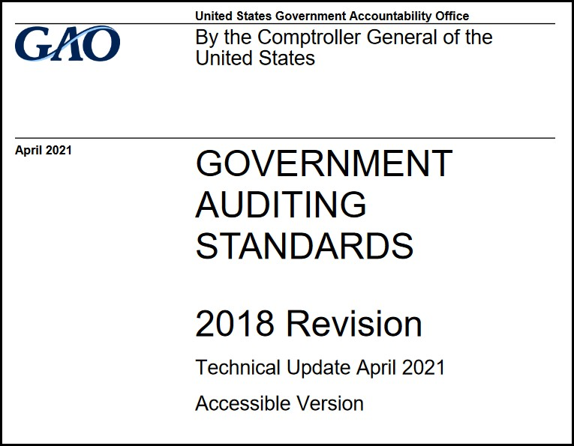
Other Audit Requirements
Conducted in accordance with Generally Accepted Government Auditing Standards (GAGAS)
O.C.G.A. §36-81-7(b)

Slide 6
Other Audit Requirements
Financial statements prepared in conformity with generally accepted accounting principles
Governmental GAAP
Opinion of auditor with respect to financial statements
Material violations of state or local law discovered during audit
O.C.G.A. §36-81-7(c)

Slide 7
Other Audit Requirements
Audit must be completed and sent to the state auditor within 180 days after fiscal year-end
Must submit corrective action plan in response to findings within 30 days of the six-month due date
O.C.G.A. §36-81-7(d)(1)

Slide 8
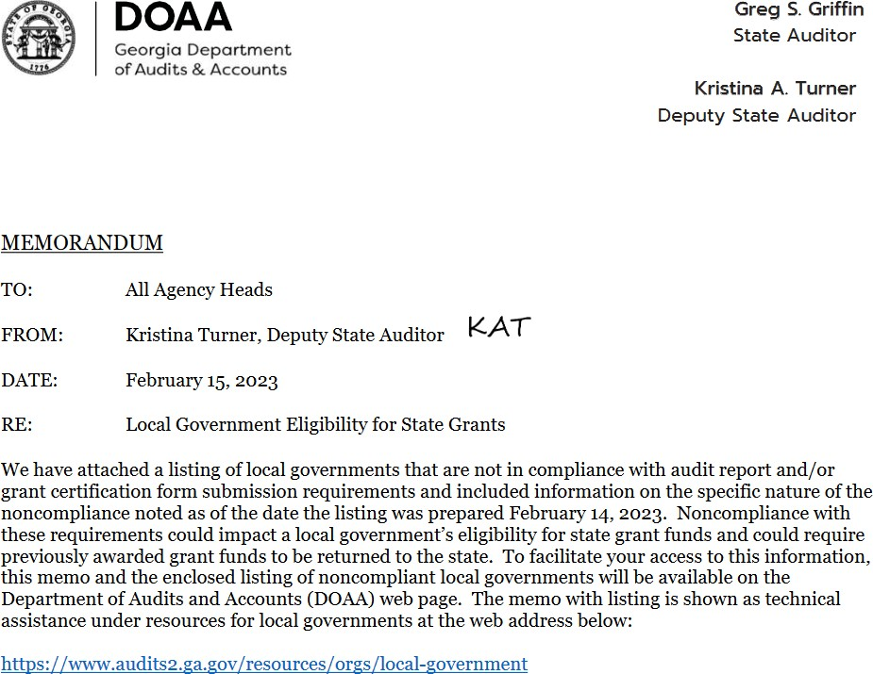
https://www.audits2.ga.gov/wp-content/uploads/2022/12/Noncompliance- Memo-Dated-February-15-2023.pdf
8

Slide 9
Role of the Audit
Accountability and transparency
Compliance with laws and regulations
Compliance with generally accepted accounting principles
Objective information to management and officials to use in decision making

Slide 10
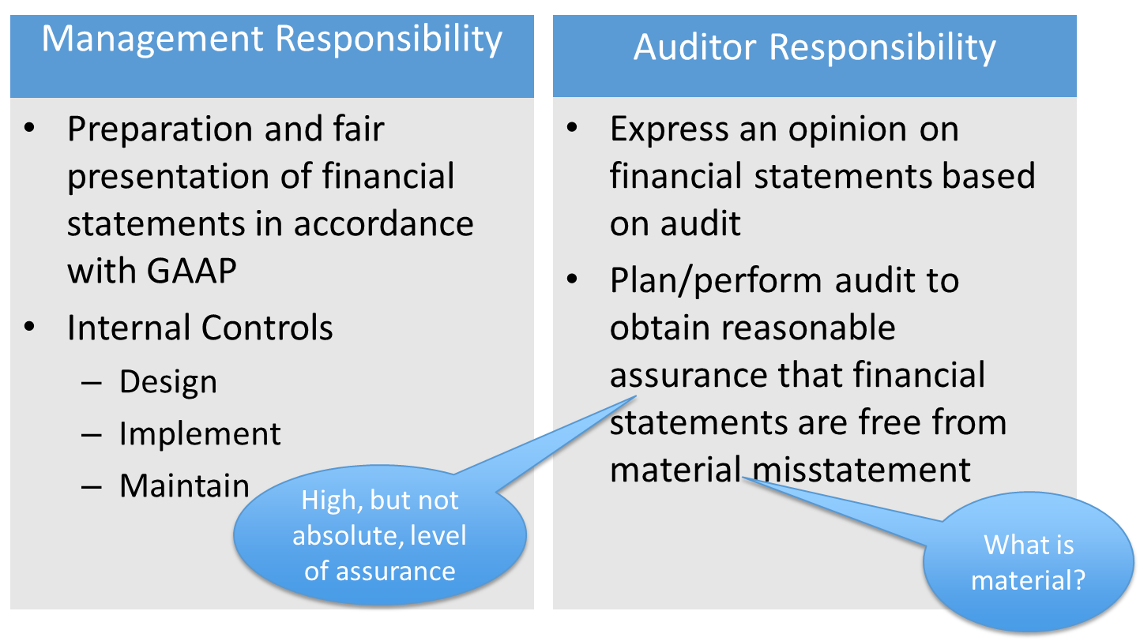
Auditor vs Management Responsibility

Slide 11
2
Reports
Audit Product
1
Report
Financial Audit
Single Audit
Auditor’s Opinion Financial Statements
Government Auditing Standards Report
Reports
Auditor’s Opinion Major Programs
Internal Controls over Financial Reporting
Internal Controls Major Programs
Compliance Laws and Regulations
Compliance Major Programs

Slide 12
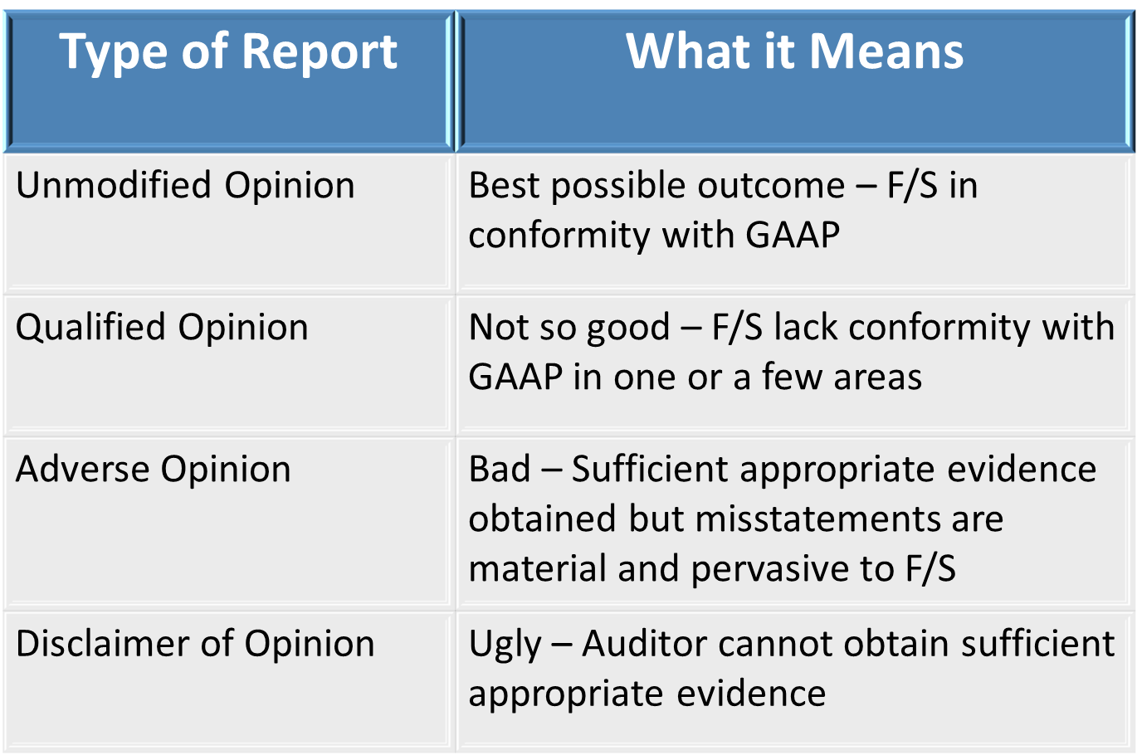

Slide 13
Single Audit Section
Report on Internal Control over Financial Reporting and on Compliance and Other Matters Based on an Audit of Financial Statements Performed in Accordance with Government Auditing Standards
Report on Compliance for each Major Federal Program and on Internal Control over Compliance
Schedule of Expenditures of Federal Awards (SEFA)
Schedule of Findings and Questioned Costs

Slide 14
Identifying a Qualified Auditor

Slide 15
Auditor Competence
Knowledge of –
GAGAS
Government environment
GAAP – Generally Accepted Accounting Principles as established by the Governmental Accounting Standards Board
GAAS – Generally Accepted Auditing Standards as established by the AICPA

Slide 16
Auditor Competence
Certified Public Accountant licensed to practice in Georgia
Continuing Professional Education (CPE) every two years consisting of at least 24 hours that specifically relates to government auditing or the government environment
An additional 56 hours of CPE directed at maintaining audit competence is required for those in-charge auditors
External peer review every three years to determine auditor has quality controls in place

Slide 17
DOAA Recommended Practice
Use of multi-year agreements, perhaps 3 to 5 year period
Ensure quality audit
Price cannot be sole criterion
Evaluate auditor rotation option at end of multi-year contract

Slide 18
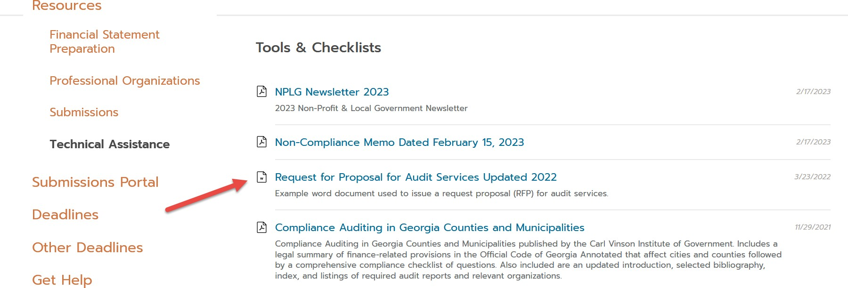
Sample RFP for Audit Services
https://www.audits2.ga.gov/resources/orgs/local-government/?rcat=technical-assistance

Slide 19
Navigating & Interpreting - Financial Statement Information

Slide 20
Audit Reports

Slide 21
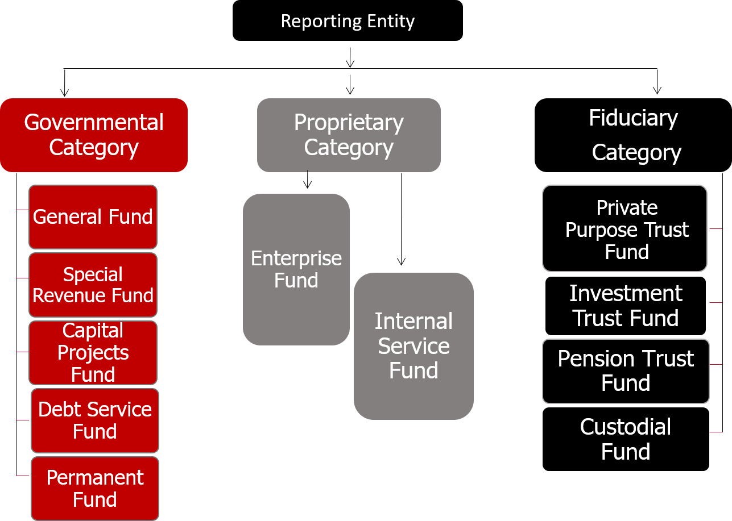

Slide 22
Governmental Funds
Most government functions financed
Reports current assets, current liabilities, and deferred inflows/outflows
Governmental Funds
Reporting Entity
Proprietary Funds
Equity known as Fund Balance (measure of
spendable financial resources)
Fiduciary Funds

Slide 23
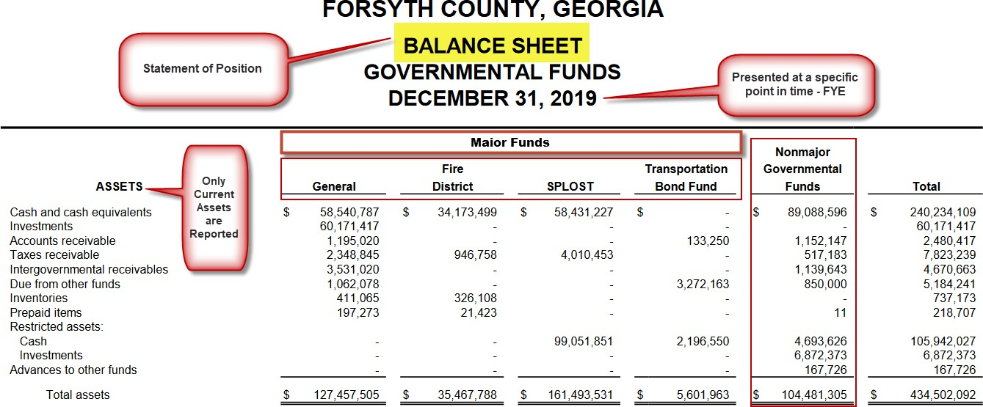

Slide 24
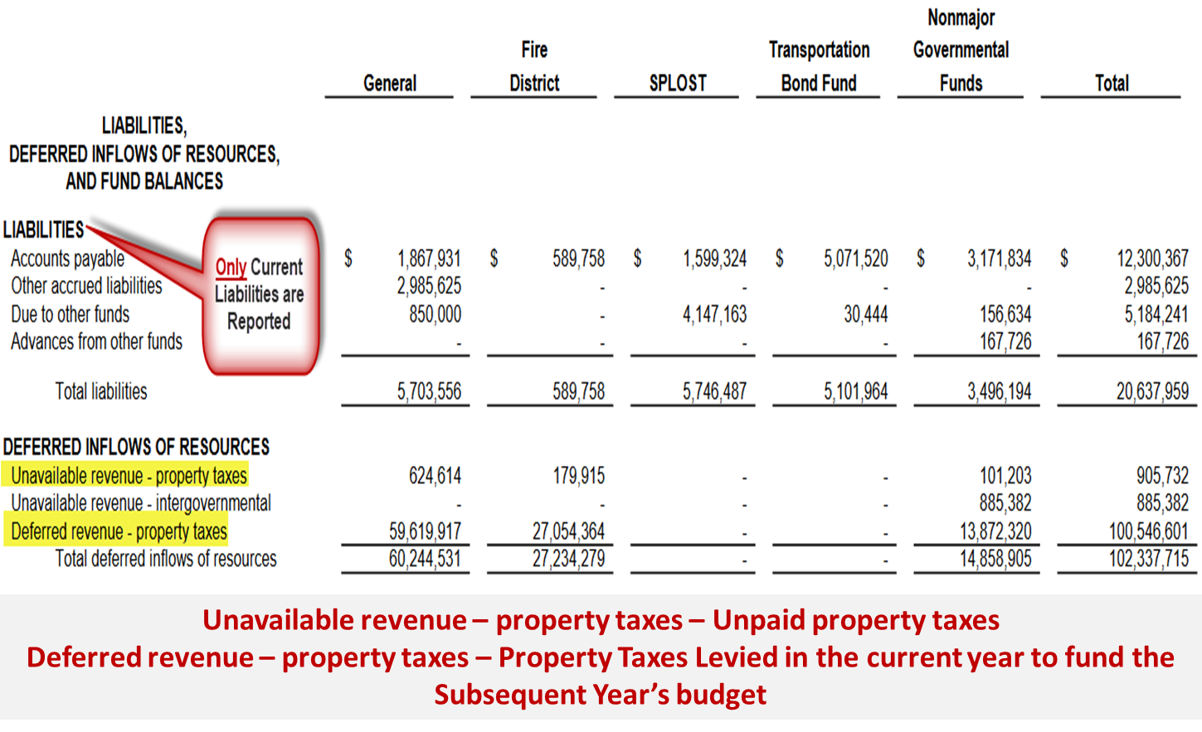

Slide 25
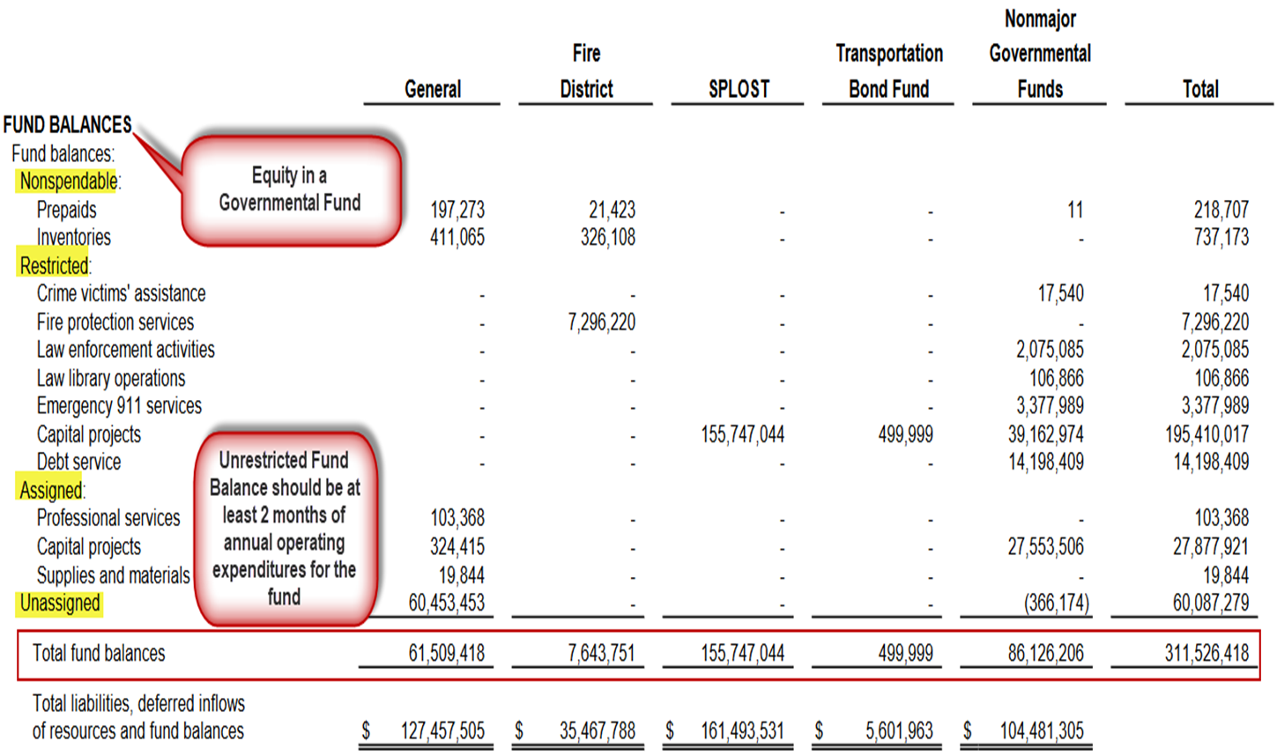

Slide 26
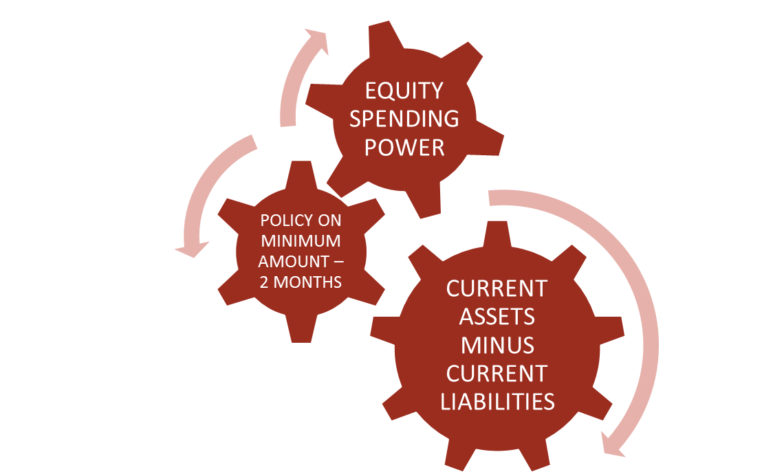
What is Fund Balance?
Fund balance is the term used for equity in governmental funds
[(current assets + deferred outflows of resources) – (current liabilities + deferred inflows of resources) = Fund Balance]
Revenue increases fund balance and expenditures decrease the fund balance

Slide 27
Where Does Your Government Stand?
Unassigned Fund Balance as a % of General Fund operating expenditures:
Calculated as follows:
Unassigned Fund Balance General Fund Revenues
= %
Recommend two months

Slide 28
Operating Statement
Reports revenues and expenditures/expenses
Purpose is to report how the fund’s equity changed during the year
Content of the operating statement differs between governmental and proprietary funds

Slide 29
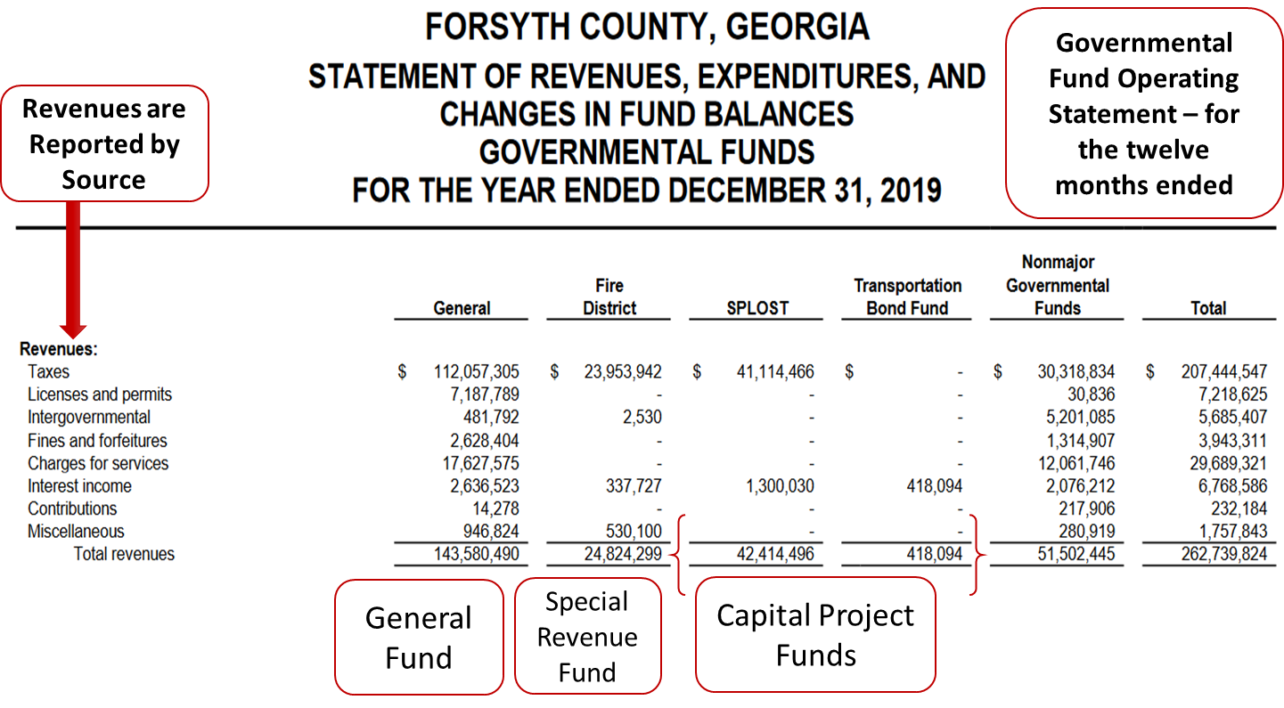

Slide 30
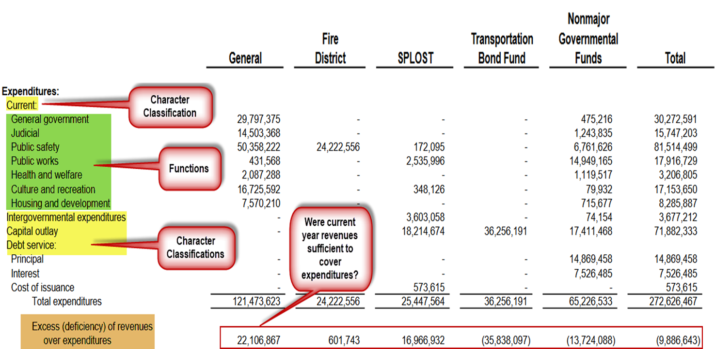

Slide 31
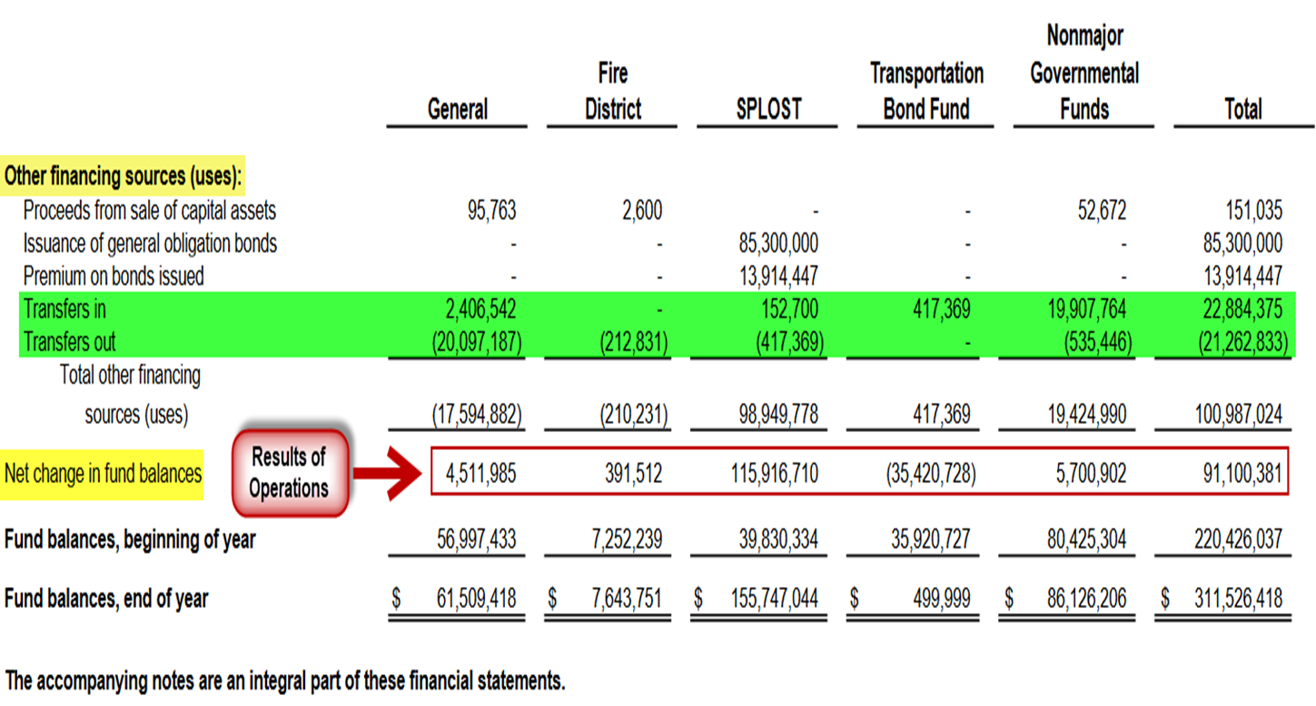

Slide 32
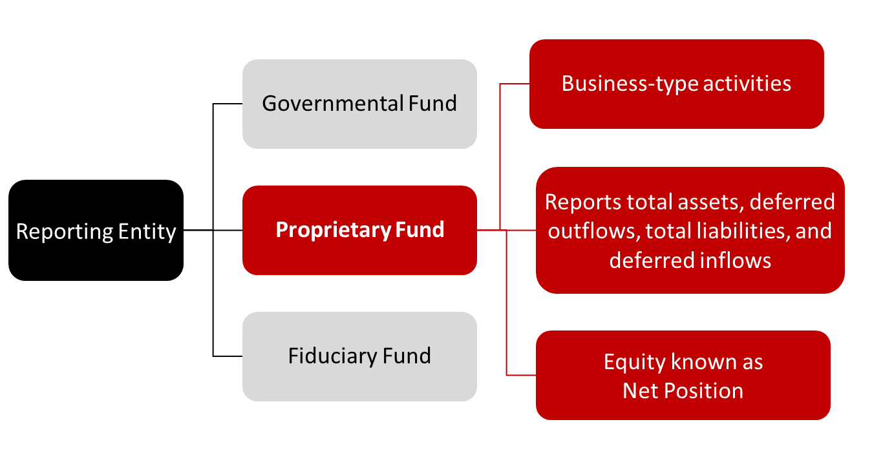
Proprietary Fund Category

Slide 33
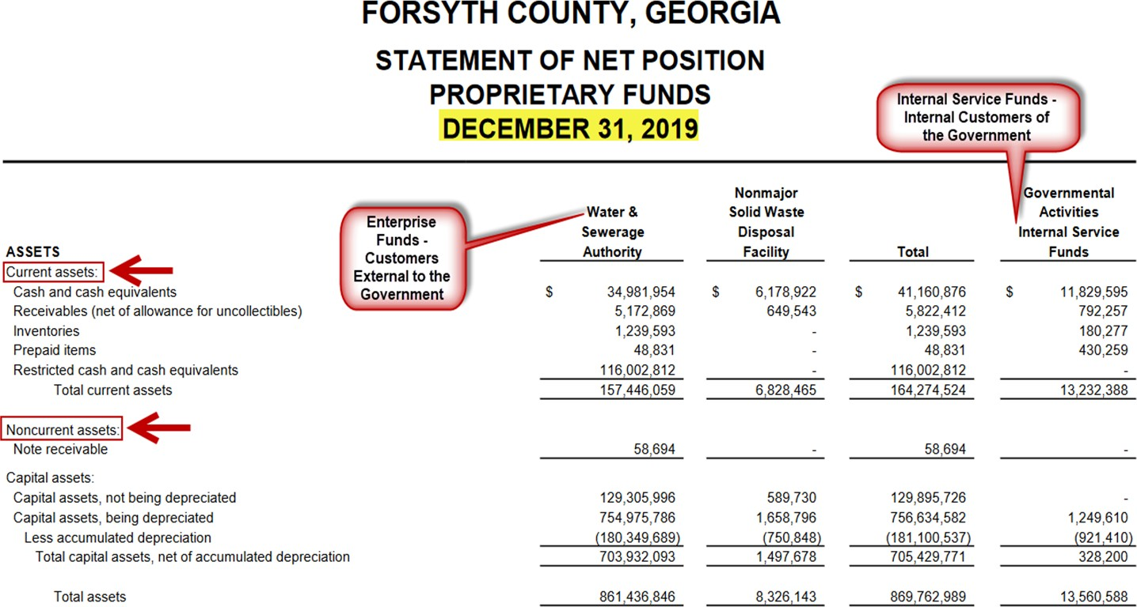
*
*Risk Management Fund, Employee Health Benefit Fund, Workers’ Compensation Fund, and Fleet Maintenance Fund

Slide 34
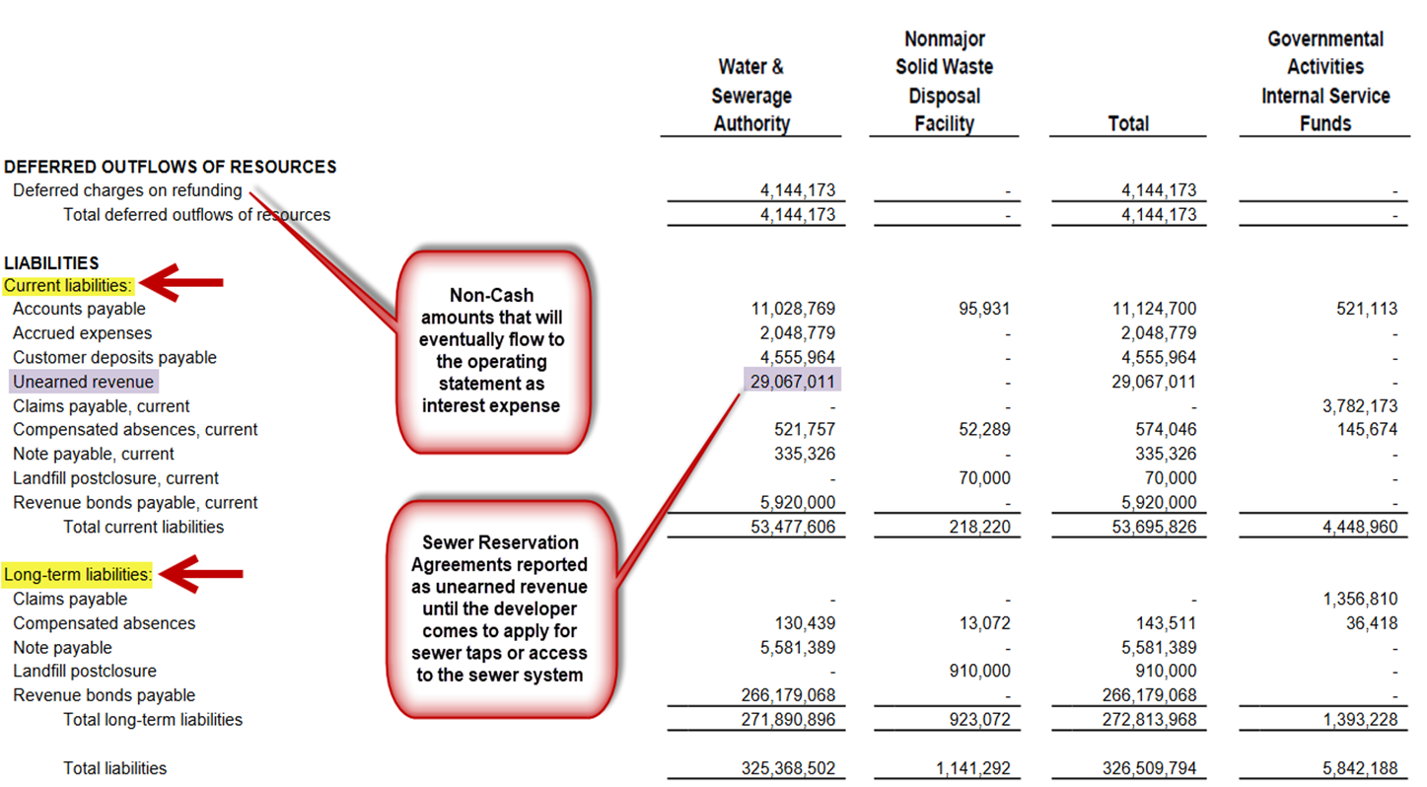

Slide 35
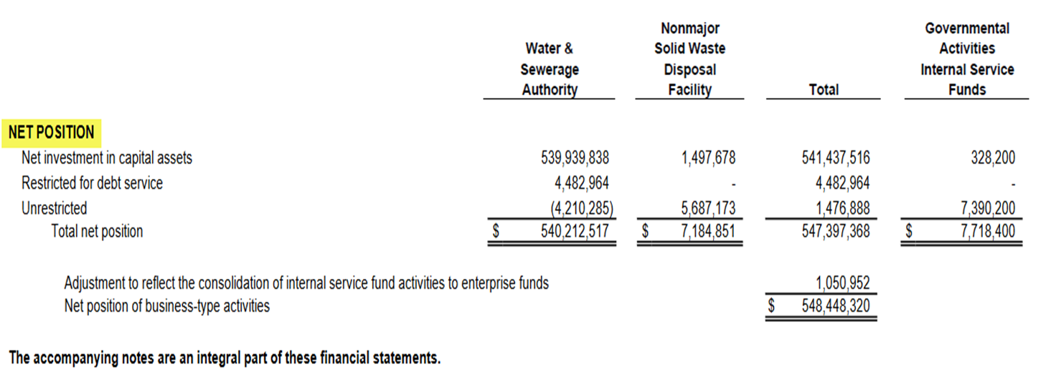

Slide 36
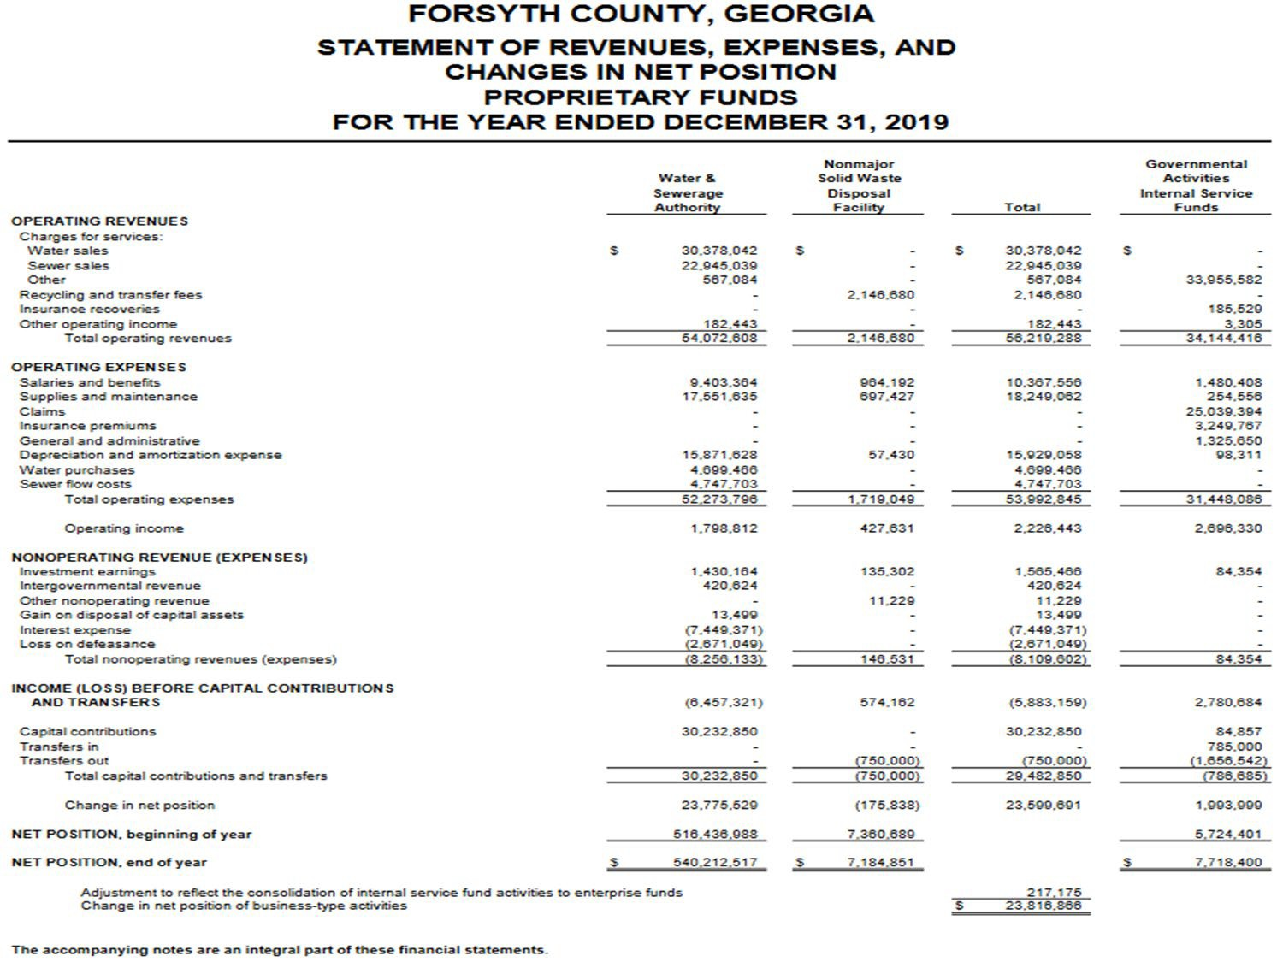

Slide 37
Fiduciary Fund Category
Governmental Fund
Reporting Entity
Fiduciary Activities
Proprietary Fund
Reports total assets and total liabilities
Fiduciary Fund
Equity known as Restricted Net Position

Slide 38
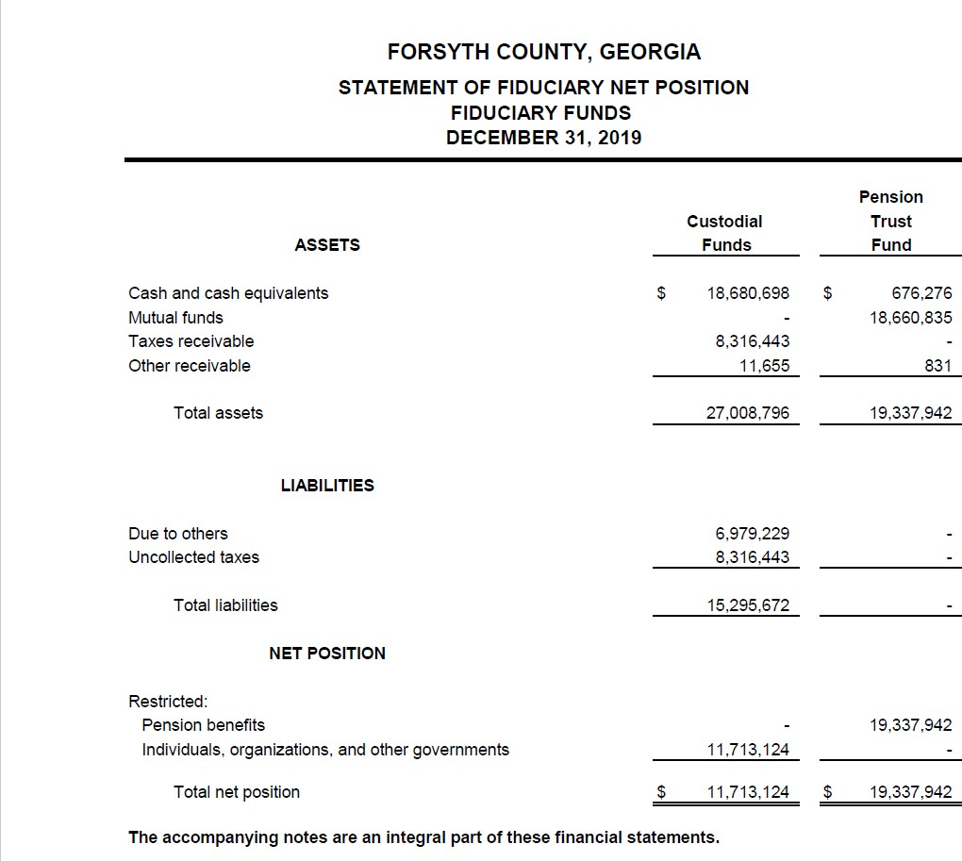

Slide 39
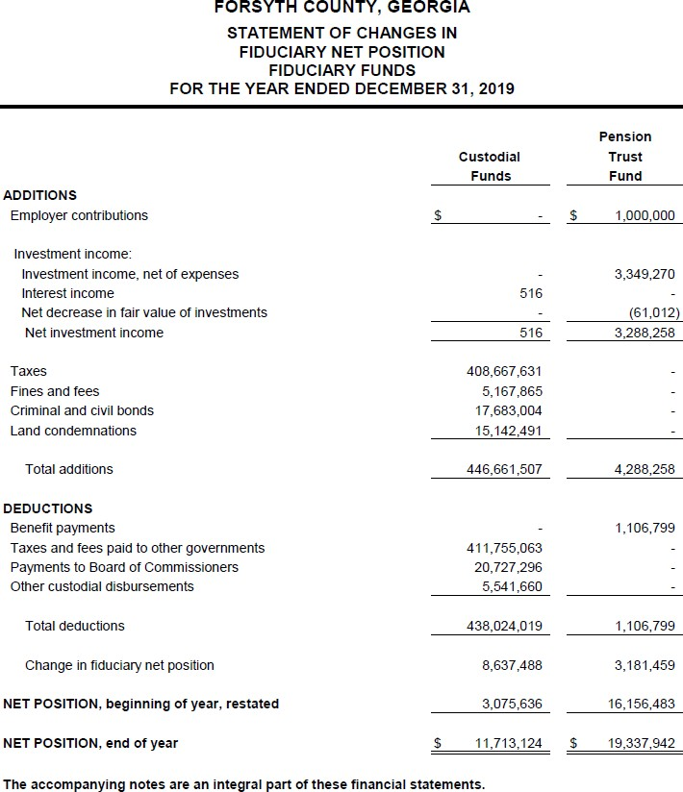

Slide 40
Notes to the Financial Statements
Integral part of the basic financial statements
Basic Financials Statements must include: “The accompanying notes are an integral part of these financial statements.” (In-depth Analysis)
Disclose information not reported on face of the statements
Fair presentation
Note 1 – Summary of Significant Account Policies
Additional Notes – Fund Balance, Deposits and Investments, Stewardship & Compliance, Capital Assets, Long Term Debt and Retirement Plans

Slide 41
Required Supplementary Information (other than MD&A)
Other reporting section
Budgetary comparison
Other Post Employment Benefits
Pension Information

Slide 42
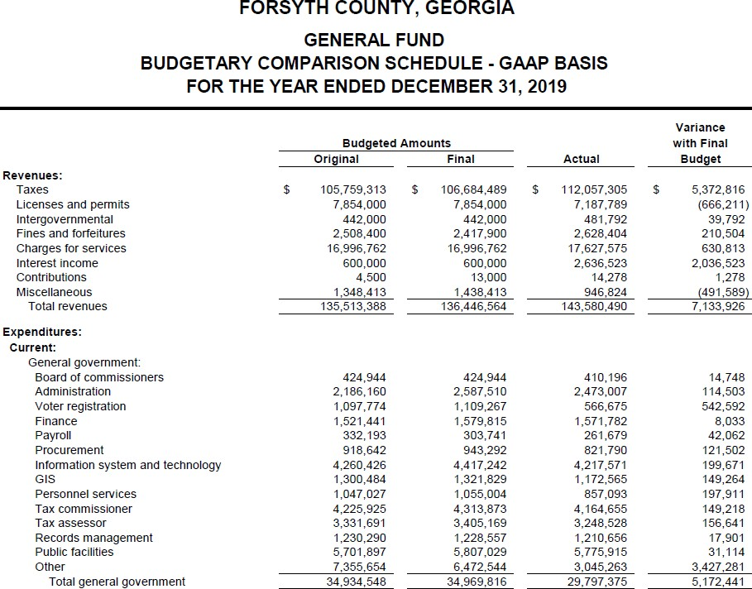

Slide 43
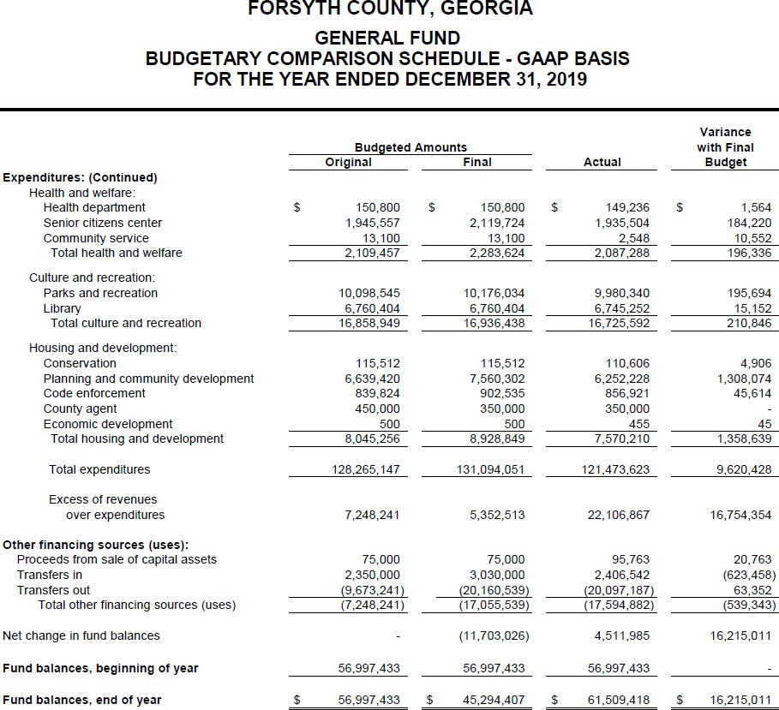

Slide 44
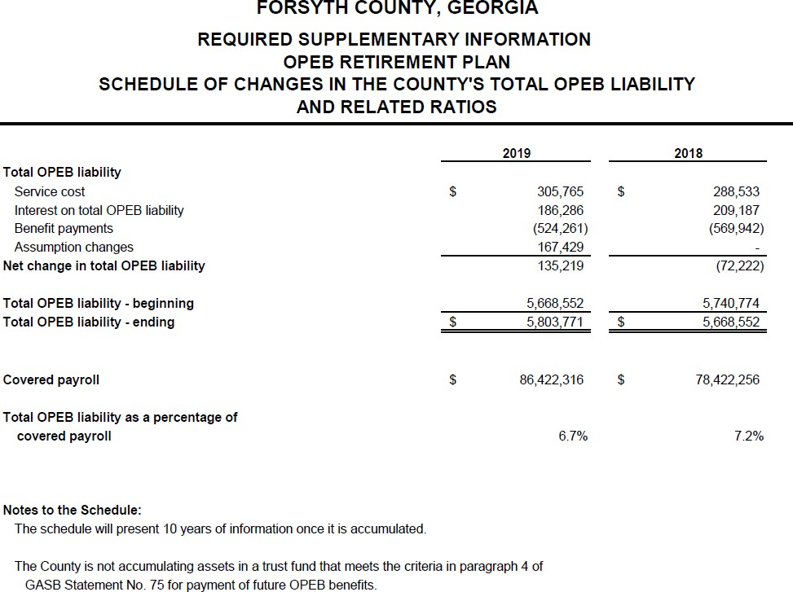

Slide 45
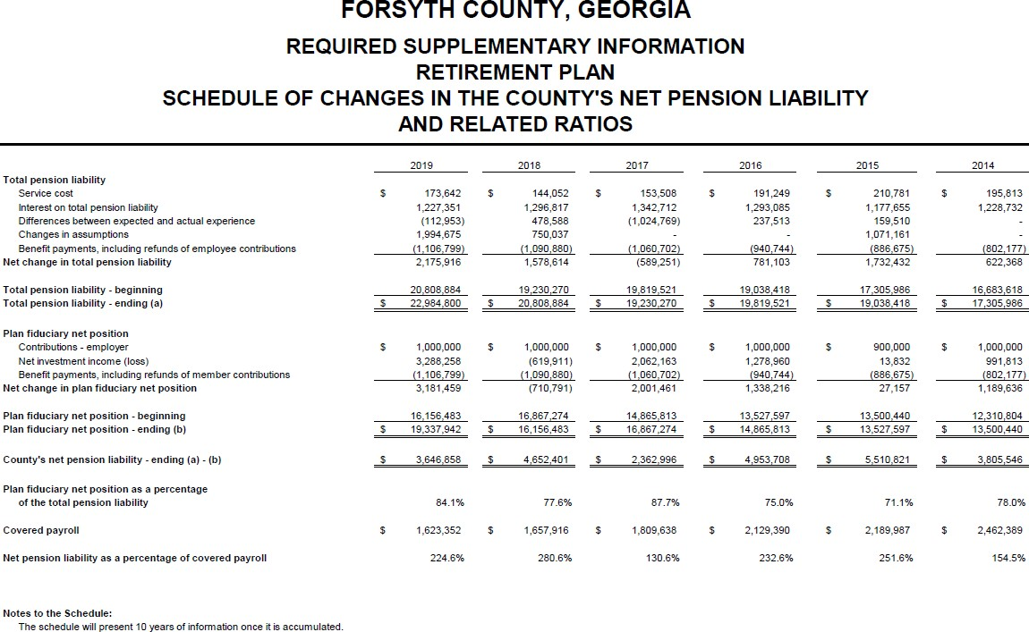

Slide 46
Statistical Section
GASB 44 – 10 year Trending
Financial trends
Revenue capacity
Debt capacity
Demographics and economy
Operating information
Additional information may be reported
All methods and assumptions explained

Slide 47
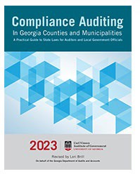
Free Resource
Compliance Auditing is available as a download, presented in PDF format
https://cviog.uga.edu/publications/compliance-auditing- publication.html

Slide 48
Other Resources
ACCG – www.accg.org – see Publications
Handbook for County Commissioners
ACCG Guidebooks
GMA Handbooks & Publications
https://www.gacities.com/Resources/GMA-Handbooks-Publications.aspx
CVIOG – Includes Free Videos and Tutorials
http://cviog.uga.edu/publications/public-resources.html www.gfoa.org, Best Practices, Advisories, Other Resources

Slide 49
CVIOG DAWG PROUD
DOWNTOWN
DEVELOPMENT
DATA ANALYTICS & VISUALIZATION
PLANNING RETREATS AND CUSTOMIZED FACILITATION
FINANCE COURSES • GOVERNMENTAL PROFESSIONALS CERTIFICATION
STATE & LOCAL GOVERNMENT SERVICES
STRATEGIC PLANNING
SURVEY RESEARCH & EVALUATION
SCHOOL
LEADERSHIP
ONLINE COURSES • LEADERSHIP DEVELOPMENT • ECONOMIC DEVELOPMENT TRAINING
WORKFORCE DEVELOPMENT
#CVIOG IGOV
CUSTOM APPLICATION DEVELOPMENT

