Slide 1
Residential Density Bonuses
How They Work +
Why Our Community Likes Them
Chris Eldridge, City Manager
Naomi Siodmok, Director of Community Development

Slide 2
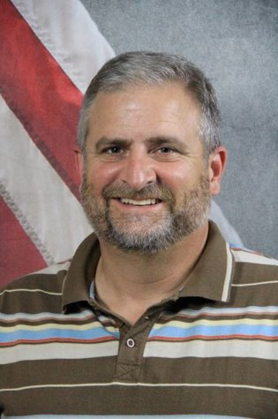
Chris Eldridge
Has served as a City/County Administrator for 25 years.​
Working with Doraville since 2020. ​
Prior to Doraville, worked with Horry County in South Carolina for 7 years.​
Graduate of Appalachian State University with a MPA from Clemson University. ​
Has worked with a variety of projects ranging from streetscapes to recreation facilities to organizational improvements. ​

Slide 3
Naomi Siodmok
Practicing for 8 years + with Doraville for 3 years.
Team received the 2022 Visionary Planning Award for sustainability efforts from Atlanta Regional Commission.
Master of Urban and Regional Planning from VCU + Master of Urban Design from GA TECH.
Focused on implementing existing plans, transportation projects, and adoption of progressive codes. ​
Previously served as a planner for the City of San Diego and Roanoke County, Virginia.

Slide 4
Agenda
The Impetus
Goal + Incentive
Density Bonus Language - Attempt 1
Initial Proposal
Council Response
Results
Density Bonus Language – Attempt 2
Improvements to Get the Language Passed
Final Takeaways

Slide 5
The Impetus
Doraville's 1st Density Bonus Recipient
Development in Doraville predominately infill
Alignment with Goals
Penciling out

Slide 6
Goal + Incentive
Doraville's 1st Official Mural
To support housing development, while providing public benefits.
Allows up to 2x current allowable density.

Slide 7
Peachtree Creek Greenway in Doraville
Density Bonus
(Take 1) Initial Proposal
Proposed many options to qualify:
Public Art Donations
Proximity to Transit
Vertical Mixed Use
Public Greenspace
Affordability
Unit Ownership
Trail Implementation
EV Charging Stations

Slide 8
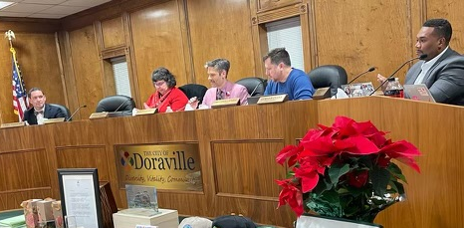
Density Bonus
(Take 1) Council Concerns
Doraville's City Council
How to regulate affordable housing
Fixed percentages for bonuses
Looking like we are addressing a problem, while not really addressing it
Administrative

Slide 9
Density Bonus
(Take 1) Results
Doraville MARTA Train
Bonuses only for transit adjacency, public art, and trails.
Established bonus ranges – “Up to …”

Slide 10
Affordable units delivered with market rate
Must maintain designated percentage of Area Median Income (AMI) for at least fifteen (15) years.
The character of the affordable units consistent with market rate
Dispersed throughout the development
Owners shall provide proof of affordability to the City on an annual basis
Owners of units shall create, store, and maintain all project records for the affordability term.
With the land disturbance permit, applicant shall submit an affordable housing plan to include detail appropriate to the request - the number, size, unit mix, location, affordability, and phasing of affordable units.
Density Bonus
(Take 2) Improvements
Restrictive Covenants
Specific criteria for affordable housing
Added workforce housing with higher density awards with less provided by the developer
Unit Ownership as a means of receiving a bonus

Slide 11
Next Steps
Creating specific standards for this "variance" process
Monitoring and enforcement
Spreading the word
Issues regarding requiring a Discretionary Process
Lessons Learned

Slide 12
Athens' Voluntary Inclusionary Housing Ordinance
Purpose, Implementation, and Lessons Learned
Niki Jones, Assistant City Manager
Stephen Jaques, Long Range Planner
Andrew Saunders, Housing & Community Dev.

Slide 13
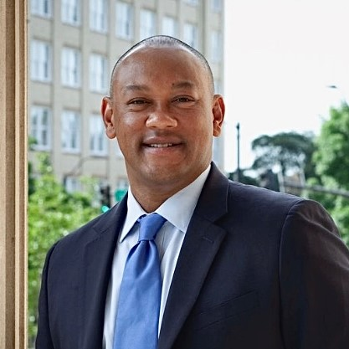
Niki S. Jones, AICP
Assistant Manager at the Unified Government of Athens-Clarke County.
More than 19 years of experience in local government.
Past Roles: Planning Director for the Town of Wendell, NC, Assistant Director of Housing and Neighborhoods for the City of Raleigh, NC and several positions with the City of Greenville, NC.
Master of Public Administration degree and a Bachelor’s degree in Urban and Regional Planning from East Carolina University.

Slide 14
Stephen Jaques
Planner III
Joined Planning Department in April 2022; formerly with the NEGRC
MPA from the University of Georgia
Strong Towns Member
Interested in organization management, street design, fiscal sustainability, public input processes, zoning, and urban design

Slide 15
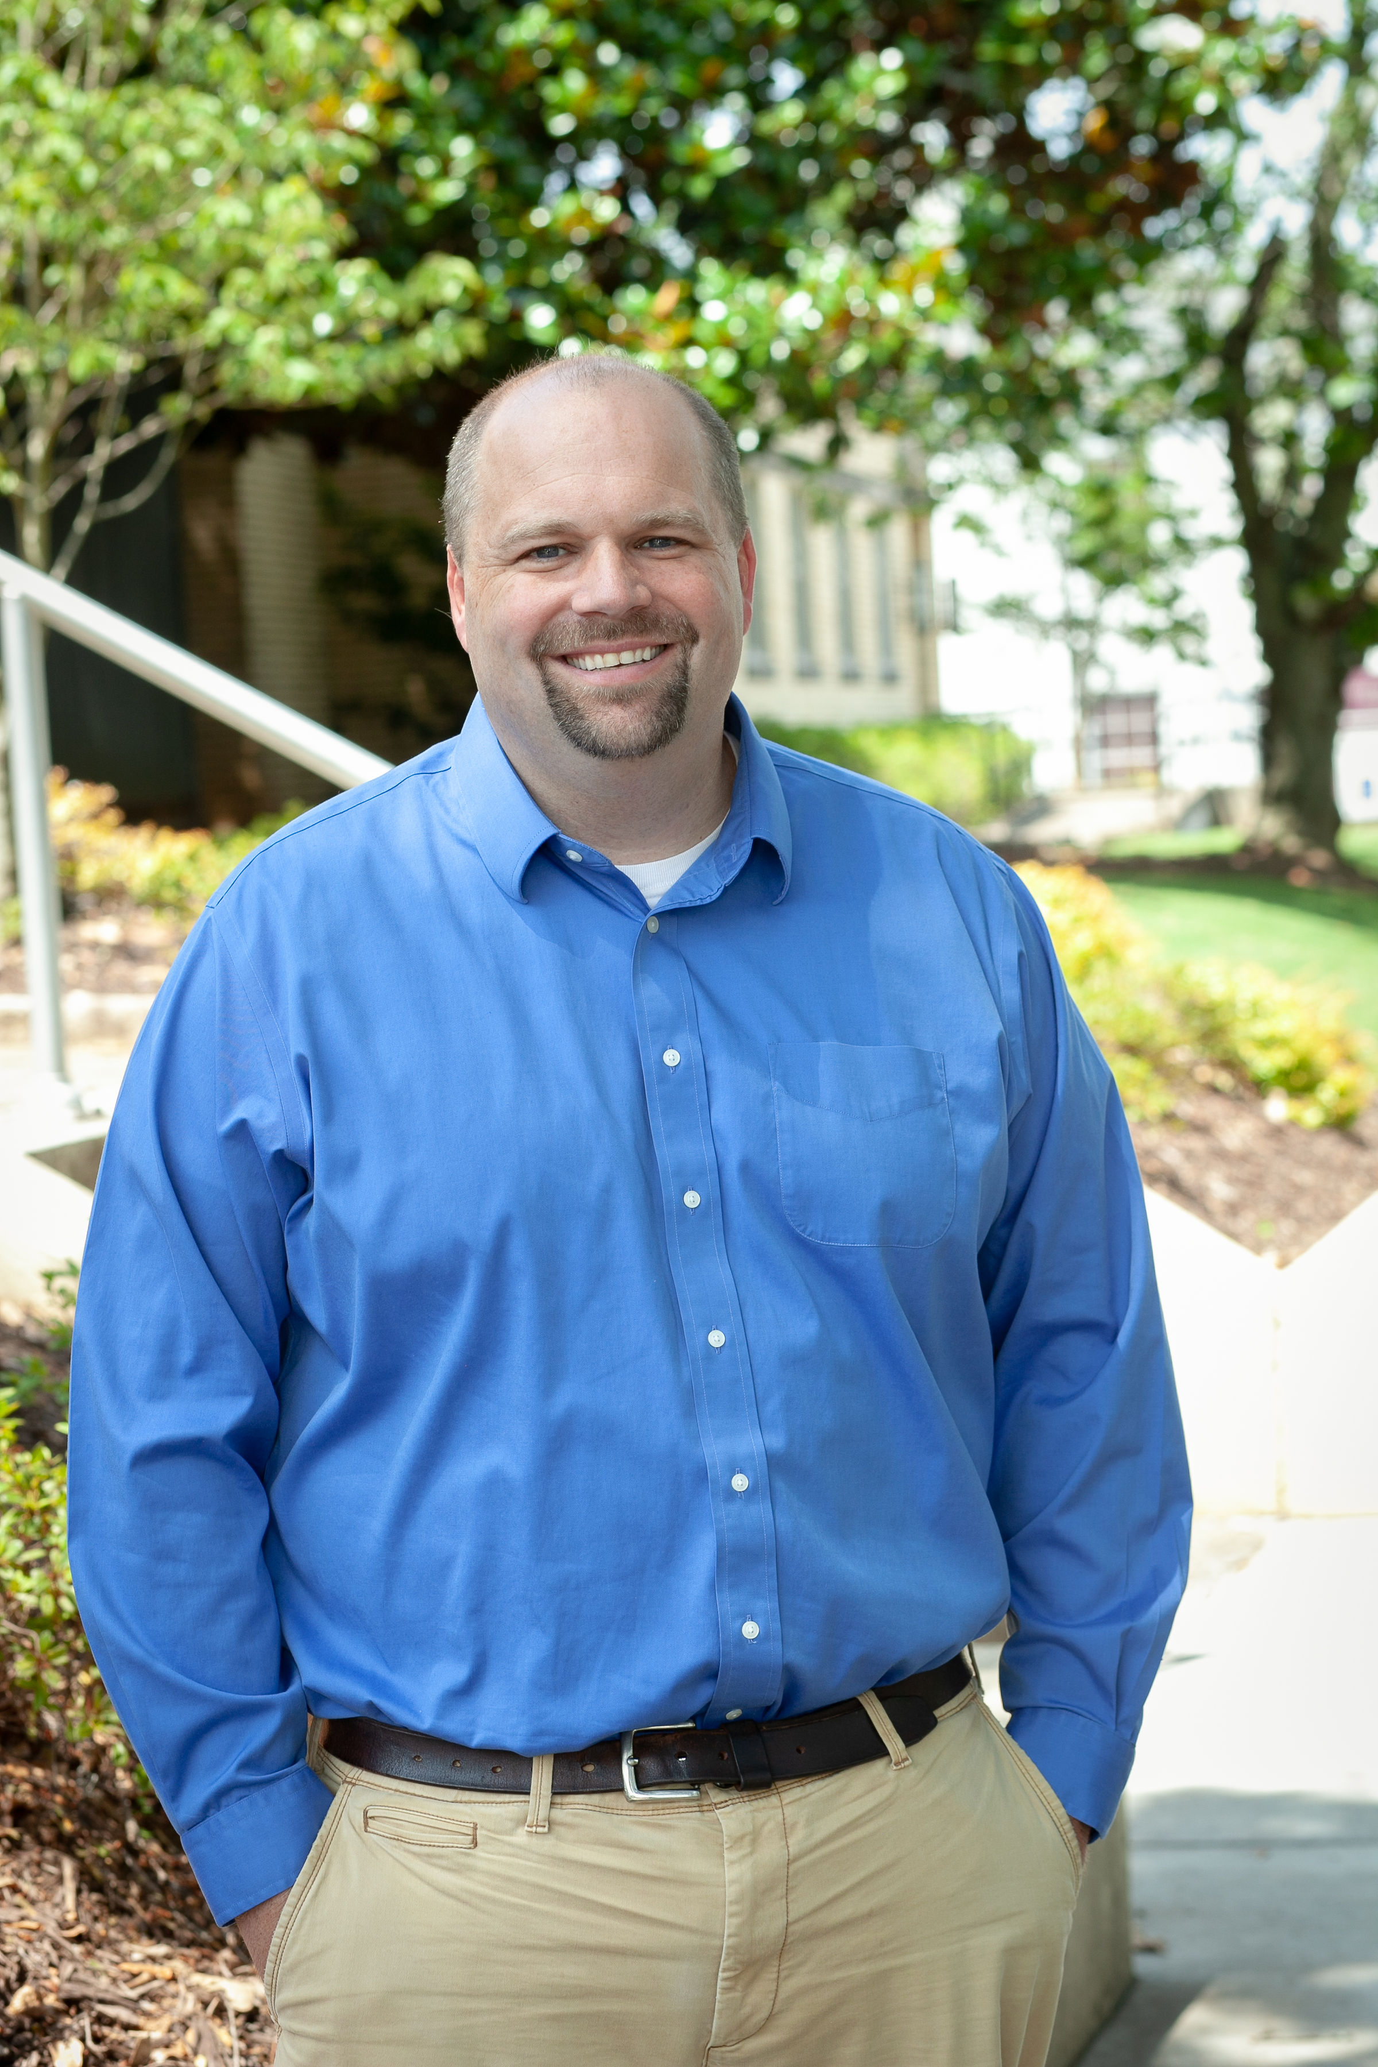
17 Years with Athens-Clarke County
Bachelors and Masters from the University of Georgia
Interim Housing and Community Development Director 2022-2023
Roles: Central Services Director, Sustainability Officer, Environmental Coordinator, Community Forester
Andrew Saunders

Slide 16
Agenda
Purpose
Development
Alignment with ACCGov Plans
Structure
Eligibility
Incentives & Commitments
Process
Lessons Learned & Next Steps

Slide 17
Purpose
Describe why, how, and when Athens-Clarke County will utilize our voluntary inclusionary housing policy

Slide 18
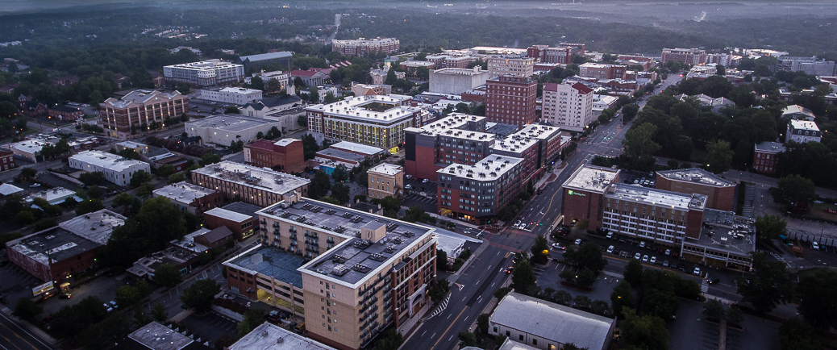
3 Primary Affordable Housing Challenges
Quality Affordable Rental Homes
Support for Homeownership
Affordable Housing Systems
37% Poverty
8,800 Cost Burdened Renter Households
6,200 Unit Gap for Households earning < $35,000

Slide 19
Development
Process
Mayor Appoints Committee
Numerous Committee Meetings
Stakeholder Input
Committee Recommendation
Ordinance Deliberation
Mayor & Commission Approval
Planning Commission Recommendation

Slide 20
ACCGov Plan
Alignment
"Increase supply of and access to affordable housing" – Comprehensive Plan
Goal Area 4: Quality, Stable, Affordable Housing for All – ACCGov Strategic Plan
Housing Goal 2: Increase amount of and provide access to affordable housing – Envision Athens Community and Economic Development Plan
Strategy 2: Incentivize Inclusionary Development –Georgia Initiative for Community Housing, Athens Report
Tactic 6: Evaluate Inclusionary Zoning – Workforce Housing Study
Comprehensive Plan
Envision Athens
GICH Report
Workforce Housing Study
ACCGov Strategic Plan

Slide 21
Eligibility
The Athens Clarke County Inclusionary Zoning program is administered as a by right process offered to developers on a voluntary basis
Allows for density bonuses in multifamily and most commercial zoning districts for the creation of affordable multi-family rental housing units
Offers two options for creation of affordable units based on affordability level offered
Intentionally designed in a manner that is easily separated from rezoning processes
Allows for payment in lieu as an option in the Commercial Downtown District only as well as for partial units required
Participation in the program also affords developers by right reductions in minimum parking requirements if in proximity to transit and reductions in required ground floor commercial space in a vertical mixed-use developments

Slide 22
Incentives &
Commitments
Density Bonus
Zoning | Density Bonus | % Affordable Units (80% AMI) | % Affordable Units (60% AMI)
RM-1 | 50% | 15% | 10%
RM-2 | 50% | 15% | 10%
RM-3 | 50% | 15% | 10%
C-O (commercial office) | 50% | 15% | 10%
C-N (commercial neighborhood) | 50% | 15% | 10%
C-G (commercial general) | 100% | 20% | 15%
C-D (commercial downtown) | 25% | 10% | 5%
Owner's Commitments
Affordable Rents
Income Eligible Tenants
Annual Monitoring
Other Incentives
20% Reduction in Parking If Within 1,500 ft of Transit Stop
50% Reduction in Ground Floor Commerical within Downtown Zoning.

Slide 24
Our Process
Concept Review
Plan Submittal
Plan Review & Approval
LURA
Payment In Lieu
Certificate of Occupancy
Construction
Permits
Affordable Rents
Annual Monitoring

Slide 25
Athens' 1st
Submittal
Zoning: CD
Type: On Site
Tenant: Very Low Income
% Affordable Units: 4.3%
% Affordable Bedrooms: 4.8%
P-I-L: Partial
Bonus Beds: 21

Slide 26
Lessons Learned
& Next Steps
Next Steps
Ordinance Updates
Educational Materials
Single Family
Owned Units
Monitoring
Lessons Learned
Align your code -> bedrooms/units
Create careful boundaries between zoning and permitting
Affordable rents are complicated –> business requires predictability
Multi-bedroom units are occasionally leased by the bedroom
Expect the unexpected... planned developments, 5+ bedroom units, etc.

Slide 27
Questions?

