Slide 1

Getting Your Financial House in Order
Kate Fitzpatrick, Town Manager
Needham, Massachusetts
VeryKateFitzpatrick.com

Slide 2

This is not financial advice!
The material provided is based on my own experience.
I am not a certified financial professional.
I am a Town Manager.
Treat this information as if you got it from your barista!

Slide 3

True or False
Required Minimum Distributions (RMDs) apply to your Roth 457/403B contributions, but not to your Roth IRAs.
You will not pay a gift tax until you exceed a lifetime allowance of $12,920,000.
Income limits prevent most managers from contributing to a Roth 457 plan.

Slide 4

Create a Solid Foundation for your Financial House
If you understand your financial situation, it will stop following you around.
Financial stress or uncertainty can lead to anxiety and depression.
You can act today to improve your situation tomorrow by reviewing spending, saving, planning, & implementing.

Slide 5
“Find your Why!”
Becoming more financially knowledgeable
Improving tracking/budgeting
Starting a family
Changing careers
Paying for college
Caring for parents
Retiring
Traveling
Reducing debt
Increasing savings
Reducing taxes
Starting a business
Making a large purchase (vehicle, home, vacation home)
Leaving money to charity or children

Slide 6
Why Save?
56% of Americans cannot cover an emergency costing $1,000 (Bankrate.com).
Meet your goals.
Achieve FINE (Financial Independence Next Endeavor).
Don’t burden your kids.
Don’t run out of money in retirement.

Slide 7
How to Save
Start where you are
Track expenses
Prioritize the “Big Three”
Have regular finance summits
Strategies?

Slide 8
Tackle the “Big Three” Before Anything Else.
Build Your Emergency Fund
Pay Off Debt
Save for Retirement

Slide 9

Build Your Emergency Fund First

Slide 10

Pay Off Debt

Slide 11
Save for Retirement
Start Early – Use the Power of Compound Interest
1
Use Roth Options
2
Tell the Others
3
Use your Position
4

Slide 12
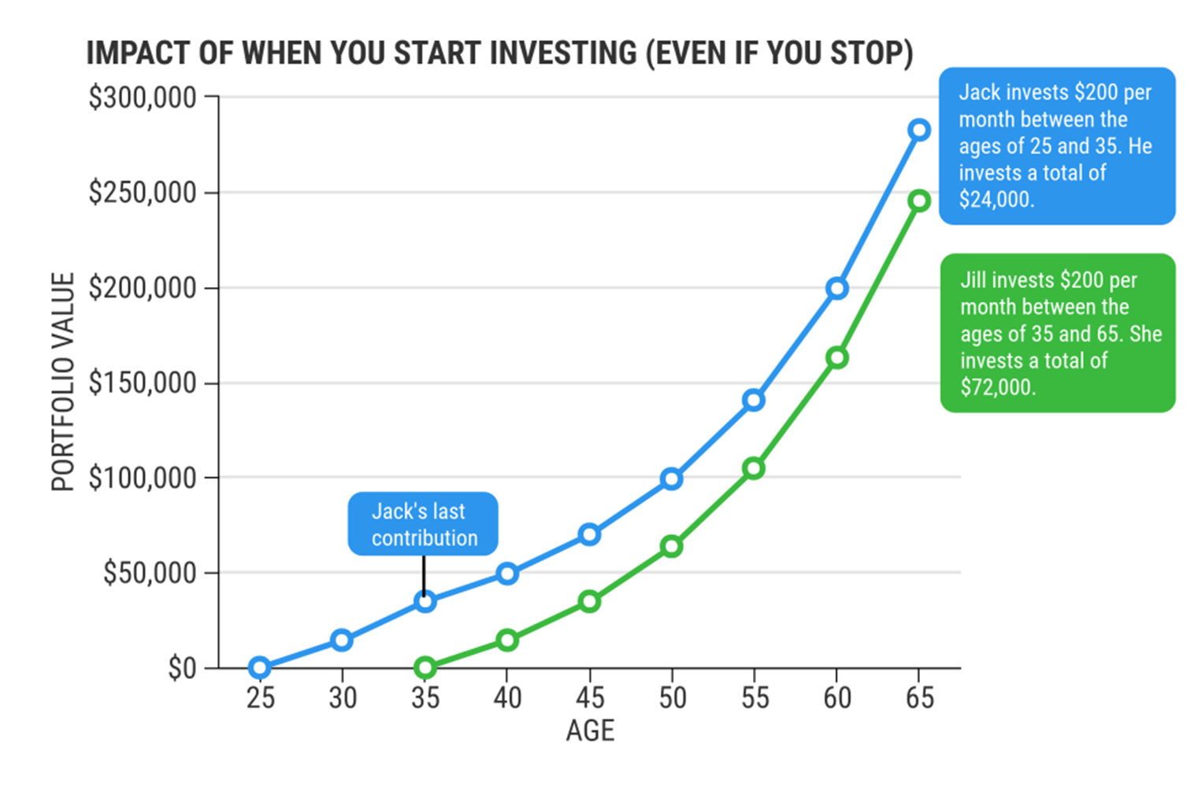
The Power of Compound Interest
U.S.News Money/Coryanne Hicks, July 23, 2018

Slide 13
You Can Go All Roth!
Notes:
My personal story about getting the roth
My personal story about not saving enough outside DB pension
Kids stories

Slide 14

Implement a Long-Term Investment Strategy
Invest for the long-term
Invest in:
  US Total Stock Market Index
  Worldwide/International Stock Market Index
  US Total Bond Market Index
“Never underestimate the power of doing nothing” – Winnie the Pooh

Slide 15
Make Sure You Have Adequate Insurance
Disability Insurance
Life Insurance
Avoid products you don’t understand or need

Slide 16
Understand Your Employee Benefits
Defined Benefit Pension
457/403b
401(a)
Health Savings Account
Flexible Savings Account
Life Insurance/Disability Insurance
Dependent Care (don’t get me started)
Notes:
HSA one time rollover; piece of paper, save receipts

Slide 17
Social Security & Medicare
What are “WEP” and “GPO” and why do I care?
Zero means zero.
When should I retire: 62, 67, or 70?
Visit SSA.gov.

Slide 18
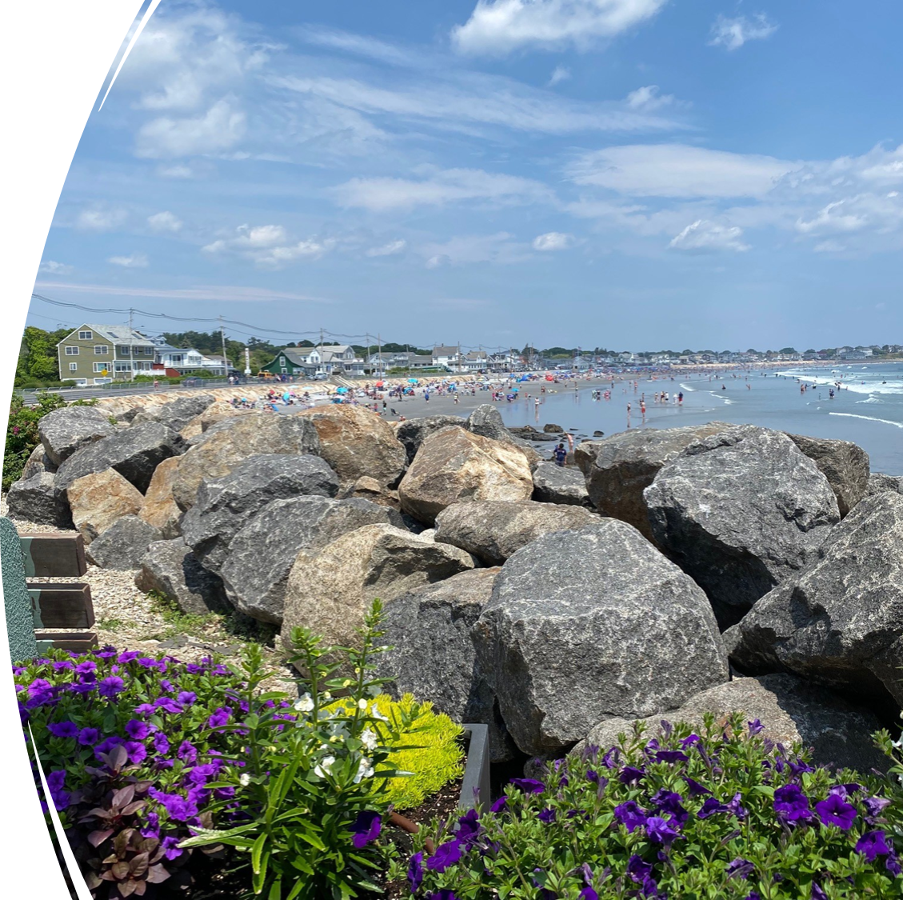
Retirement Planning
FINE
Actual needs
Start early
Liquidity
Have conversations with yourself.
Notes:
My personal story about getting the roth
My personal story about not saving enough outside DB pension
Kids stories

Slide 19
Complete Estate Planning Now
Wills
Guardians
Durable Power of Attorney
Health Care Proxy
Trust

Slide 20


What is Your Current Level of Comfort?
Emergency Fund
Pay Off Debt
Saving for Retirement
Saving for Education
1 2 3 4 5
1 2 3 4 5
1 2 3 4 5
1 2 3 4 5

Slide 21


What is Your Current Level of Comfort?
Life Insurance
Disability Insurance
Estate Documents
FINE
1 2 3 4 5
1 2 3 4 5
1 2 3 4 5
1 2 3 4 5

Slide 22
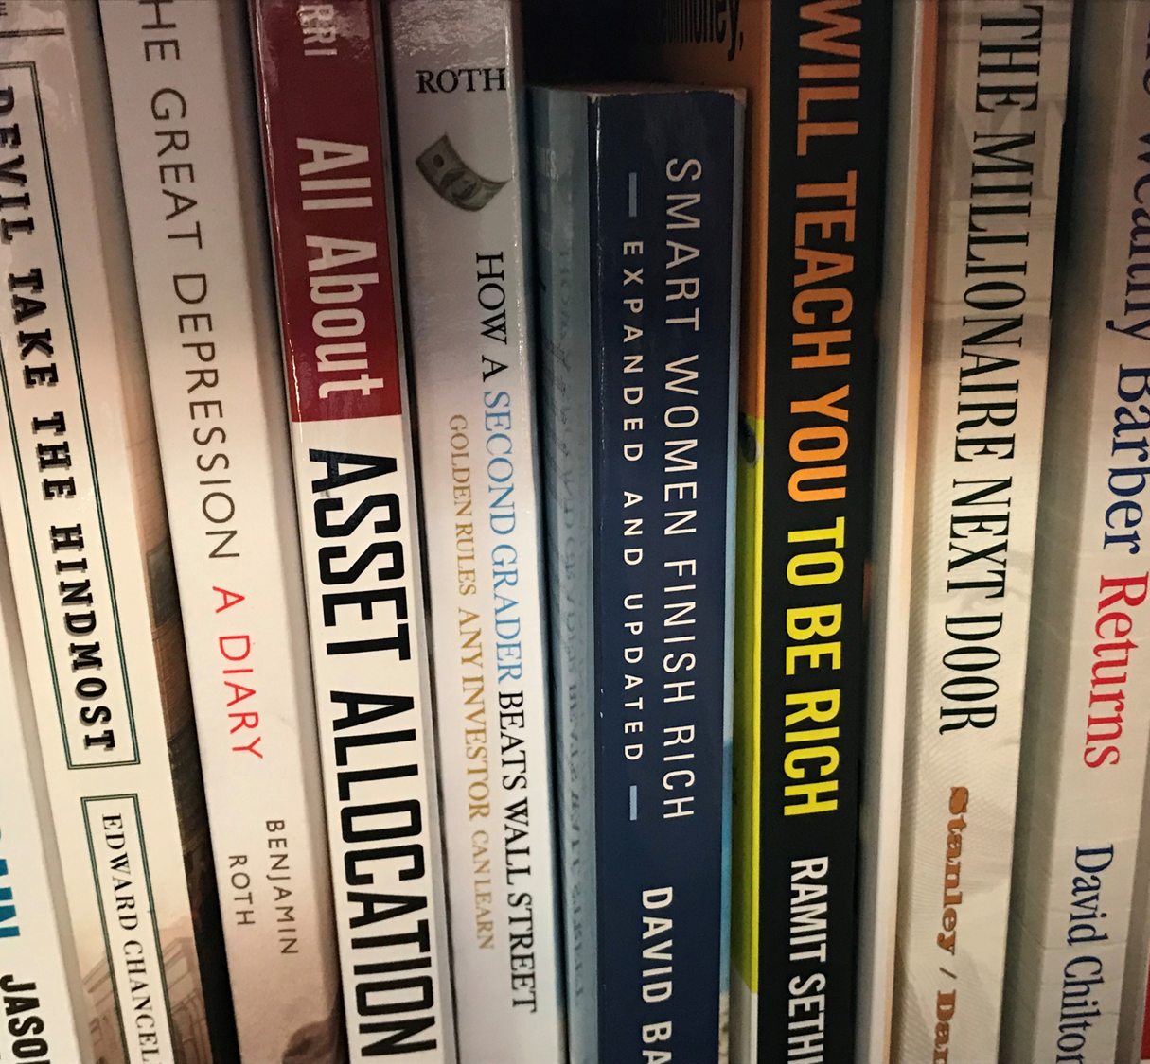
Take Action!
What is one thing you can do to improve your financial resiliency?
  This week?
  This month?
  This year?

Slide 23
Resources
Jill on Money Podcast
Your Money, Your Wealth Podcast
The Dumb Things Smart People do with Their Money, Jill Schlessinger
The Great Money Reset, Jill Schlessinger
The New Retirement Savings Time Bomb, Ed Slott
The Wealthy Barber, David Chilton
If You Can, William J. Bernstein
The Millionaire Next Door, Stanley & Danko

Slide 24
Questions?
Kate Fitzpatrick, Town Manager
Needham, MA
kfitzpatrick@needhamma.gov
VeryKateFitzpatrick.com

Slide 25
This is not financial advice!
The material provided is based on my own experience.
I am not a certified financial professional.
I am a Town Manager.
Treat this information as if you got it from your barista!

