Slide 1
BUILDING THE STRATEGIC PLAN MUSCLE

Slide 2
Key Questions
Why are 52% of local and state employees thinking of leaving public service? (MissionSquare Research Institute)
How are you transferring the knowledge of long term employees to the many new ones?
(12% of all GA municipal employees are eligible to retire GMA)
How do you empower employees when they are constantly questioned by outside “Experts?

Slide 3
Why Plan?
Realistic picture of current state of organizations processes
Share “How” we are getting there to foster collaboration
Take systemic action, with budget support
Achieve desired future state of organization

Slide 4
Employee Driven
Local Governments face an uphill challenge in achieving Community Goals since:
Elected officials & communities constantly question expertise
National narrative & economy make recruiting/retaining employees challenging
Empowering employees to be problem solvers and lead at all levels
Employee Driven Strategic Planning is a culture game changer for organizations:
Employees got in public service for a reason
Experts are “In House”
Trust and engage employees with fun and most important work
When employees help with strategy they are more bought into
implementation

Slide 5
Where ACCGov Has Been
Annual Mayor & Commission Strategic Commitments (FY2018)
Developed / Implementing Organizational Strategic Plan (Aug-Feb FY22)
Connecting that through Departmental Strategic Plans (ongoing)
Focus on Four Community Challenges (Summer 2020)

Slide 6
Role Clarity
MANAGER'S OFFICE STAFF AND MAYOR & COMMISSION→ GOAL AREAS
MAYOR & COMMISSION → STRATEGIES
DEPARTMENT/OFFICE LEADS→ INITIATIVES
STAFF SUBJECT MATTER EXPERTS → MILESTONES

Slide 7
Key Language
Strategies: Statements that indicate items of critical importance to the organization, department, division, or office. In other words, they are work items designed to address strengths, weaknesses, opportunities and threats outlined in the SWOT analysis.
Initiatives: Action statements that allocate resources to address how strategies will be carried out. Initiatives tend to include a scope, budget, and timeline.
Milestones (and sub-milestones): Concrete steps that fill out the timeline (think: work breakdown)

Slide 8
Clear Process
All plans cross-talk
SWOTs, PESTLE
Exercises
Priority groups gap analysis
Formation of six goal areas
Strategy formation
Initiative construction
Initiative refinement
FY23 budget process
Strategic Plan adoption
Goal Leads named
Goal Team formation
Construction of milestones
Refine & present milestones
Select performance measures for FY23
Connect measures to data
Begin reporting
Iterate

Slide 9
Current Focus: Implementation
98 INITIATIVES
3 YEARS (WHAT'S A YEAR 1 PRIORITY? 2?
3? ALL 3 YEARS?)
EVERYTHING IN PROCESS/CONTINUO US IS ALREADY OFF THE BOARD
EVERY INITIATIVE HAS AN OWNER WHO IS A SME

Slide 10
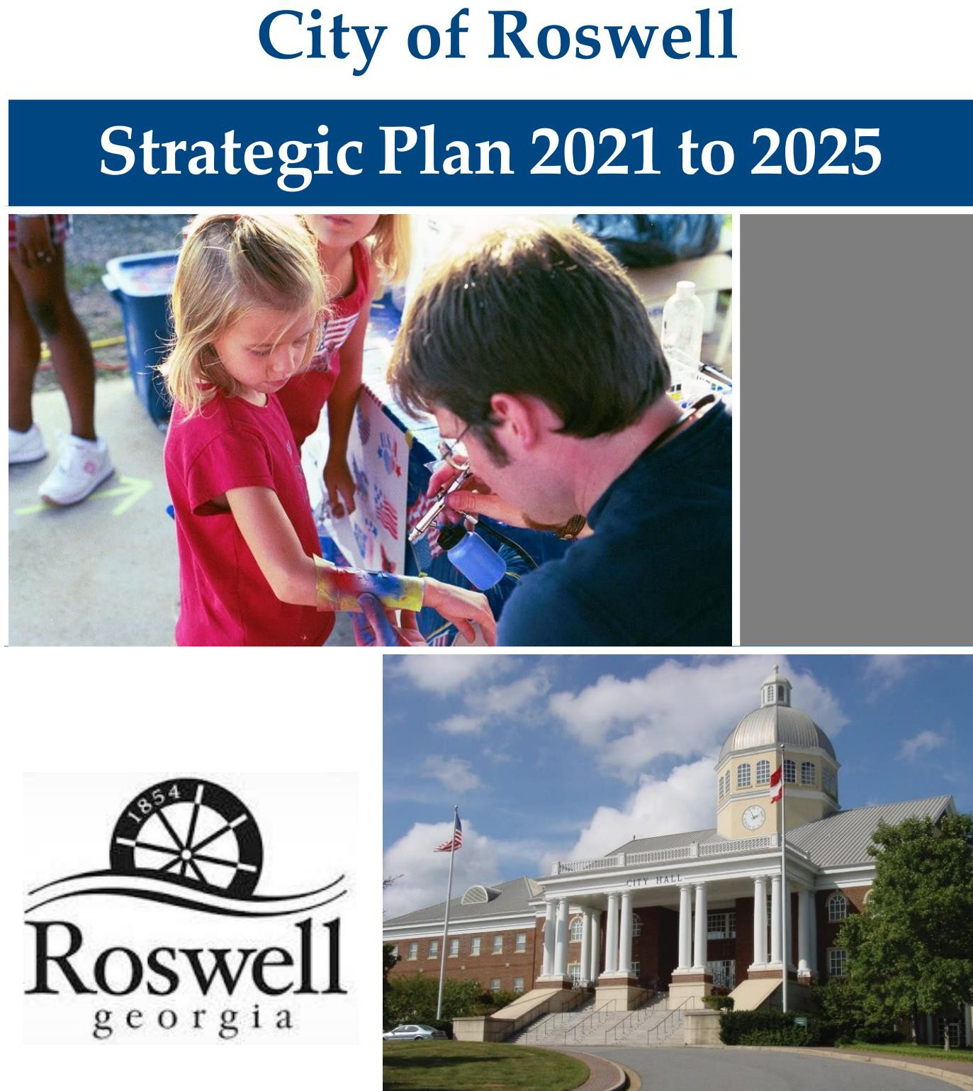
Introduction:
The City’s strategic planning efforts allow community members and City leaders to determine what is important for future success by identifying opportunities to implement new initiatives.
The opportunities are supported by a vision, mission, organizational values, and goals that focus Council and staff’s collective efforts thoughtfully and transparently. This document is the result of an extensive process that engaged the community, City leaders, and staff to develop this policy and
decision‐making framework for the
future.

Slide 11
11

Slide 12
Strategic Plan: a 10-year plan to chart the direction of the County
Destination: Where we’re heading
Master Plans: Parks, Sewer, Fire; department-specific; long-range
Maps: Guidance we need to get there
C.I.P.: multi-year planning instrument to fund capital purchases
Operating Budget: annual planning instrument to fund operations
Money: How it’s funded
Annual Work Plan: a tool used to chart the steps needed in order to fulfill longer-range plans (above) and provide focus for day-to- day operations Steps: The actions we take to get to our destination
12

Slide 13
Strategic Plan: a 10-year plan to chart the direction of the County
Question: Does this achieve the
objectives of our Strategic Plan?
Master Plans: Parks, Sewer, Fire; department specific; long-range
Question: Is it in line with our Master Plan (if applicable)?
C.I.P.: multi-year planning instrument to fund capital purchases Operating Budget: annual planning instrument to fund operations Question: How will it be funded?
Annual Work Plan: a tool used to chart the steps needed in order to fulfill longer-range plans (above) and provide focus for day-to- day operations Question: What do I need to do to fulfill our long-range plan?
13

Slide 14
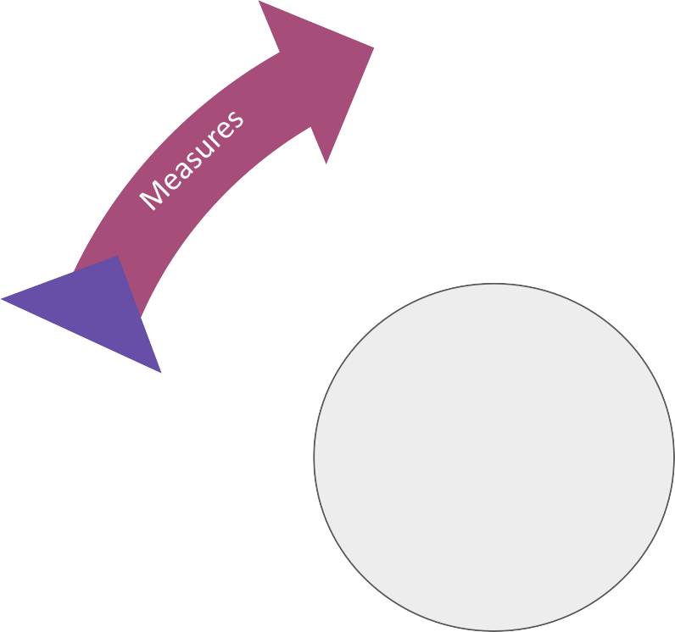
Practice, We’re Talking About Practice!
Products & Services
Strategic Plan

Slide 15
Create a Draft Plan within 3 Meetings!
Meeting 1 |  |  | Meeting 2 |  | Meeting 3
Products and Services | Customer s | Reflectio n | Purpose | Goals | Strategies | Initiatives | Measures
2.5 - 3 hours |  |  | 2.5 - 3 hours |  | 2.5 - 3 hours
Presentation Adria Finch and I presented at ELGL 2022

Slide 16
Step 1: Identify your Products and Services
Brainstorm all of your department’s products - things that you create
Brainstorm all of your department’s services - things that you deliver
Administrative Department (Budget)
Product: Line item budget allocations Service: Oversee bidding process
Operational Department (Animal Services)
Product: Update SOPs & Ordinances Service: Reunite lost pets with owners

Slide 17
Step 2: Identify all of your Customers
Brainstorm all of your internal customers. Who do you serve within your organization?
Brainstorm all of your external customers. Who do you serve within the community?
Administrative Department (Finance/Budget)
Internal: Department Heads, Administrative Assistants, Project Supervisors, Contract Managers, Departmental Financial Analysts, Legislature/Council External: Companies that bid on projects, residents that pay fees/licenses
Operational Department (Animal Services)
Internal: Police Department, Corrections, Attorney’s Office External: Animals, Residents, Non-Profit Stakeholders (i.e. Humane Society)

Slide 18
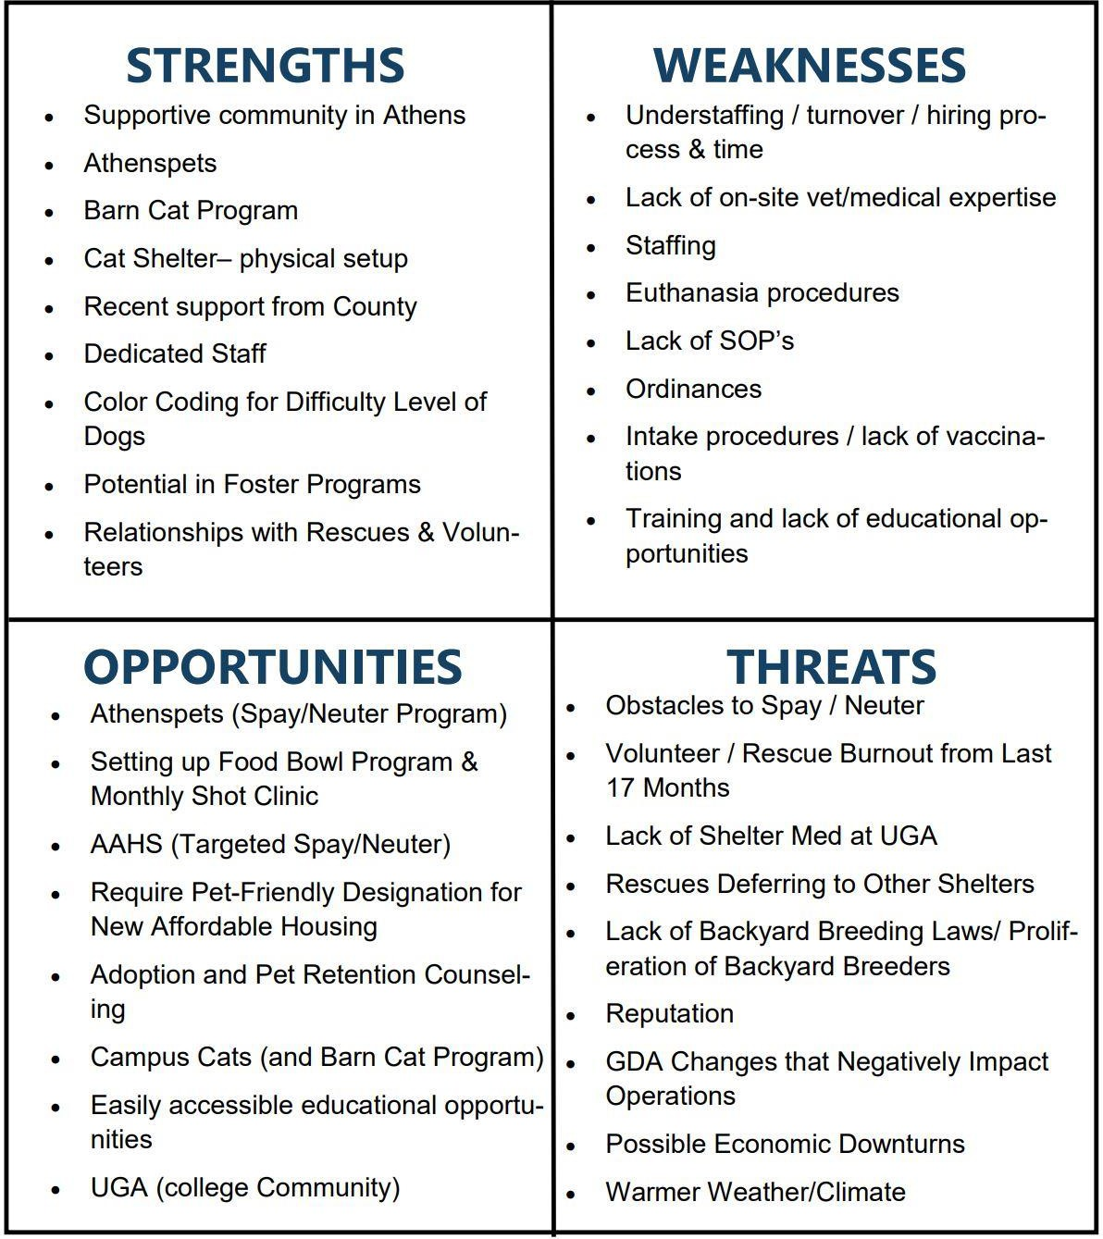
Step 3: Conduct a Reflection
SWOT Analysis
Internal Strengths - resources of capabilities that can be used for accomplishing your purpose and objectives
Internal Weaknesses: Deficiencies in resources or capabilities that hinder your ability to succeed
External Opportunities - Factors or situations that exist beyond your department, but could positively impact it
External Threats/Challenges - Factors or situations that exist beyond your department, but could negatively impact it.

Slide 19
Step 3: Conduct a Reflection
Think about the current state:
Reflect on what your community needs
Reflect on what your community wants
Reflect on what your organization needs
Reflect on what your organization wants
Using the wants and needs, conduct a Start, Stop, Continue:
Identify things you should start doing
Identify things you should stop doing
Identify things you should continue doing

Slide 20
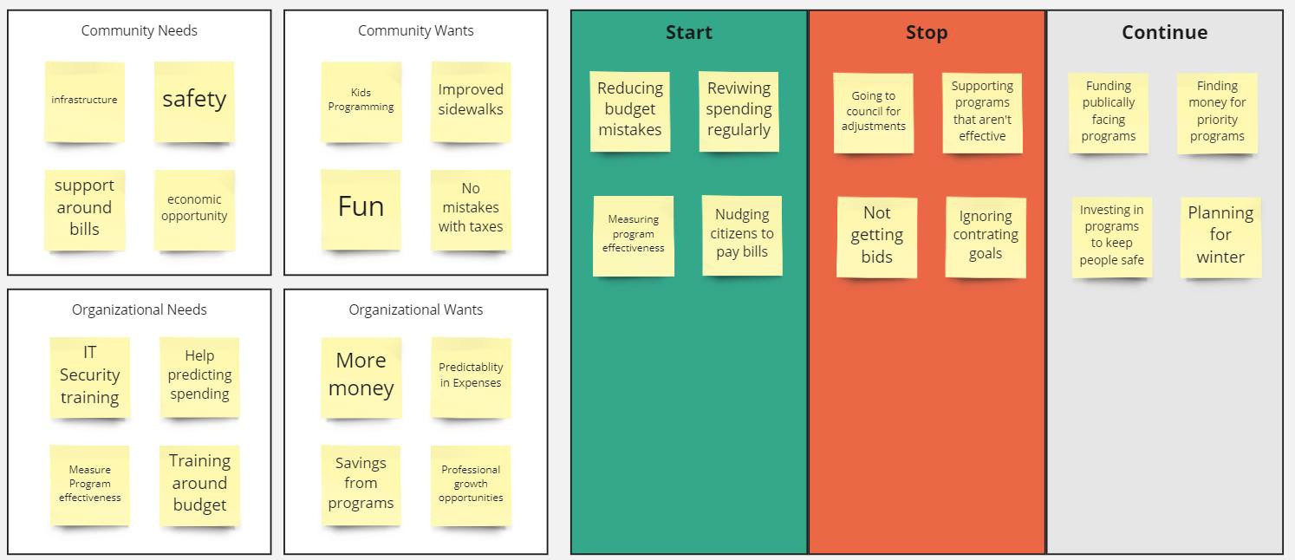
Step 3: Conduct a Reflection

Slide 21
Step 4: Identify your purpose
1. Identify what your department does
2. Identify why your department does the “whats”
3. Identify how the department does the “whats”
4. Use these to draft statements that describe the fundamental reason for the department’s existence.
Administrative Department (Budget)
Develop and oversee the annual operating budget and CIP. Serve as internal consultants supporting departments in achieving their goals while being focused on financial sustainability of the organization through process improvements.
Operational Department (Animal Services)
Provide quality care and seek positive outcomes for all animals that come through our doors Protect community members and neglected animals by enforcing laws and educating the public.

Slide 22
Step 5: Clarify High Level Goals
If they exist, review broad organizational objectives, vision, mision, and values
Cascade your goals down from these.
Review the customers identified in Step 2.
Review the reflection information identified in Step 3.
Identify themes from the research that you’ve completed.
Create broad statements of things you would like to accomplish on behalf of the customers.
Administrative Department (Budget)
Ensure that the city delivers the services and programs that residents need through effective budgeting practices.
Operational Department (Animal Services)
Protect the safety of both animals and residents by reducing the number of needy and homeless animals in the community and improving legal compliance

Slide 23
Step 6: Establish Strategic Priorities
Review the reflection that you completed in step 3.
Write down things that must happen in order to reach the goal established in step 5:
Things you must do well
Barriers that you must overcome
Develop 2 - 4 strategic priorities
Administrative Department (Budget)
Identify the effective programs and operations that are most needed by residents. Reduce budget variance to ensure better alignment with spending and operational needs.
Operational Department (Animal Services)
Improve Community Access to Animal Resources through public/private partnerships. Maximize efforts to reunite lost pets with owners in keep them in homes where they are cared for.
Tip: Make sure these aren’t too narrow. If the statement sounds like something you can go and do now, it is likely an initiative, not a strategic objective.

Slide 24
Step 7: Developing Initiatives
Plot your strategic priorities on the right hand side of a timeline.
Brainstorm projects, programs, changes, etc. that need to occur in order for your to achieve strategic priority within three years.
For each strategy created develop 3 - 5 initiatives.
Plot these initiatives on the timeline, illustrating what needs to occur in order to achieve the
strategic priority.
Administrative Department (Budget)
Effective City Operations: Hire Budget performance team Framework to measure the effectiveness Launch budgeting engagement effort Budget Variance Spending history to drives monthly allotments Develop regular budget:actuals review system Launch new budgeting software
Operational Department (Animal Services)
Improve Community Access: Increase # of low cost spay/neuter clinics Trap Neuter Release Ordinance More Customer Friendly hours Reunite Lost Pets: Identify technology for ACO’s to use in field Develop bilingual resources Update Return to Owner SOP

Slide 25
Step 8: Establish Measurement Criteria
Review the strategic priorities and the timeline that you created.
Brainstorm the following for each strategic priority
a. Outputs - deliverables or things that are done or created
b. Outcomes - results that are achieved
c. Metrics - things that we can measure
3. Baseline where the department is with the metric you selected.
4. Identify a reasonable target and turn it into a SMART goal (specific, measurable, attainable, relevant, timely).
Administrative Department (Budget)
Effective City Operations: Reduce the total funding to less effective programs/operations from $1M to $500K. Budget Variance: Reduce budget variance from 15% to 3% within three years.
Operational Department (Animal Services)
Improve Community Access: -Increase Volunteer and Foster hours -Pet Food Pantry Utilization Reunite Lost Pets: -Length of Stay at Shelter -100% of Animals complete intake process

Slide 26
Goal, Strategy, Initiative

Slide 27
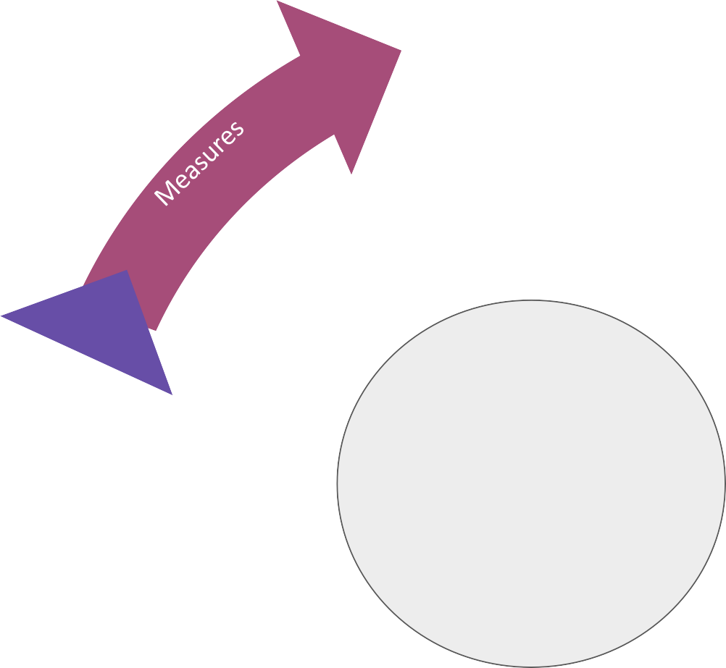
Who is in?
Products & Services

