Slide 1


Civics in Georgia and
Workforce
Pipeline
FOR CHANGE WE
CAN TRUST

Slide 2

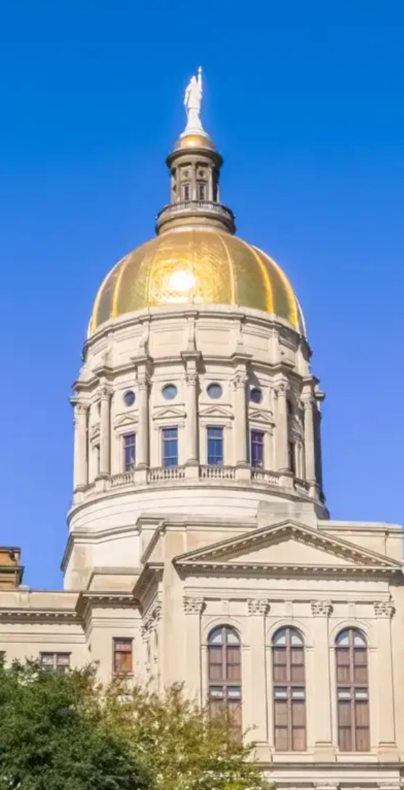
About the Center for Civic Engagement
Georgia Center for Civic Engagement
We exist to educate and equip students to become informed and active citizens.
Target: Elementary, Middle, and High School Students
Founded in 1919 as the State YMCA of Georgia.
Transitioned to Georgia Center for Civic Engagement in 2021.
Founder and CEO: Dr. Randell E. Trammell
Nationally recognized youth civic development and civic education scholar and practitioner.

Slide 3
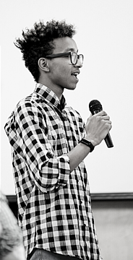
WHAT DO YOU DO?
WHAT ARE YOUR GOALS?
Missional Tactics
School Club Model (ENGAGE)
Democracy Labs—Government Simulations for Students
Professional Development for Educators
Curricular Design and Consultation
Georgia Civic Engagement Graduation Diploma Seal*
Georgia Civic Engagement Honor Society
Civic Coach Program
Pathway to Public Service
Our Goal is to serve EVERY Middle and High School student in Georgia instilling in them a sense of the rights and responsibilities that belong to them as citizens.

Slide 4
What role does the Georgia Center for Civic Engagement play?
We have a two-phase approach to increasing positive civic outcomes:
We support educators with professional development, curricular resources, and best-practices.
We provide for students opportunities to simulate government processes, provide leadership development programs, and provide opportunities for service.
We exist to
EDUCATE and EQUIP
students to become INFORMED and ACTIVE CITIZENS

Slide 5


National Civic Health Check-Up
1 in 4 students don’t know the three branches of government
11 States do not require civics / government to graduate
17% of young people do not trust the government
70% of high school seniors say they have not written a political opinion

Slide 6

Where does Georgia stand?
2019 Georgia Civic Health Index reports:

Slide 7
Where does Georgia stand?

Slide 8
Georgia Commission on Civics Education
SB 220 created the Georgia Commission on Civics Education. Its purpose is to “promote and enhance the education of students on the importance of civic involvement in a constitutional republic, the study of state and local government among the state's citizenry, the importance of civic engagement and public service, and communication and collaboration among organizations in the state that conduct civics education.”
The Commission is specifically tasked to “periodically review the conditions, needs, issues, and problems related to civics education in Georgia schools, including, but not limited to, career, technical, and agricultural education (CTAE) instruction for the government and public administration and the law, public safety, corrections, and security pathways, and shall issue annually a report on the same to the General Assembly, and recommend any action or legislation which the commission deems necessary or appropriate.”

Slide 9
Georgia Commission on Civics Education
Commission Members
Sen. Jason Anavitarte
Justice Charlie Bethel
Hon. Wes Cantrell
Hon. Chris Carr
Mr. Kurt Doehrman
Rep. Matt Dubnik
Rep. Matthew Gambill
Dr. Tim Hynes
Mr. Jim Kelly
Rep. Yasmin Neal
Ms. Michele NeSmith
Sen. Chuck Payne
Sen. Freddie Powell Sims
Mrs. Jane Robbins
Hon Judy Teasley
Mr. Brian Wallace
Dr. Randell E. Trammell, Chair

Slide 10
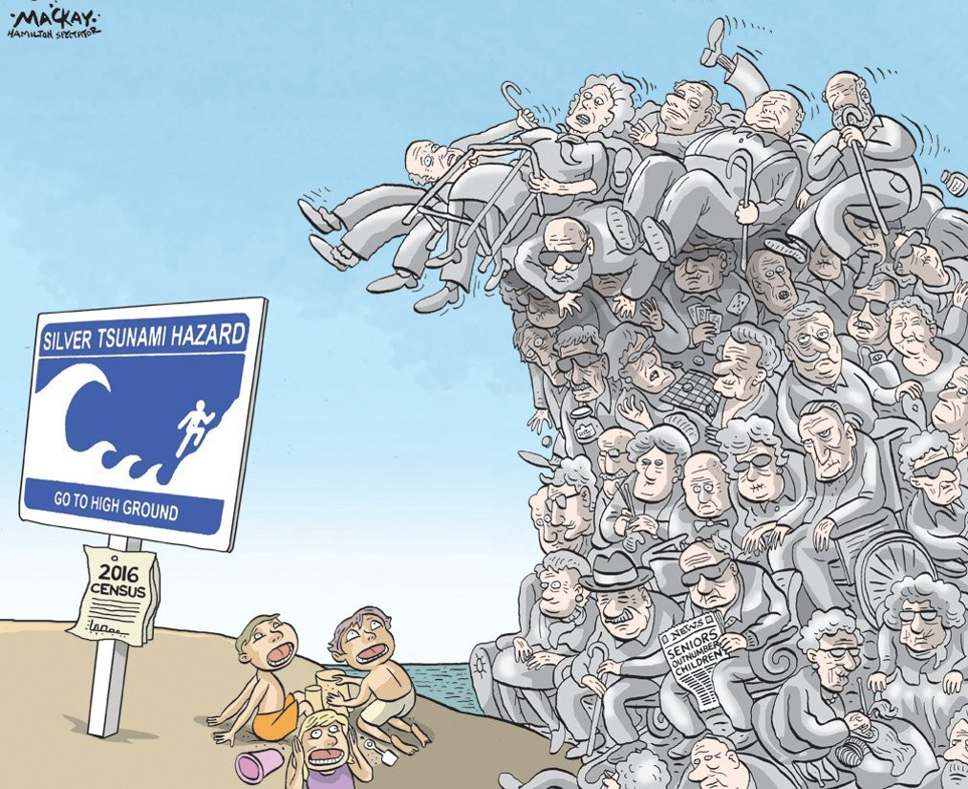
The Silver Tsunami

Slide 11

The Silver Tsunami
It is estimated that at least 31% and possibly as much as 68% of local and state government employees can retire today.
In a 2021 study with the CVIOG, the Georgia Municipal Association found the following:
  Over 85% of responding municipalities reported difficulty in attracting applicants with needed skills
  One of the top 5 reasons employees left municipal service (21%) was retirement
  59% of municipal governments have little to no succession planning in place

Slide 12
Tsunami Preparation
Pipeline to Public Service through the Government and Public Administration CTAE Pathway.
  Series of 3 year-long courses
    Introduction | American Government
    Federal and State Government | Intelligence
    State and Local Government | Economics
  Year 4 is designed to have a work-based learning experience within local government.
  Working with GMA/ACCG to develop a credentialing program for these high school students that will have them job ready for your workforce upon graduation.

Slide 13

Customer Service - Credential

Slide 14

What Can Municipalities and County Governments do to engage youth?
Start a Youth Council/Commission
Partner with your local school system to adopt and implement the Government and Public Administration Pathway
Prepare your organization for interns flowing from the Pathway
Host a Mayor’s / Commissioner’s Reading Club
Get in front of students (class visits)

Slide 15

How Can We Help YOU?
Dr. Randell E. Trammell
President and CEO
Center for Civic Engagement
Office: 770-455-9622
Cell: 404-626-0540
Email: Randell@georgiacivics.org

