Slide 1
How Georgia Has Lured Hollywood’s Magic and What This Means for Our Economy GCCMA 3 8 2023

Slide 2
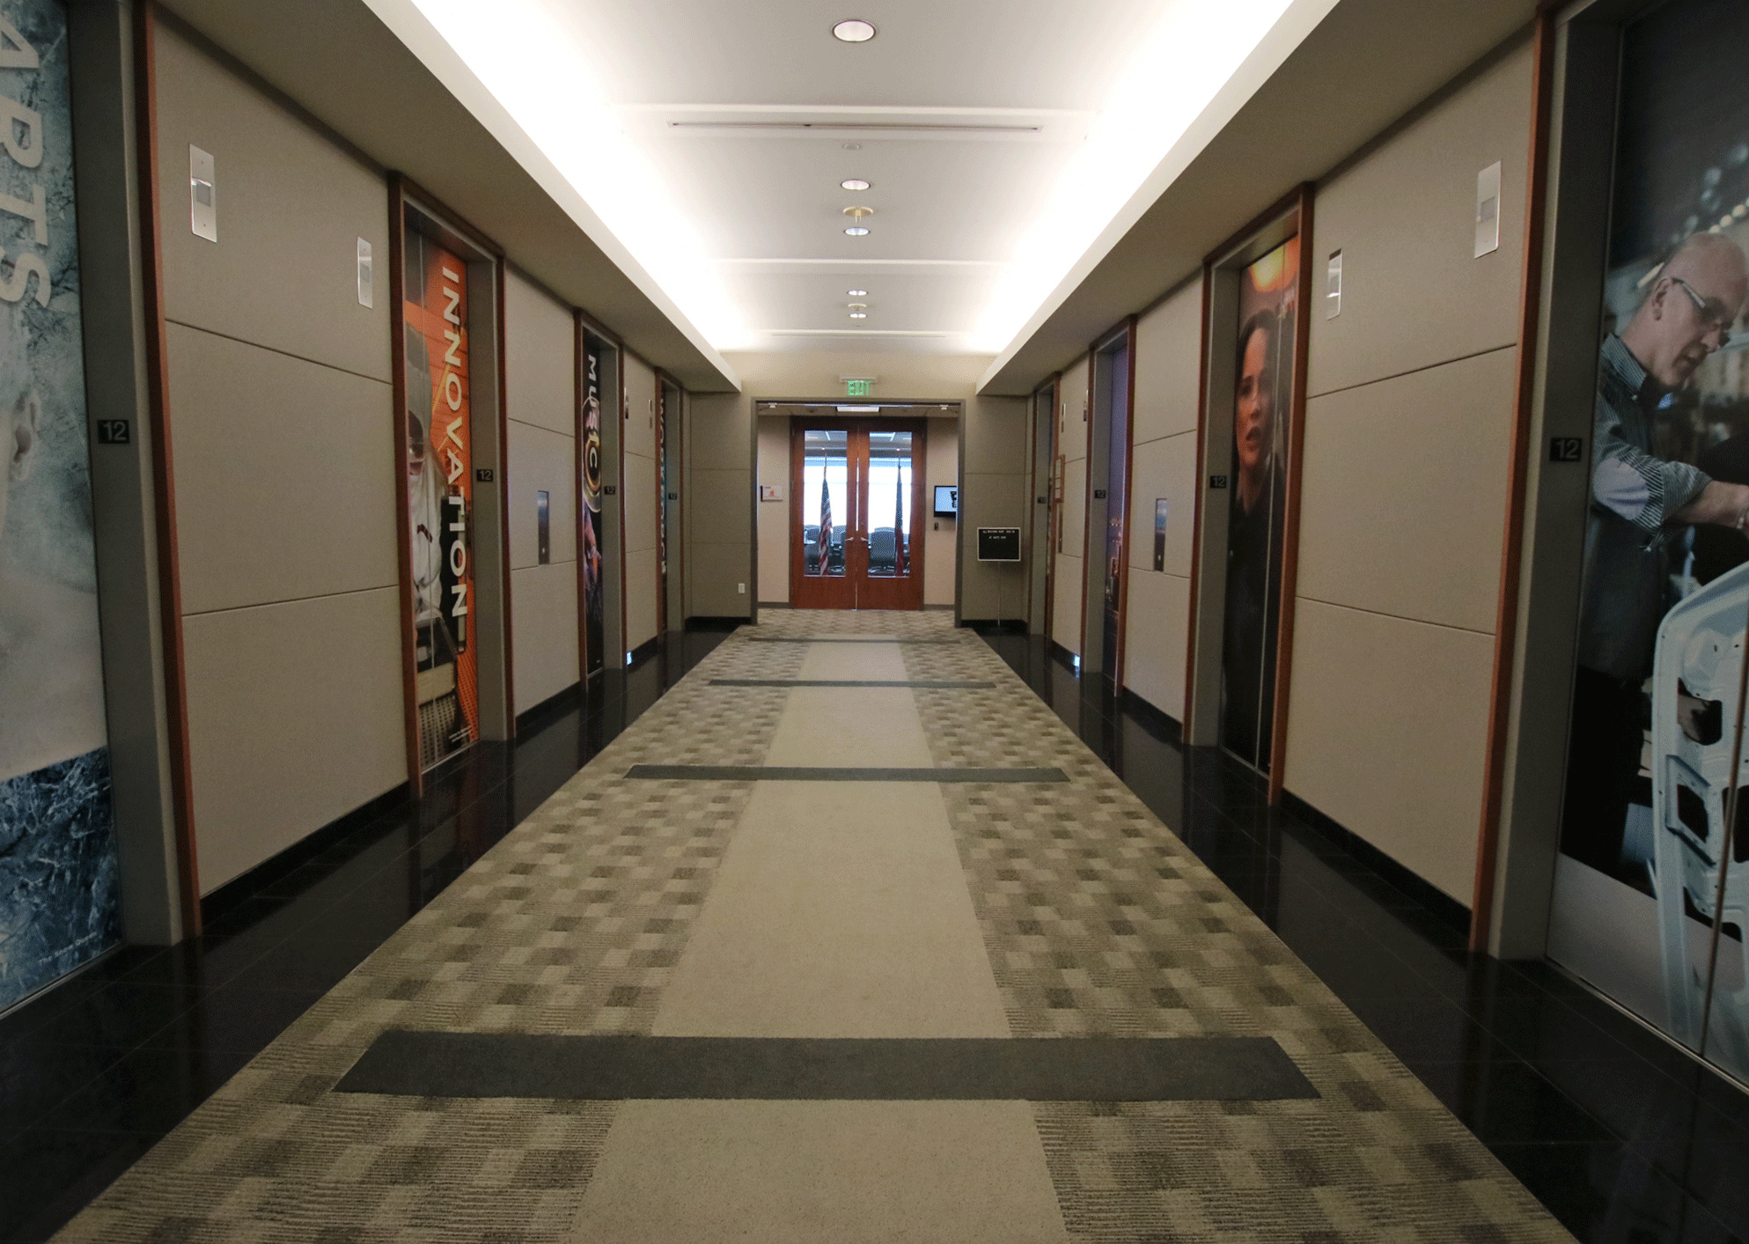
Georgia Department of Economic Development
Aerospace
Agribusiness
Arts
Automotive
Defense
Energy
Film & Entertainment
Life Sciences
Logistics & Supply Chain
Manufacturing
Technology
Tourism
The state’s sales and marketing arm
Notes:
Global/trade/tourism/centers of innovation/GCA
Industry Trade Tourism

Slide 3
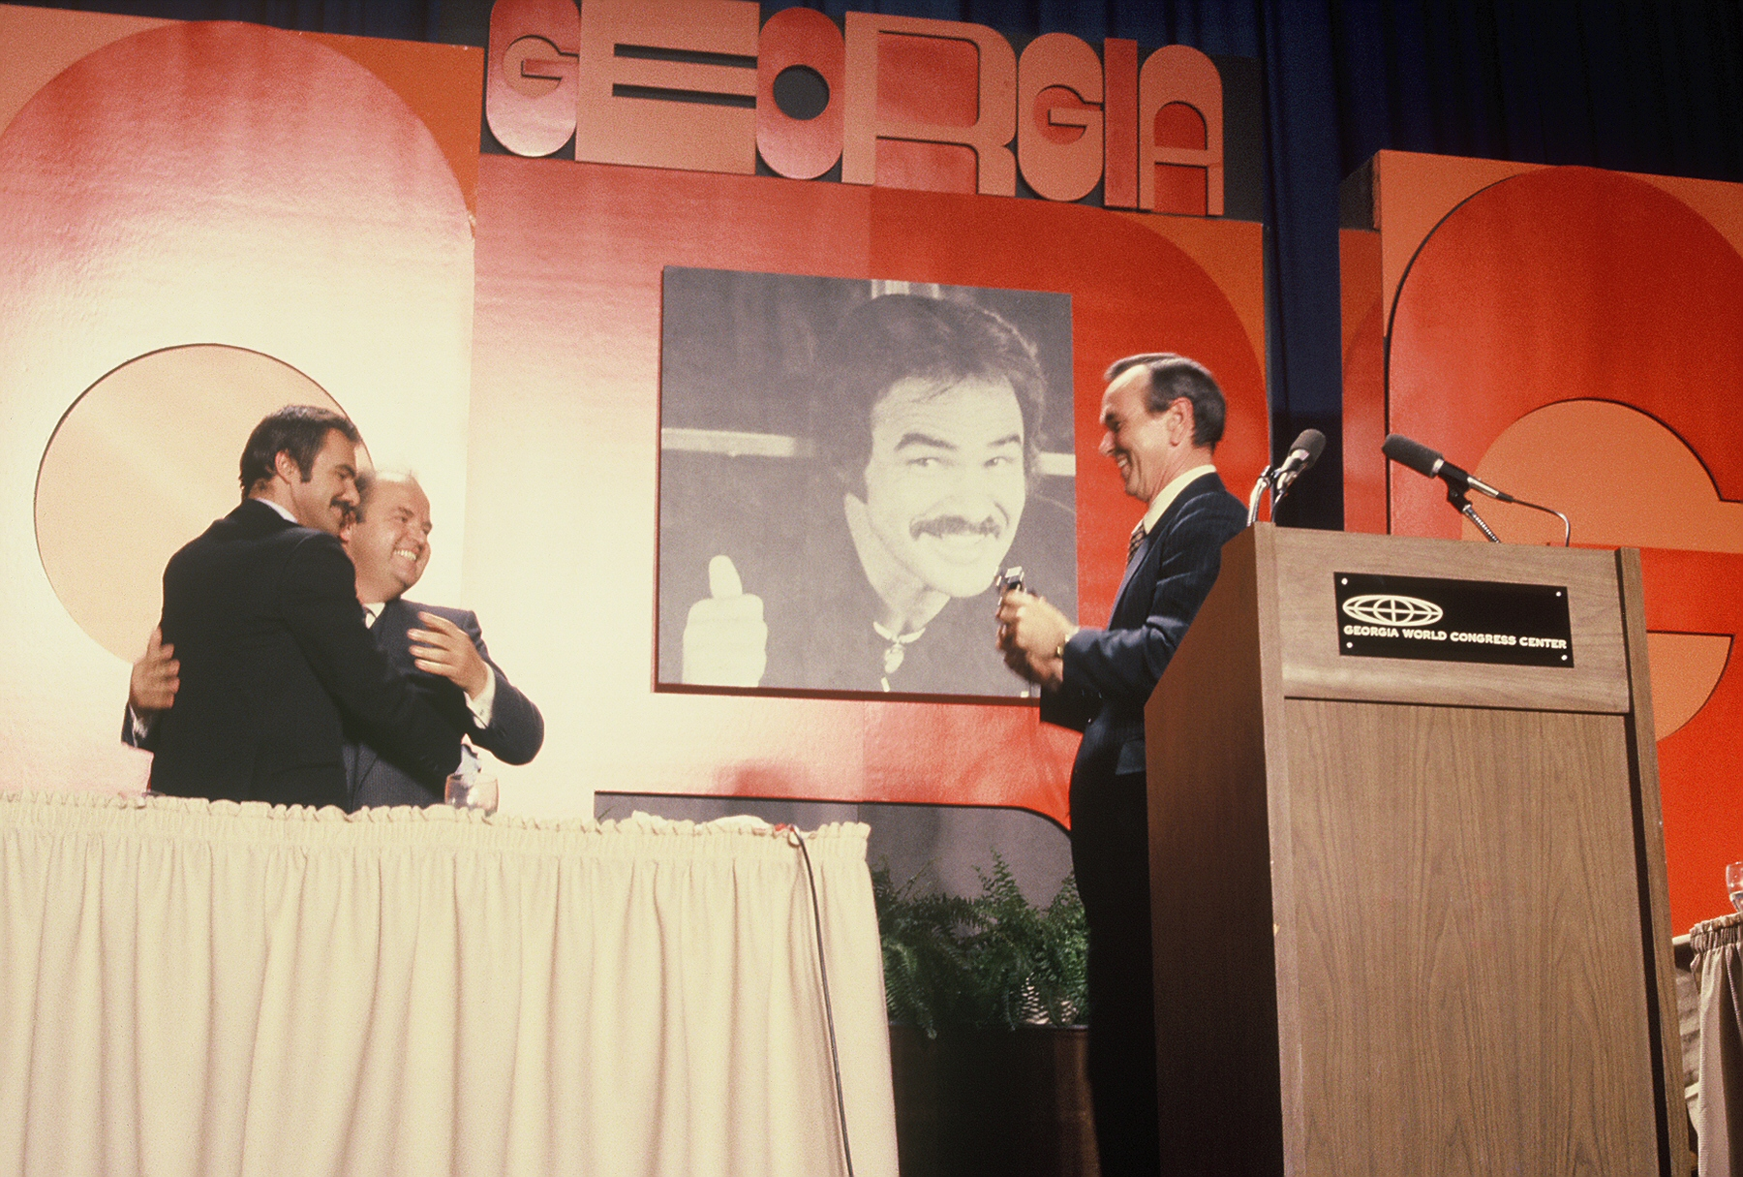
The Georgia Film Office
Formed in 1973
Free services, including:
Location assistance
Resources for finding crew/jobs
Resources for finding stages/production office
Administering tax incentive program
Notes:
Some think that the film industry in Georgia is a recent phenomenon, but started in 1973

Slide 4
Industry Shift locations-driven to incentive-driven
1997: Canada introduces world’s first production incentives
2004: Georgia loses Ray Charles biopic to LA due to incentive
2005: First version of GA incentive passes
2008: Current version of GA incentive passes
Today: More than half US states and dozens of countries offer some form of incentives
Notes:
1990s, Canada
By the way, these savings are typically cooked into the budget—our incentive means that they’ll spend 30% more money here.

Slide 5
INCENTIVE
keeping us competitive
Minimum spend: $500,000
Two levels: 20% - base amount
30% maximum (with 10% promotional uplift)

Slide 6
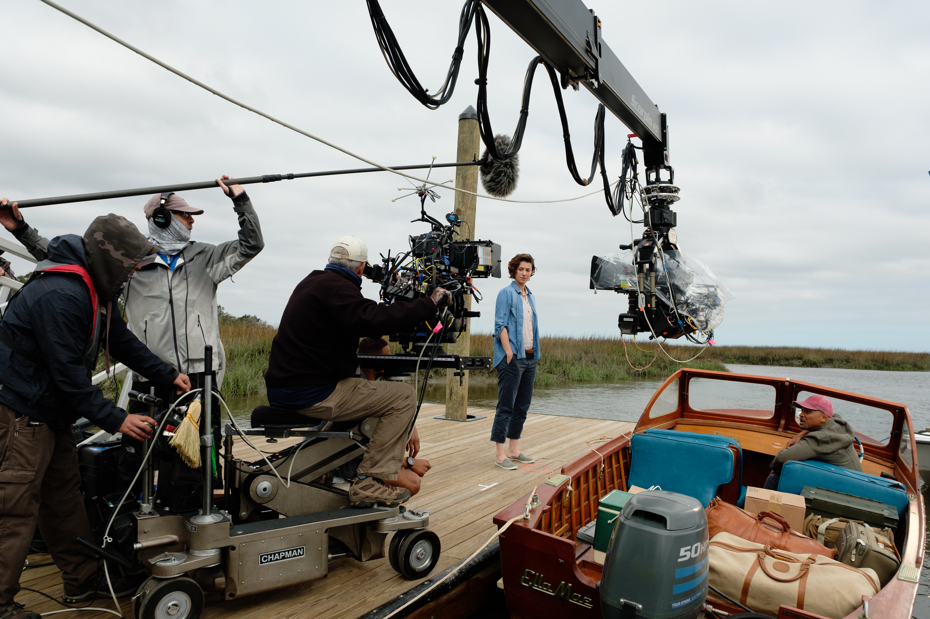
2008 INCENTIVE
Not a rebate – a tax credit
Can be used to pay tax bill, transferred, or sold
To monetize, studios sell to an individual or corporation with a GA tax liability
Buyers can purchase for about .85 - .92 on the dollar

Slide 8
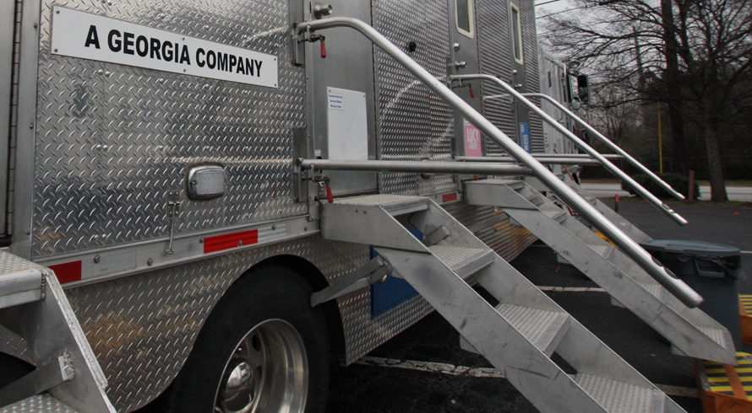
INFRASTRUCTURE
Georgia companies paying taxes – employing
Georgia residents who pay taxes
According to the MPAA, there are more than 4,800 film/TV production industry businesses in Georgia. These are Georgia companies that employ Georgians and pay their full share of taxes.
Camera rental
Props rental
Costume companies
Casting companies
Post production companies
Catering & craft services
Picture car suppliers
Truck and trailer rentals
Hardware, paint & lumber
Traffic control, portable toilets
Scaffolding, platforms, rigging equipment
Foam fabricators
Printers and sign shops
Military surplus and paramilitary gear suppliers
Draperies and fabrics
Notes:
Hundreds of companies located or expanded in Georgia to provide support to these companies—
And when the incentive passed in 2008, it happened at the perfect time. When Hollywood was experiencing a huge disruption.
Netflix, Hulu, Amazon, YouTube, Apple—and that created a tremendous need for content and consequently, it created great opportunities for Georgia.
It also started in a time when a lot of Georgians and local businesses really needed the work,
and the great thing about the film business is that it comes in fast, is super labor intensive, and it spends a lot of money on a lot of different kinds of businesses. According to the MPAA, there are nearly 3,000 film/TV production industry businesses in Georgia. And just the six companies that make up the MPAA pay on average $770 million per year to over 6000 vendors in the state, which means that half the vendors they using are not movie companies.
Now, Cherokee County gets a good share of the business, but even if a project is not shooting in your area, there are probably businesses that are being supported by the film industry.
Former Senator Charlie Bethel story.

Slide 9
BY THE NUMBERS
GEMINI MAN
Release date: Oct 4, 2019
Shoot date: Feb 26 - April 12, 2018
MORE THAN 330 VENDORS EMPLOYED –
THESE VENDORS ARE BASED IN 64 CITIES ACROSS THE STATE:
Georgia Spend:
Alpharetta
Athens
Atlanta
Auburn
Baxley
Bloomingdale
Brooklet
Brunswick
Carrollton
Chamblee
Clermont
Collins
Crescent
Cumming
Darien
Dawsonville
Decatur
Doraville
Duluth
Ellenwood
Fayetteville
Gainesville
Garden City
Glennville
Hagan
Hinesville
Jonesboro
Kennesaw
Lawrenceville
Ludowici
Mableton
Macon
Madison
Marietta
Martinez
McDonough
Meridian
Nahunta
Norcross
Palmetto
Peachtree City
Pembroke
Pooler
Powder Springs
Reidsville
Rex
Richmond Hill
Rincon
Roswell
St. Simons Island
Savannah
Senoia
Statesboro
Stockbridge
Sylvania
Thunderbolt
Townsend
Tucker
Tybee Island
Union City
Vinings
Waco
Waycross
Woodstock
$26,583,087
Georgia Crew Hired:
400
Georgia Cast/Extras Hired:
215
Hardware/Lumber/Supplies Spend:
$1,289,230
Transportation/Truck Rental Spend:
$748,608
Catering, Other Food Spend:
$452,670
Lodging (room nights):
25,123
Notes:
For example, the film Gemini Man which was based in Savannah, spend more than 26 Million, with 330 vendors in 64 cities across the state. Towns such as Rex, Ludowici, Garden City, Collins, Crescent, Brooklet, and Glennville.
They employed 615 cast and crew equaling 14,741 man days. They were responsible for more than 10,000 car rental days, and 25,000 room nights. Think about that—what it means for our tourism industry- this is one project of 391 shot in Georgia that year—and it accounted for more than 25,000 room nights.

Slide 10
2080 Crew Members
Spent over $192 m in the state
Labor = $127 m
Notes:
2080 crew members , shot almost an entire year in the state
Spent over $192 m
Cast, crew, & extras make up $127 m of that
Hotel rooms, 15 603 days, over 1.9 m on housing

Slide 11
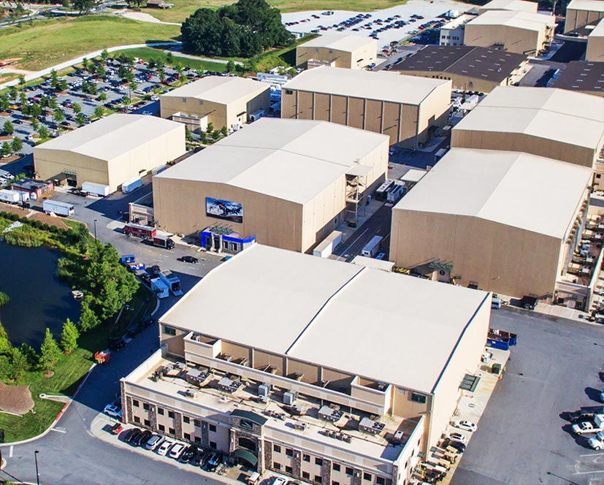
STAGES
Empty real estate in 2008 helped us win business while stages were built and retrofitted
EUE Screen Gems
Tyler Perry Studios
Eagle Rock Studios
Eastside Stageworks
Mailing Avenue Stageworks
Westside Stageworks
Trilith Studios
Atlanta Metro Studios
Third Rail Studios
Blackhall Studios
Areu Bros. Studios
OFS
Upper Westside Filmworks
Cinelease Three Ring Studios
Over 3 M sf of and purpose-built stage space

Slide 12
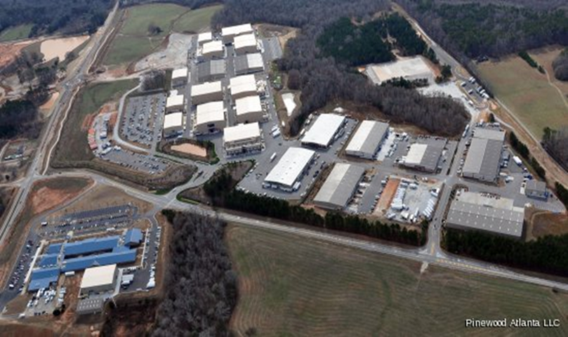
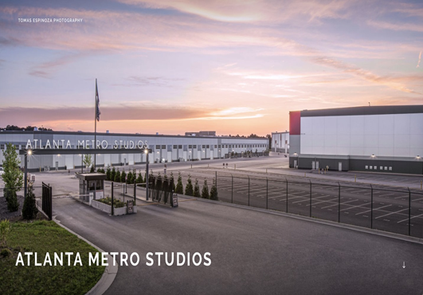
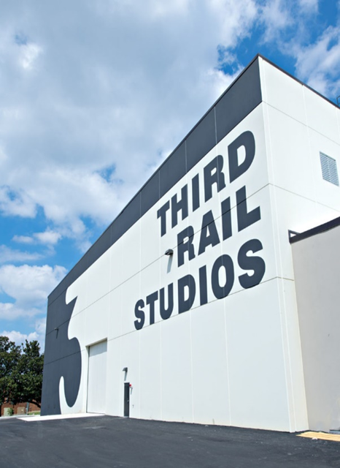
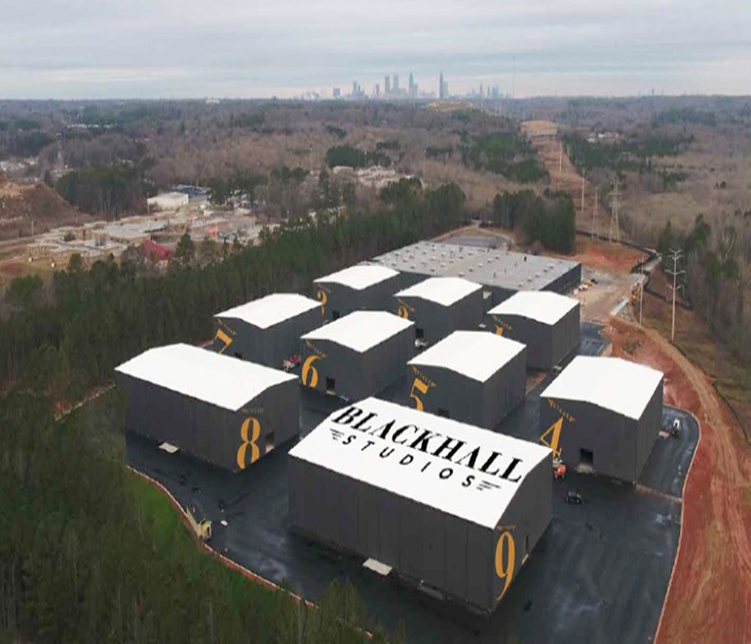

Slide 13
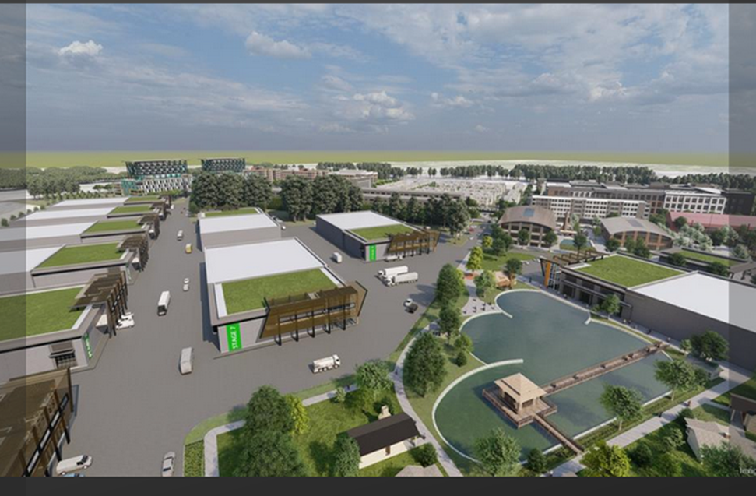
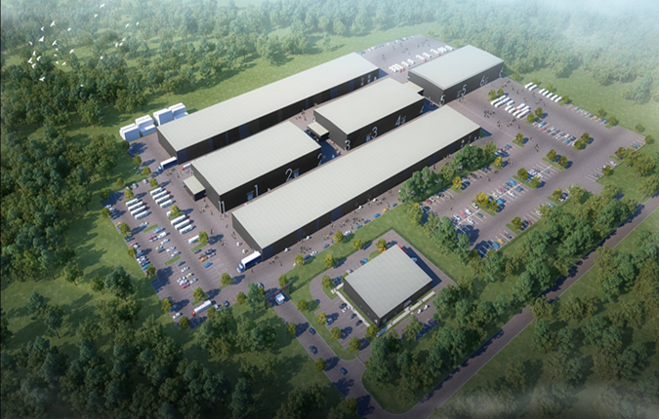
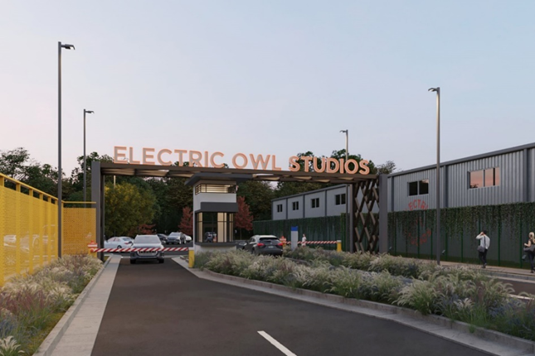
Notes:
In March of 2021, Gray TV announced it would build at least 10 film stages on 128 acres of undeveloped property in Doraville at the site of the former GM factory. The first phase of Gray’s plans also include buildings that focus on e-gaming, digital media and robotics. Gray purchased the adjacent property- Third Rail Studios- and have incorporated that property into the overall development. They have already begun development of more than 1 million square feet of stage, mill and office space on the site.
In November 2021, former Third Rail developers announced that they would be developing a new gold LEED- certified soundstage complex, Electric Owl, on Redan Road in Stone Mountain. This facility will initially house about 300k square feet of stages.
Also in November of 2021, Reynolds Capital announced that they would be investing $60 million in a new soundstage development in Athens, GA. Athena Studios will initially host approximately 350k square feet of stage and mill space. Reynolds will also develop a building for UGA and the Georgia Film Academy to teach students film making, which they are providing at no cost to the institutions. Athena Studios is scheduled to be completed in November of 2022.

Slide 14
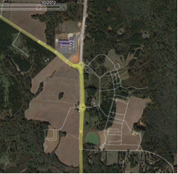
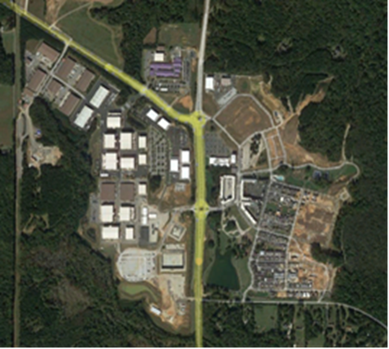
32 stages totaling 653,150 SF (this includes 8 new stages currently under construction)
40 ancillary buildings that include workshops, offices, and vendor warehouse space
35 different local, national, and global companies based at Trilith Studios
277 Single Family Houses Built and Under Contract
57,000 square feet of retail buildings to house over 30 restaurant and retail tenants
60,000 square foot Piedmont Wellness Center facility
192 Room Boutique Hotel, including 35 extended stay rooms

Slide 15
Notes:
Georgia has the benefit of having an experienced workforce,
which is growing due to schools state wide adding film courses, and due to the Georgia Film Academy.
The GFA is a partnership-- HD
28 campuses,
Initial attempt here in Savannah from what I have been told was that there were not enough students to warrant launching the program, and couldn’t get a contract with union 491, as of last week BOR got it worked out. The current partner schools in this region are now Georgia Southern, Savannah State, College of Coastal Georgia and Ogeechee Technical.

Slide 16
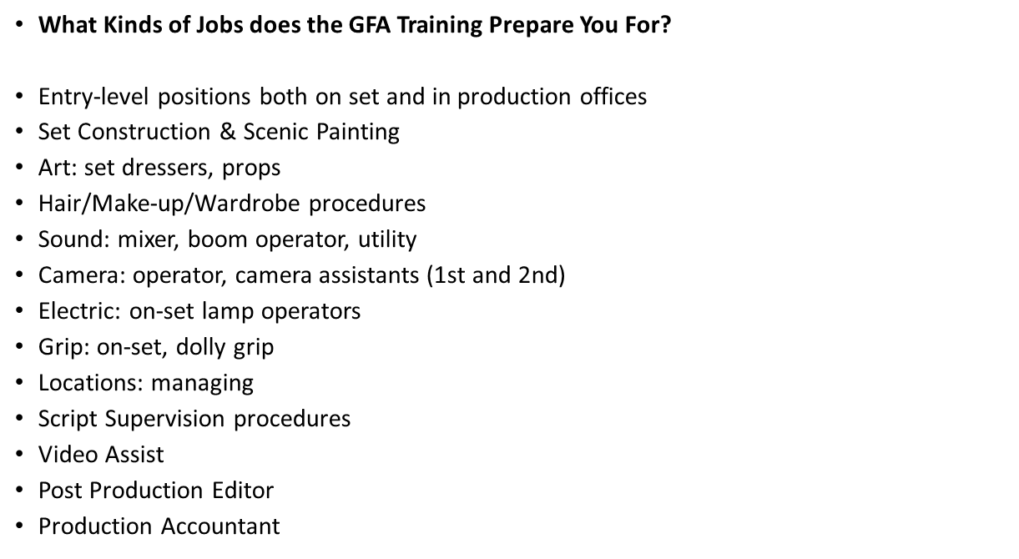
Notes:
The Savannah College of Arts and Design (SCAD) is also currently undergoing a major expansion on the Savannah Film Studios that will make it the largest, most comprehensive university film studio complex in the nation.
UGA now has an MFA program in Screenwriting

Slide 17
Camera Ready: All 159 counties online

Slide 18
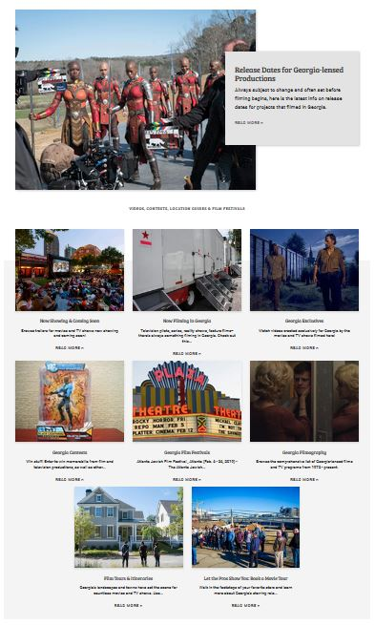
Exploregeorgia.org/film
Release Dates
Now Showing/Coming (trailers)
Now Filming
Exclusive Videos
Contests
Film Festivals
Filmography (1972 – now)
Film Tour Itineraries

Slide 19
RESOURCES
Official website: georgia.org/fmde
Crew/Business Listings: georgia.org/reel-crew-production-directory
Camera Ready: georgia.org/cameraready
Facebook: facebook.com/gafmde
Twitter: @gafmde

Slide 34
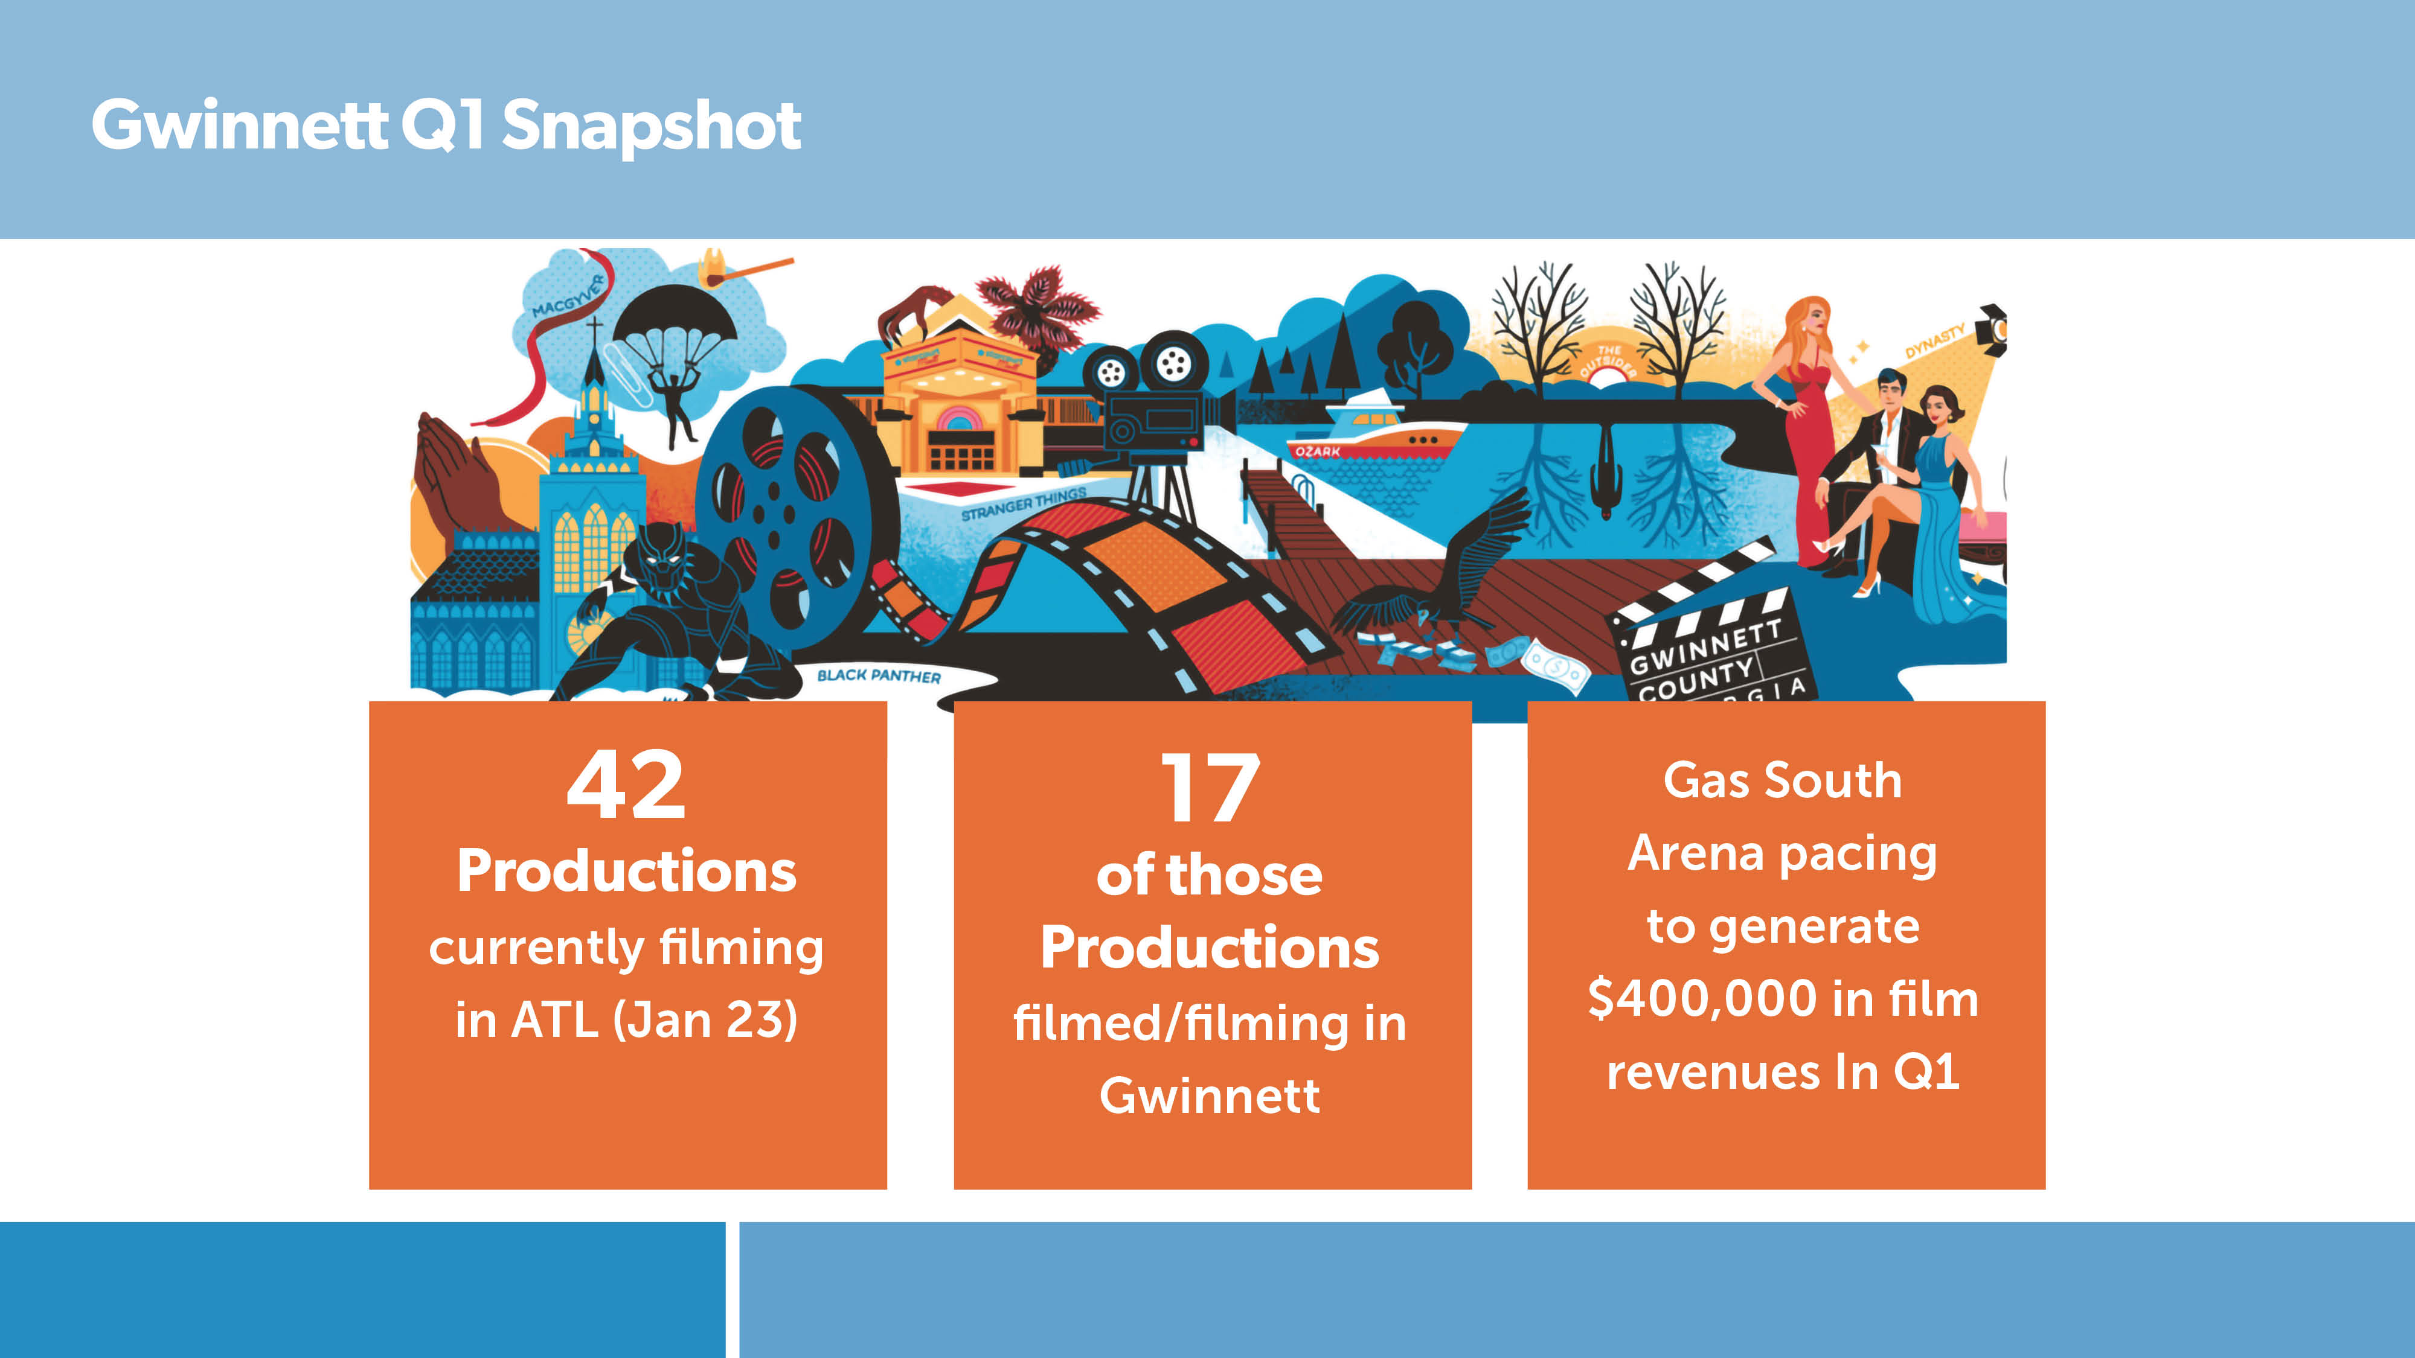

Slide 36
